Slide 1
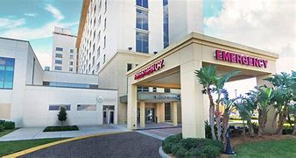
II. Community Health Update & Information
Halifax Health
Dr. Jennifer Chan, Department Chair & Medical Director of Emergency Services

Slide 2
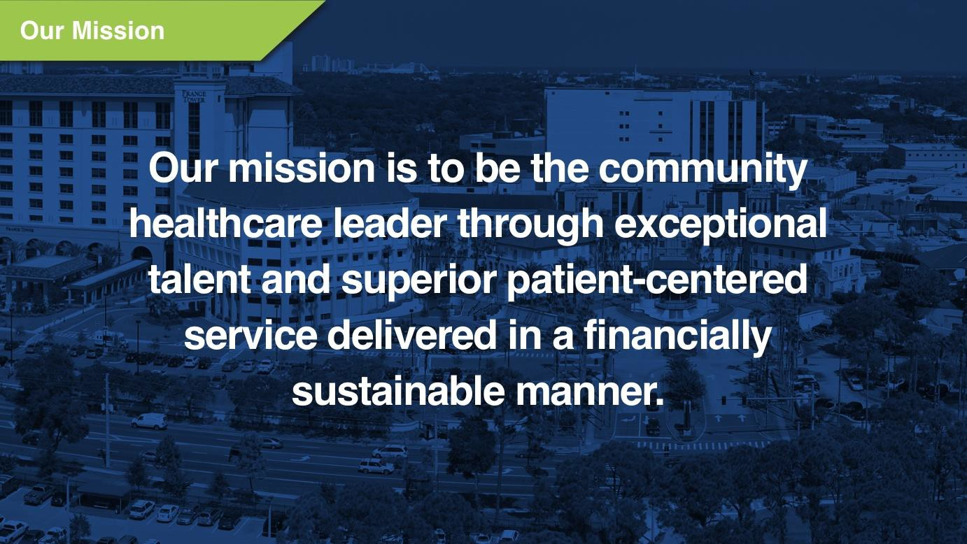

Slide 3
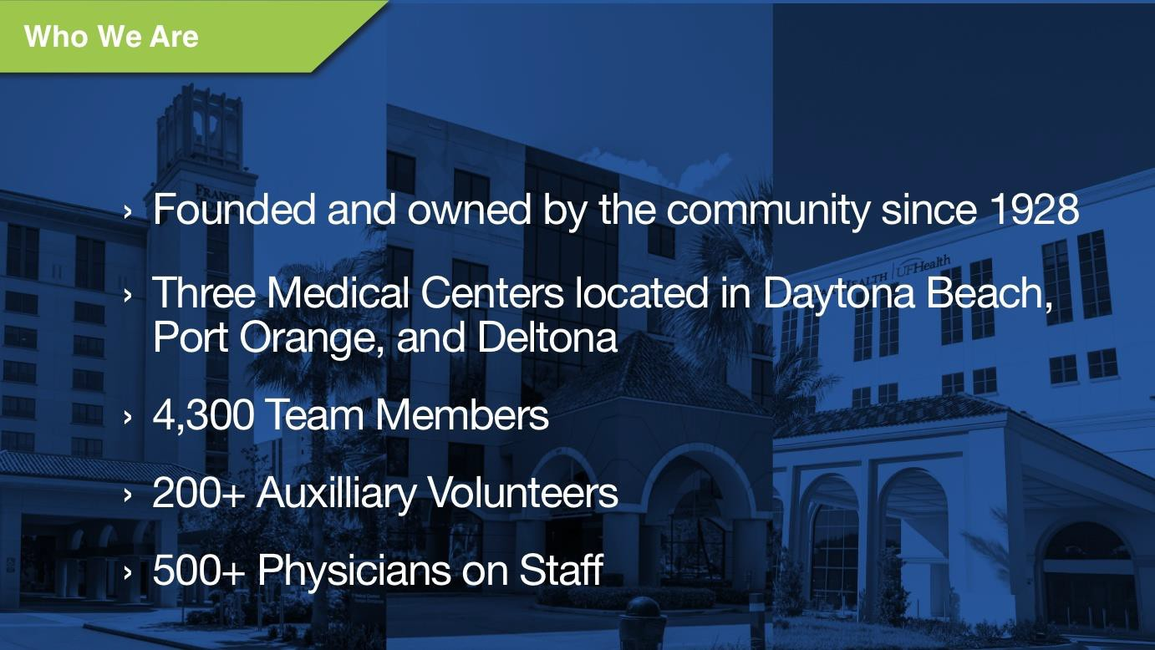

Slide 4
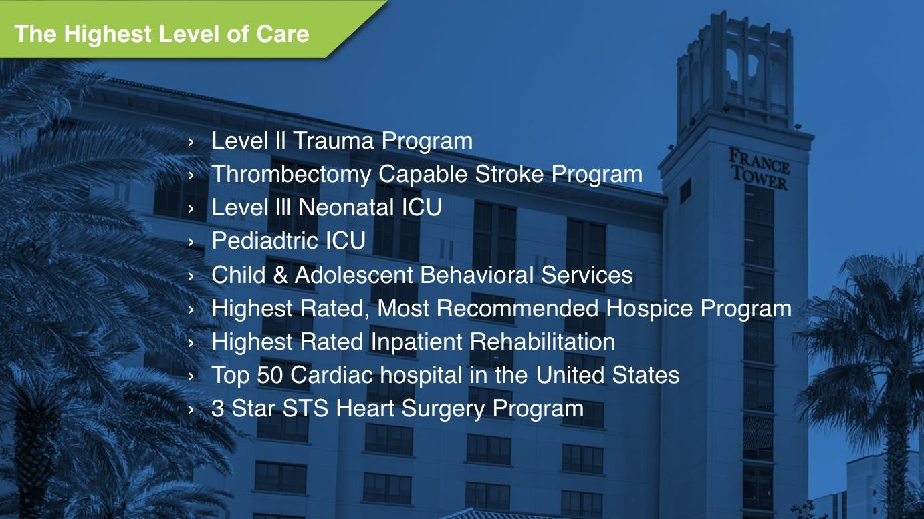

Slide 5


Slide 6
By the Numbers 2023
Emergency Department Visits:
Patients Under a Baker Act:
Hospital Admissions:
Surgeries:
Births:
Hospice:
Community Services:
91,691
8,472/1,870 Children
36,319
15,603
1,626
2,953
$60 million (at cost)

Slide 7


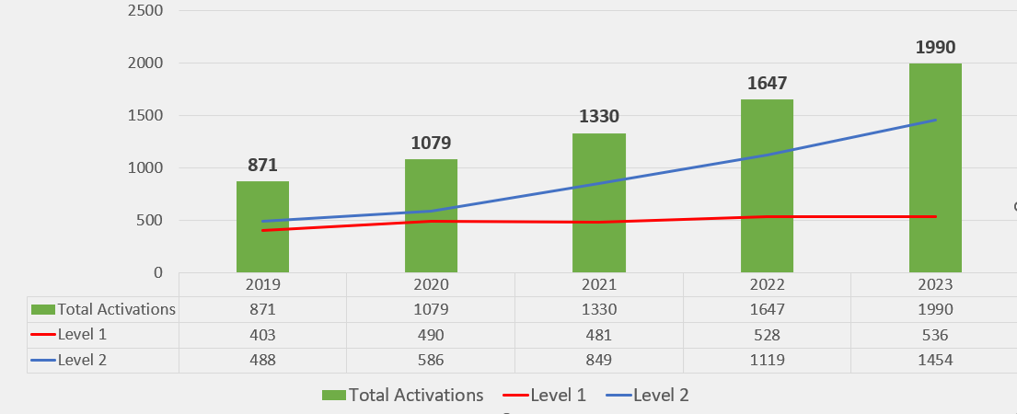
Trauma Trends
Trauma Activations

Slide 8

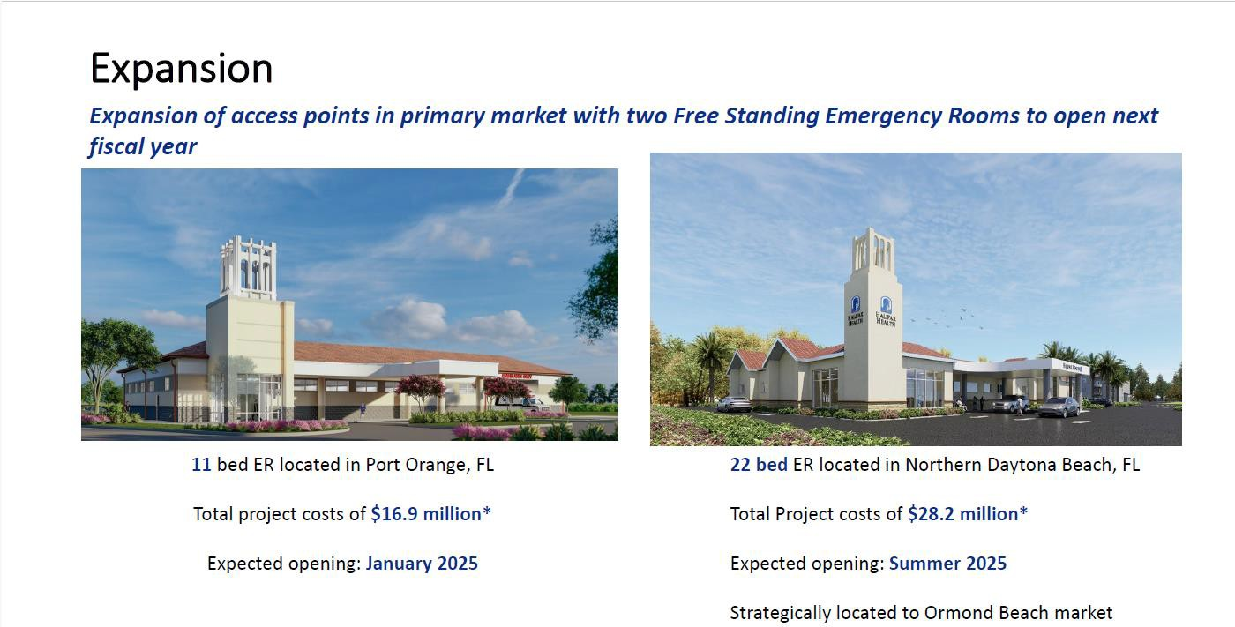

Slide 9
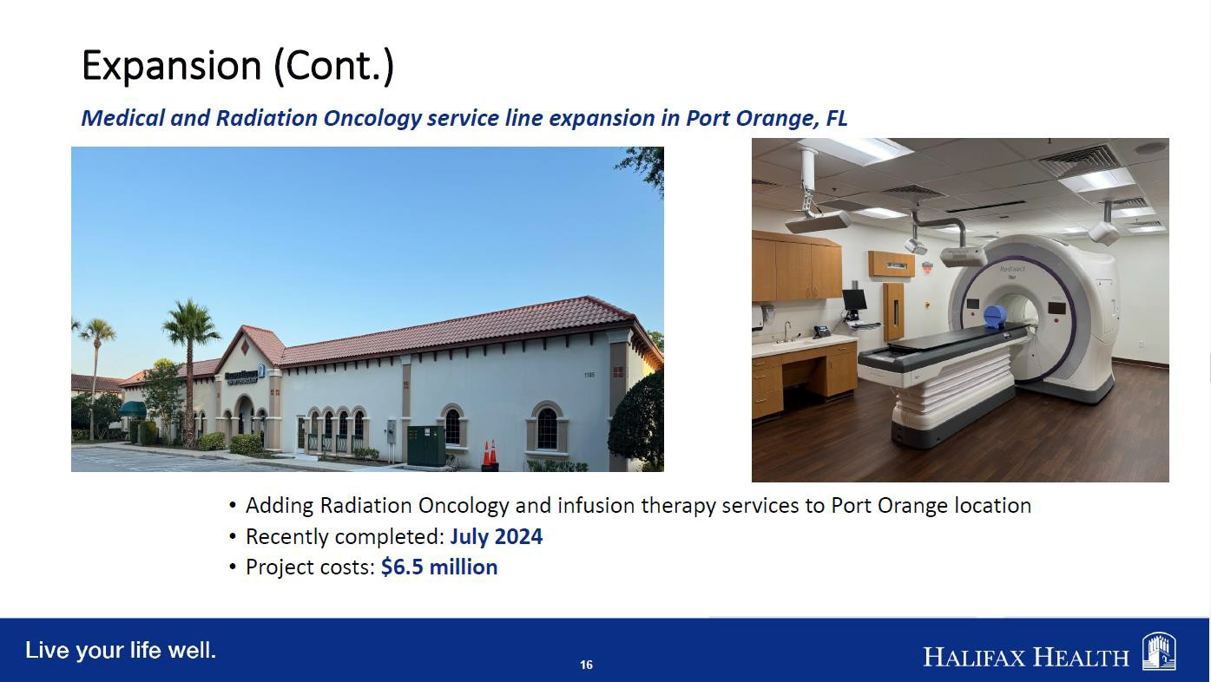


Slide 10
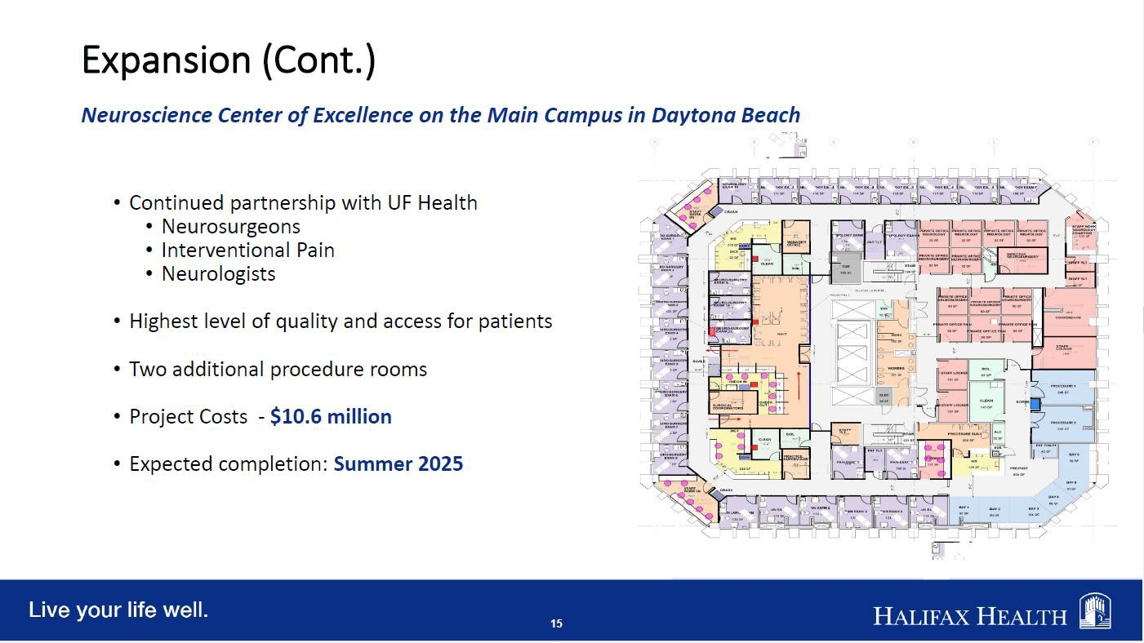

Slide 11

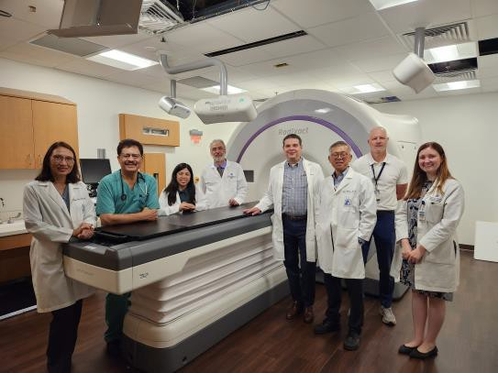
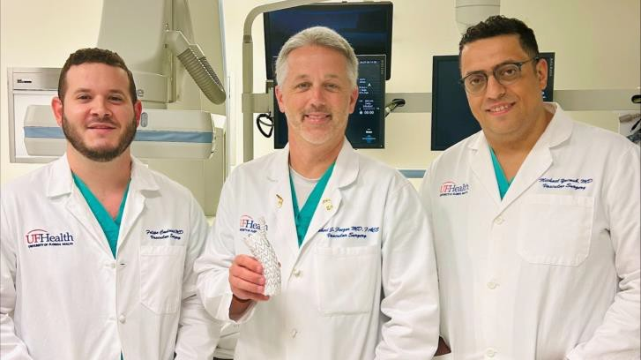
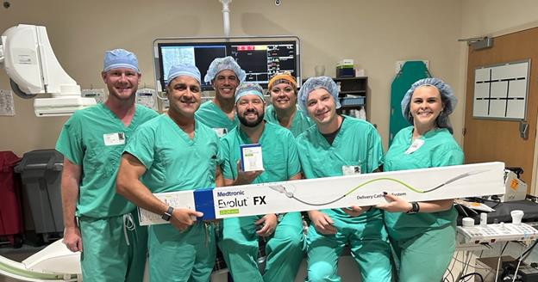

Halifax Health is First in the U.S. to Treat Patients with Cancer Using the Accuray Radixact Radiation Delivery System and VitalHold Technology
UF Health Vascular Surgeons at Halifax Health Introduce New Non-Invasive TAMBE Stent Technology
Halifax Health Performs First Procedure in East Central Florida Using Evolut FX+ TAVR System for Patients With Symptomatic Severe Aortic Stenosis

Slide 12

Workforce
Technology
• TAMBE
• Evolute
• Prostate Embolization
Optilume Stricture Treatment | Urethral Balloon Dilation
Contributed $1.5 million in collaboration with Daytona State College and the Florida State
Legislature to support the LINE grants for nurses.
Daytona State College partnership $500,000 Education to Employment Scholarship Fund
Student Nursing Internship Program achieving a 100% pass rate on the NCLEX.
Created Five Apprenticeship programs
Over 200 Volunteers providing over 90,000 volunteer hours
Top 150 Places to Work

Slide 13
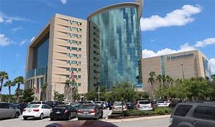
II. Community Health Update & Information
Advent Health
Lorenzo Brown, Fish and West Volusia Market President

Slide 14
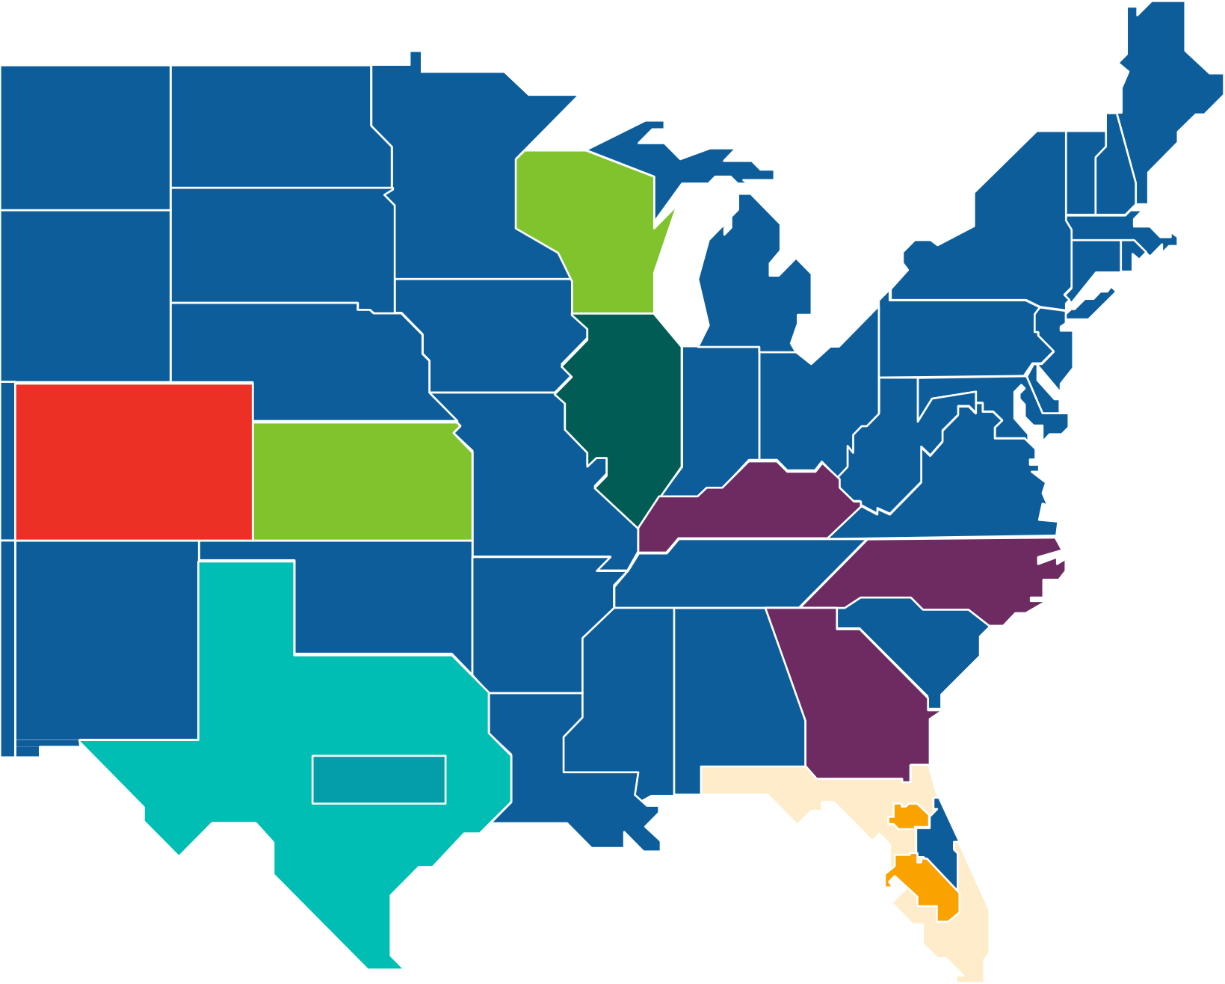












Overview
1973 AdventHealth was established
8M+ Patients served annually
95,000+ Team members
3,800+ Employed physicians
52 Hospitals in nine states
22 Home health & hospice agencies
56 Urgent care facilities
22 Offsite ERs
30 Hospitals and Offsite ERs in Florid

Slide 15
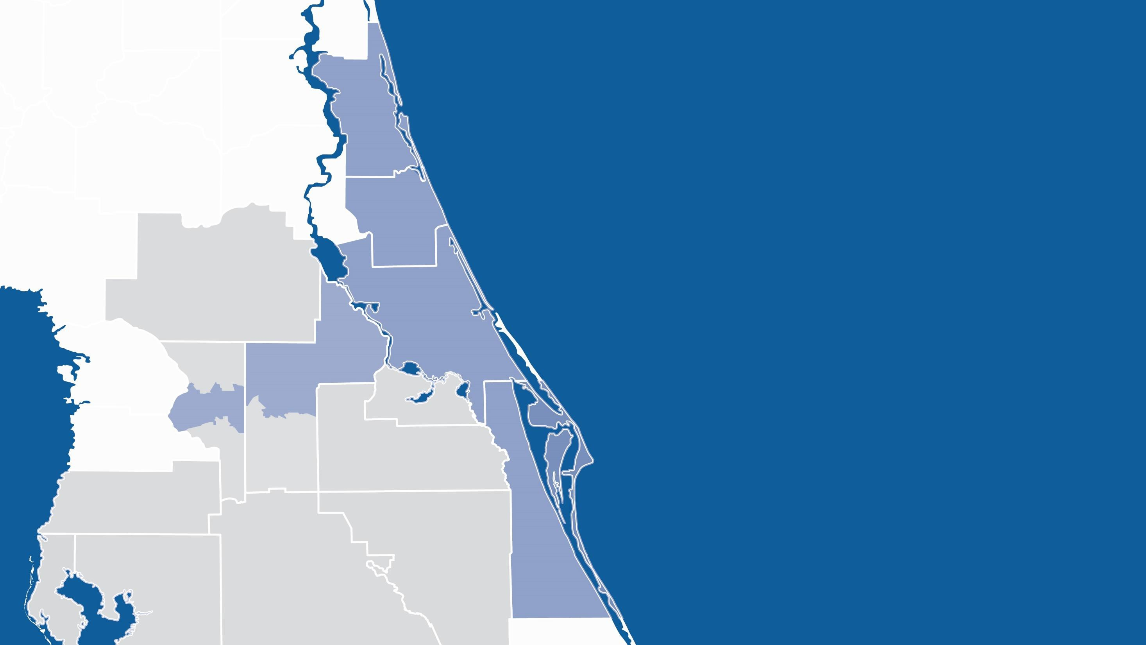


























13
2

Slide 16
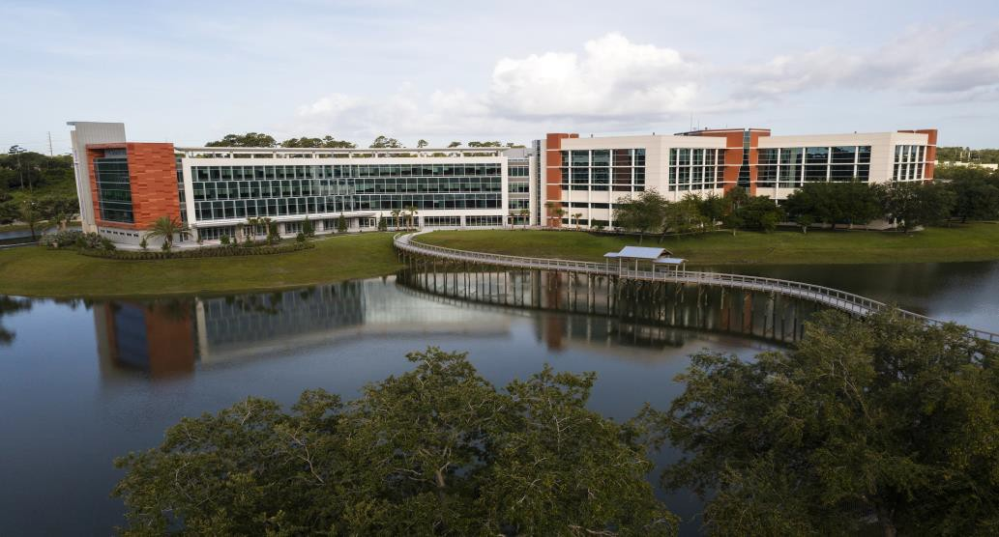
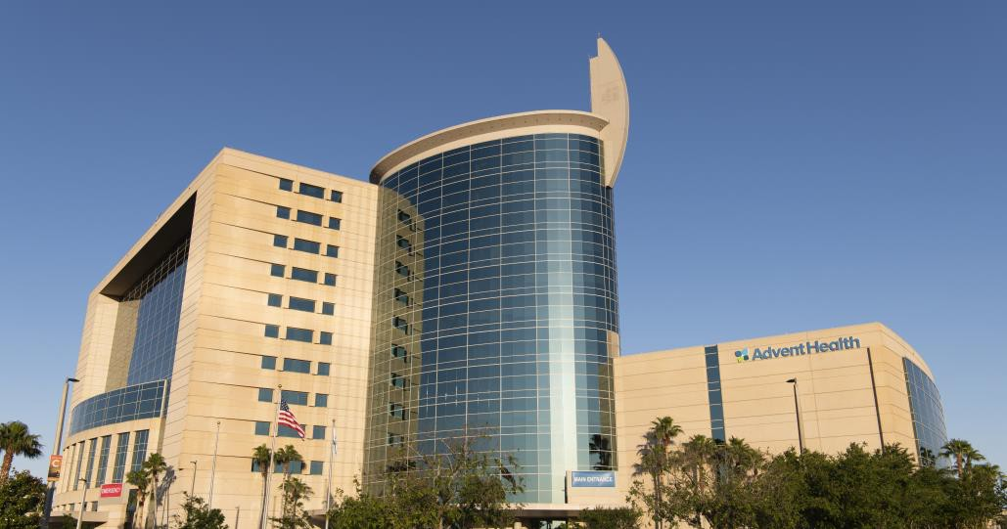






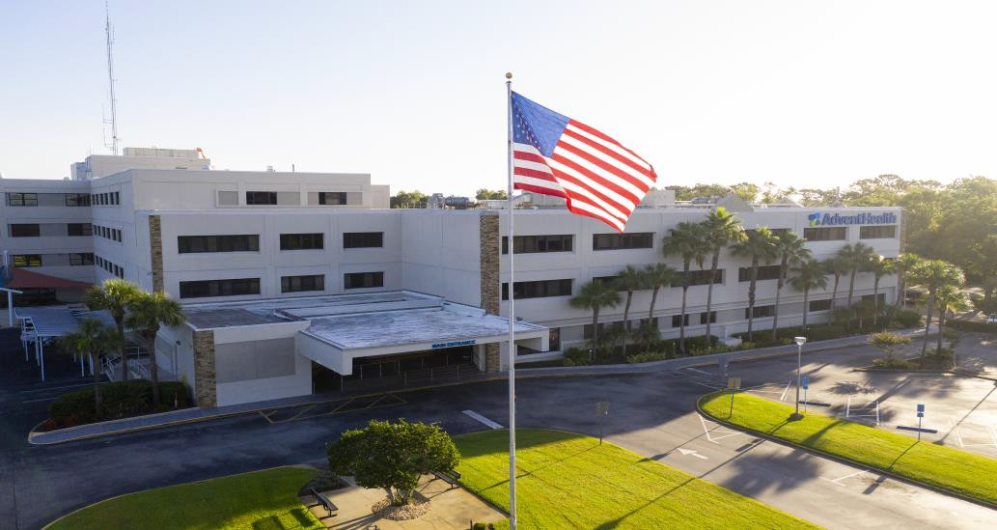
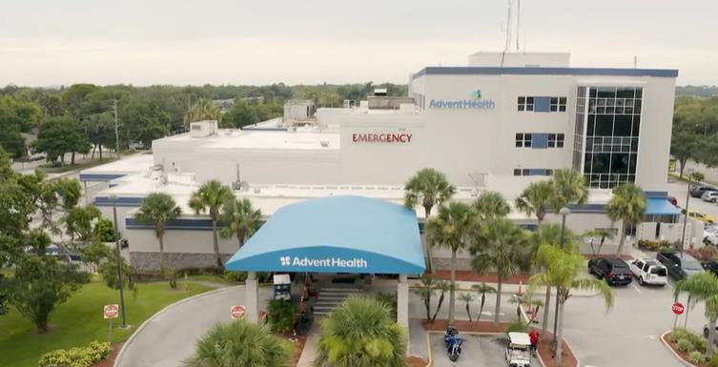






Slide 17
6,000
residents are AdventHealth employees
50,000
inpatient visits
2.2 million
total visits

Slide 18

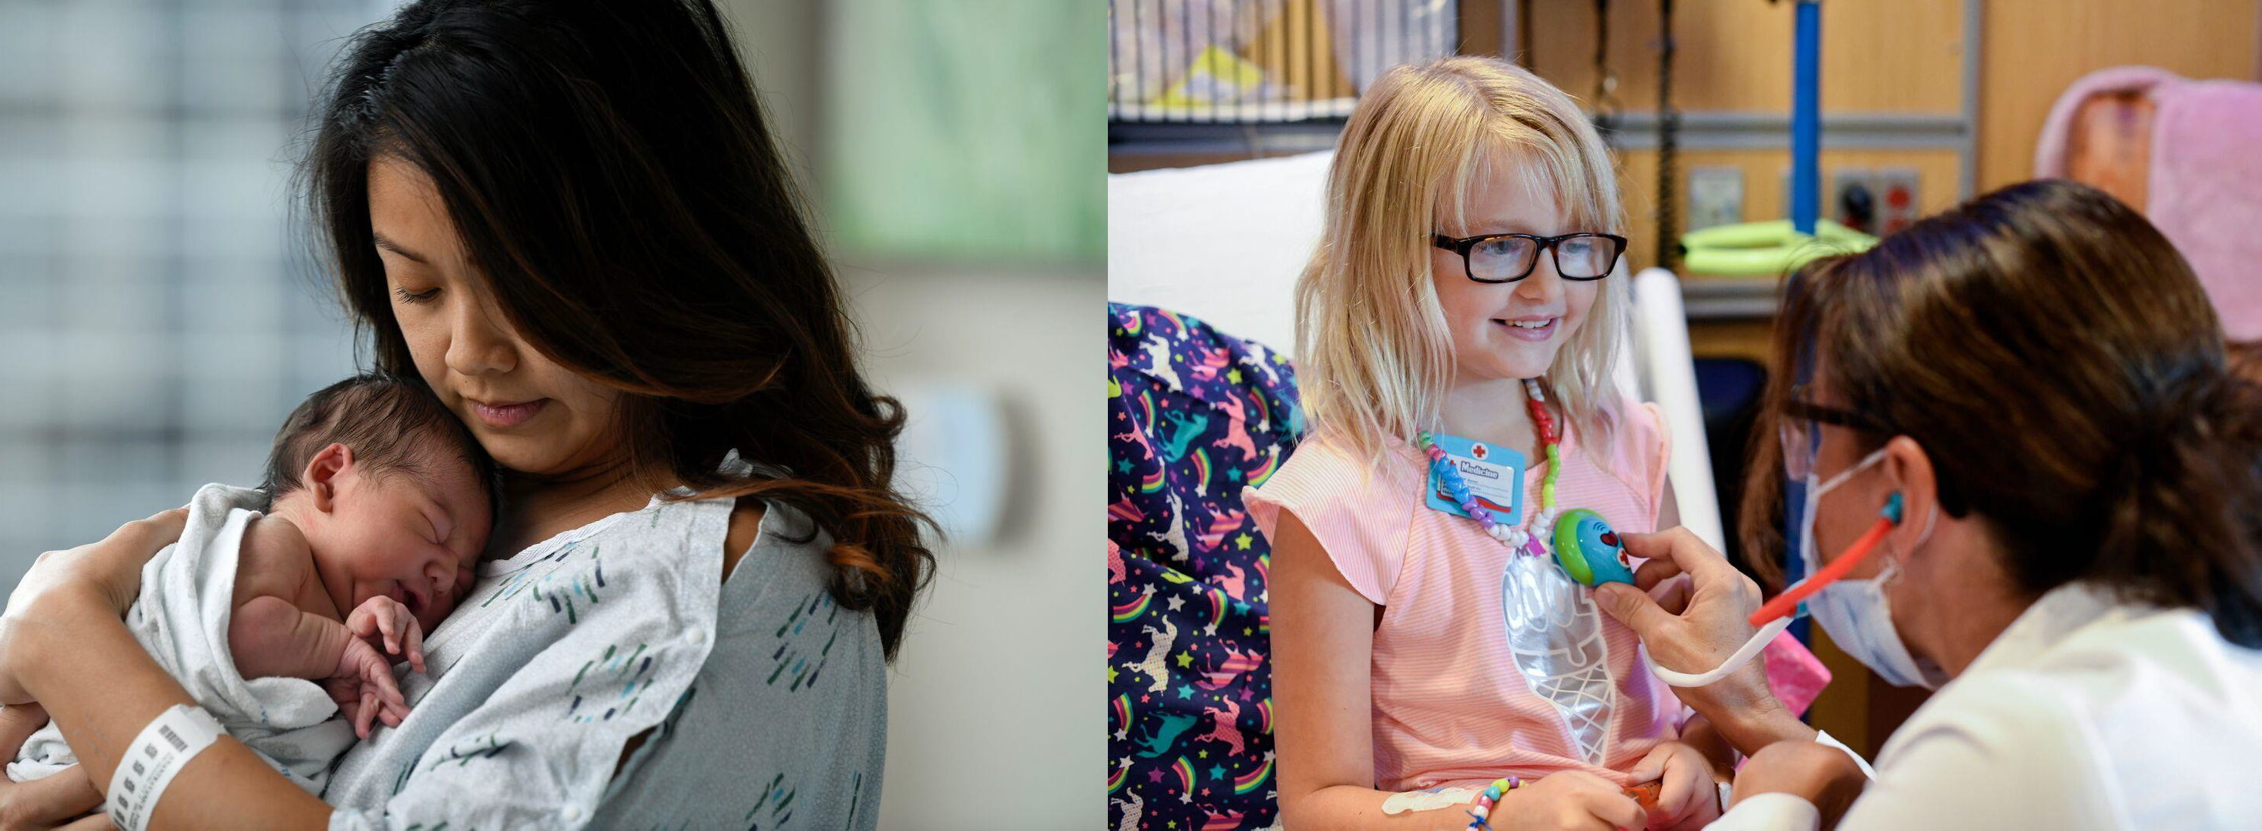

Slide 19
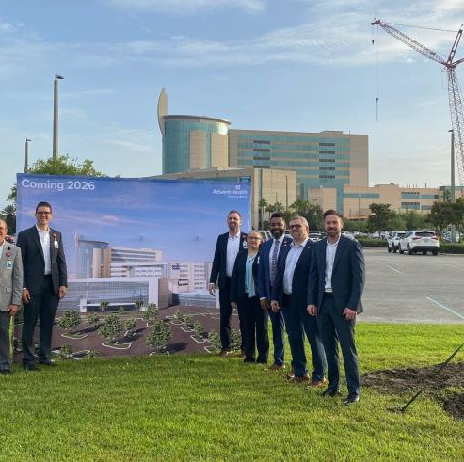
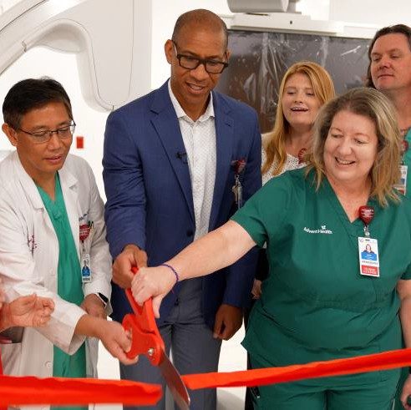
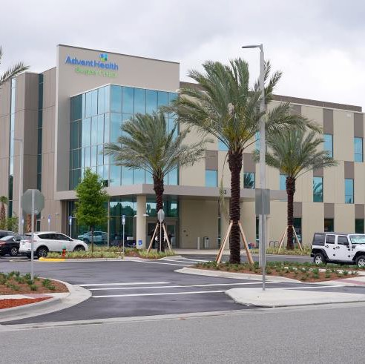
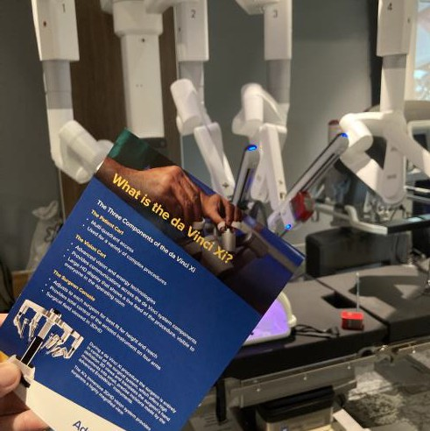






















Slide 20




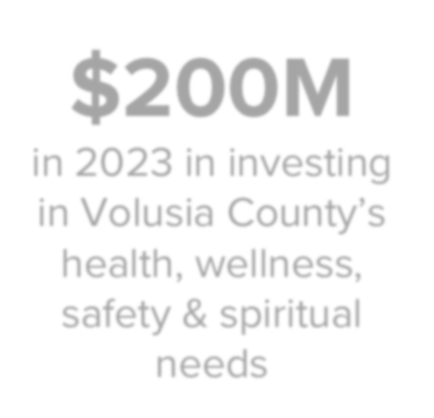















Slide 21
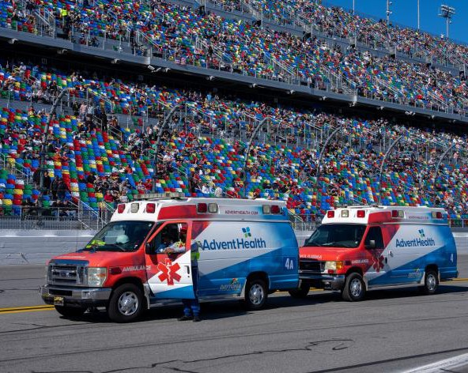
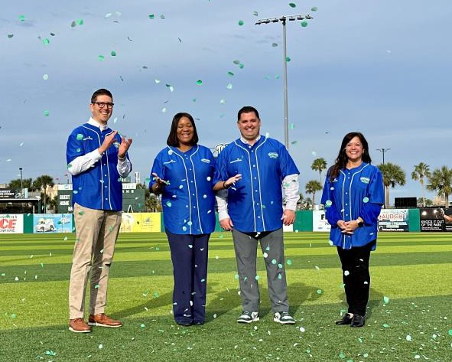
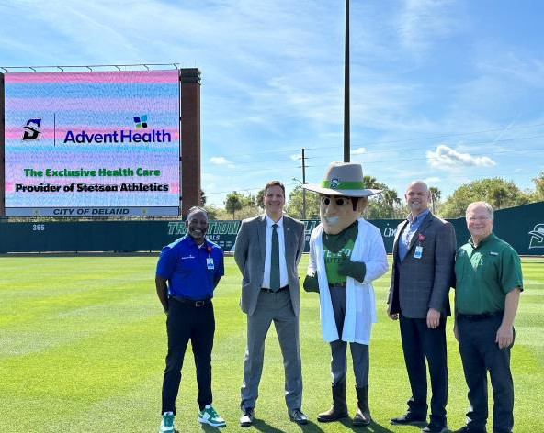
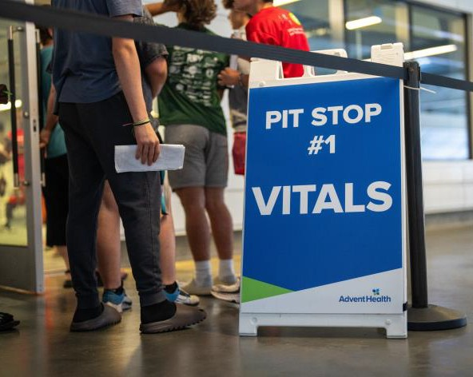







Slide 22









































Slide 23




















Slide 24





Slide 25
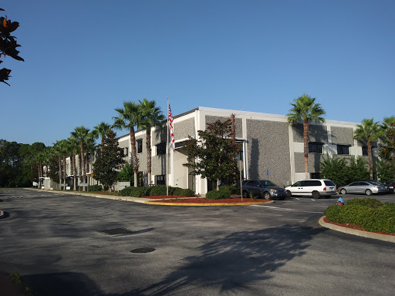
II. Community Health Update & Information
    Florida Department of Health in Volusia & Flagler Counties
    Stephen Civitelli, Administrator

Slide 26
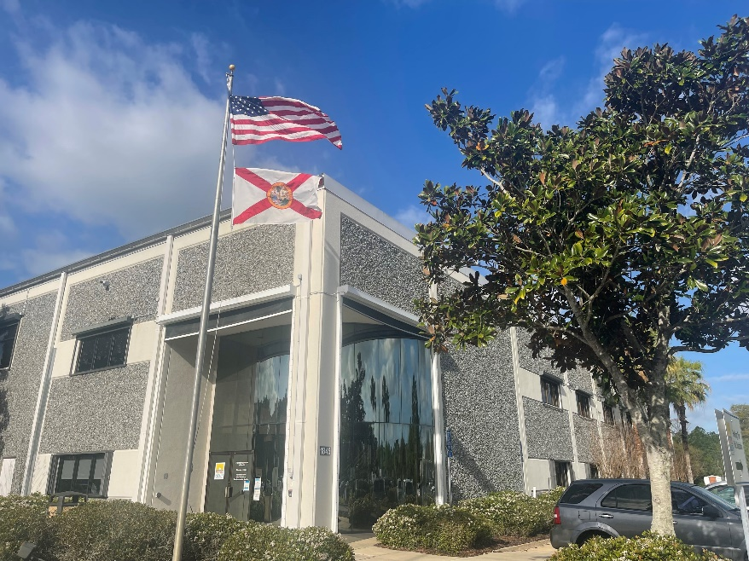
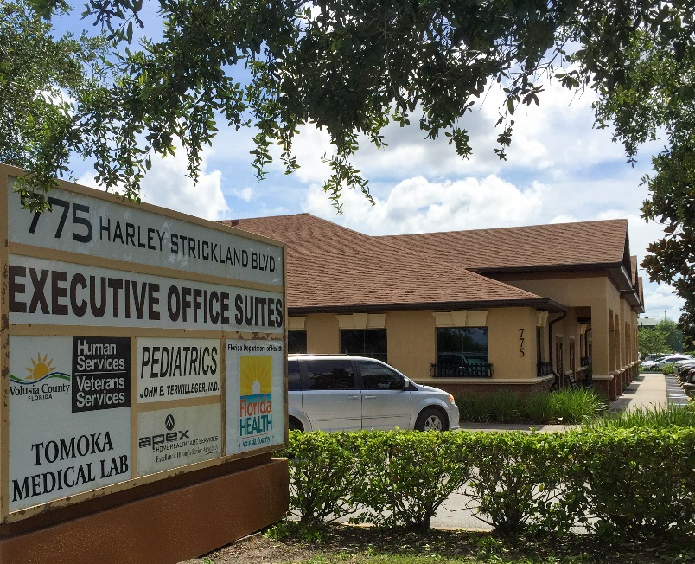
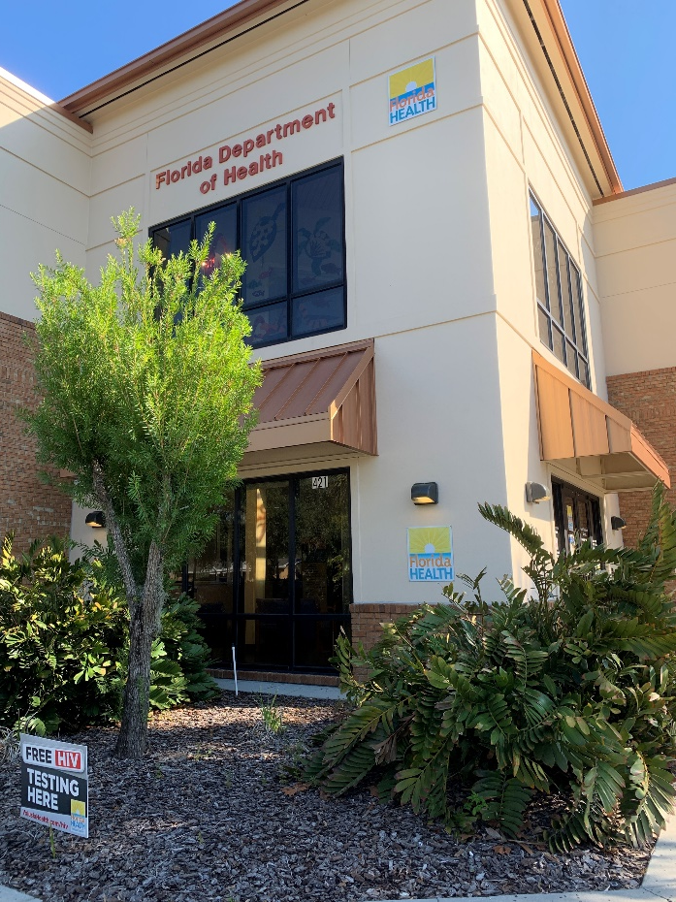
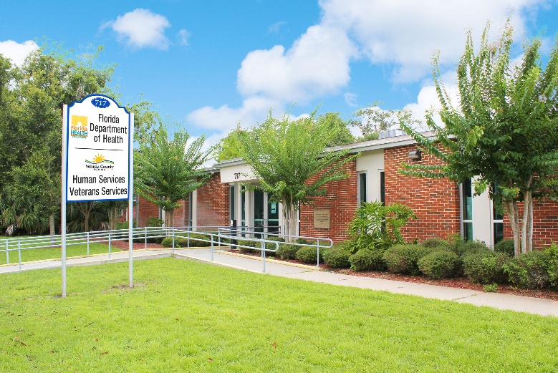
Our Locations

Slide 27
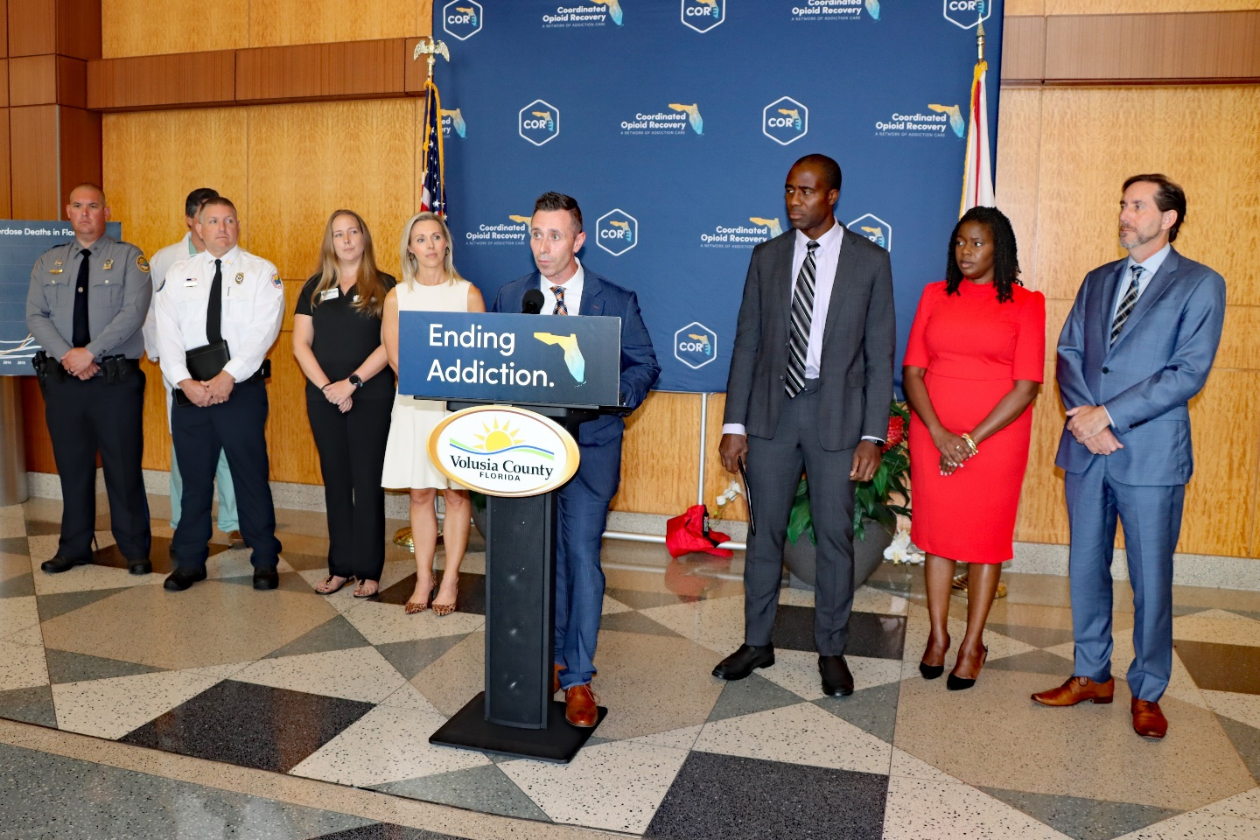
What we do
Clinical Services
Dental Services
Emergency Response &
Preparedness
Environmental Health
Epidemiology
Community Health
Overdose Prevention
WIC Program
Vital Statistics

Slide 28
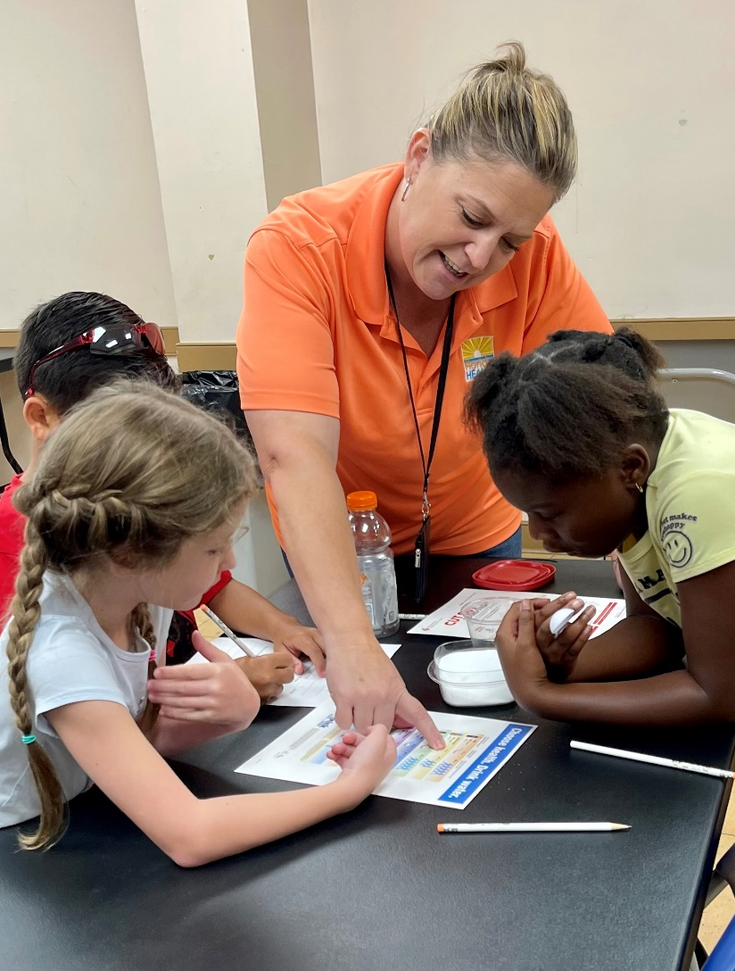
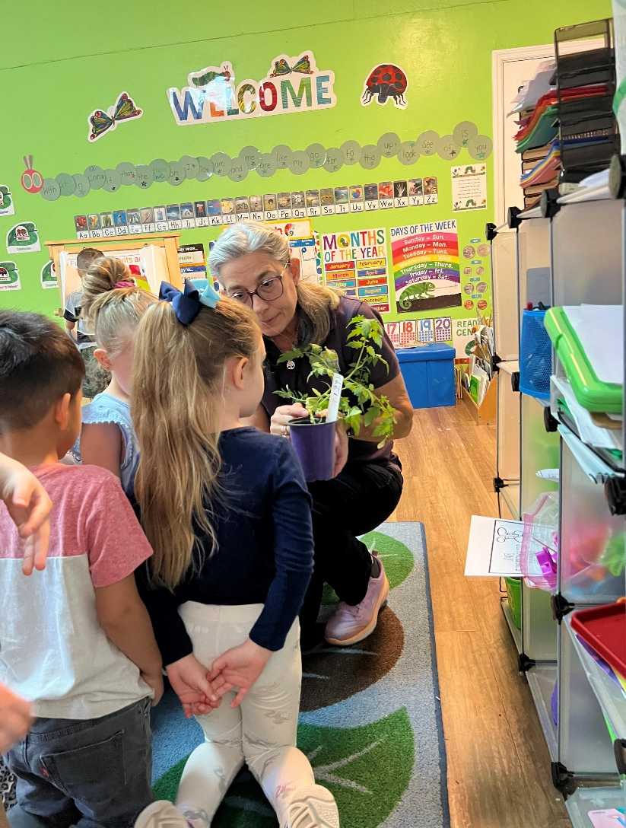
Going beyond our buildings…
Importance of Nutrition
Learning about fruits and vegetables at the preschool level.
Helping summer campers learn about sugar in drinks.
Bringing Second Harvest produce truck to visit DOH clinics with free produce.

Slide 29
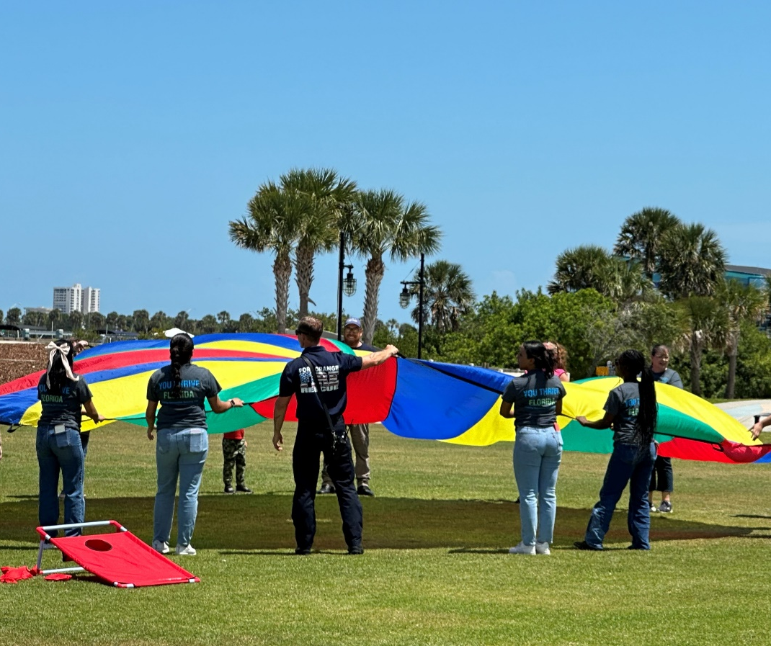

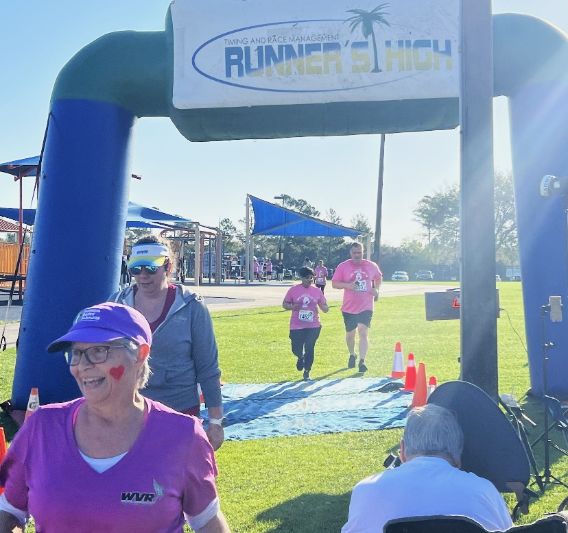
Going beyond our buildings…
Combatting Obesity
Supporting events that encourage activity and exercise.
Family Fun Day in South Daytona.
Freedom 5K in Daytona Beach.
Love Your Heart 5K in Deltona.
Head Start Family Fun Days in South Daytona and DeLand.
Bingocize (movement with health education for seniors).

Slide 30
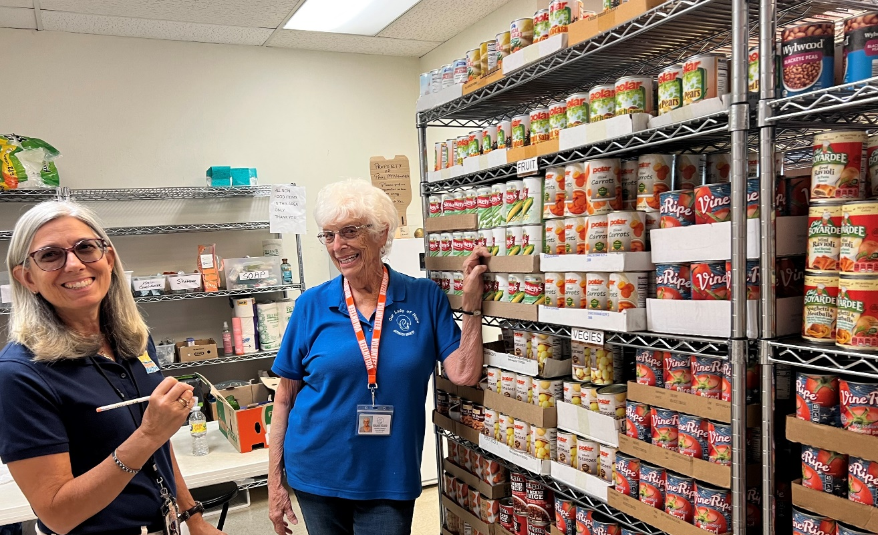
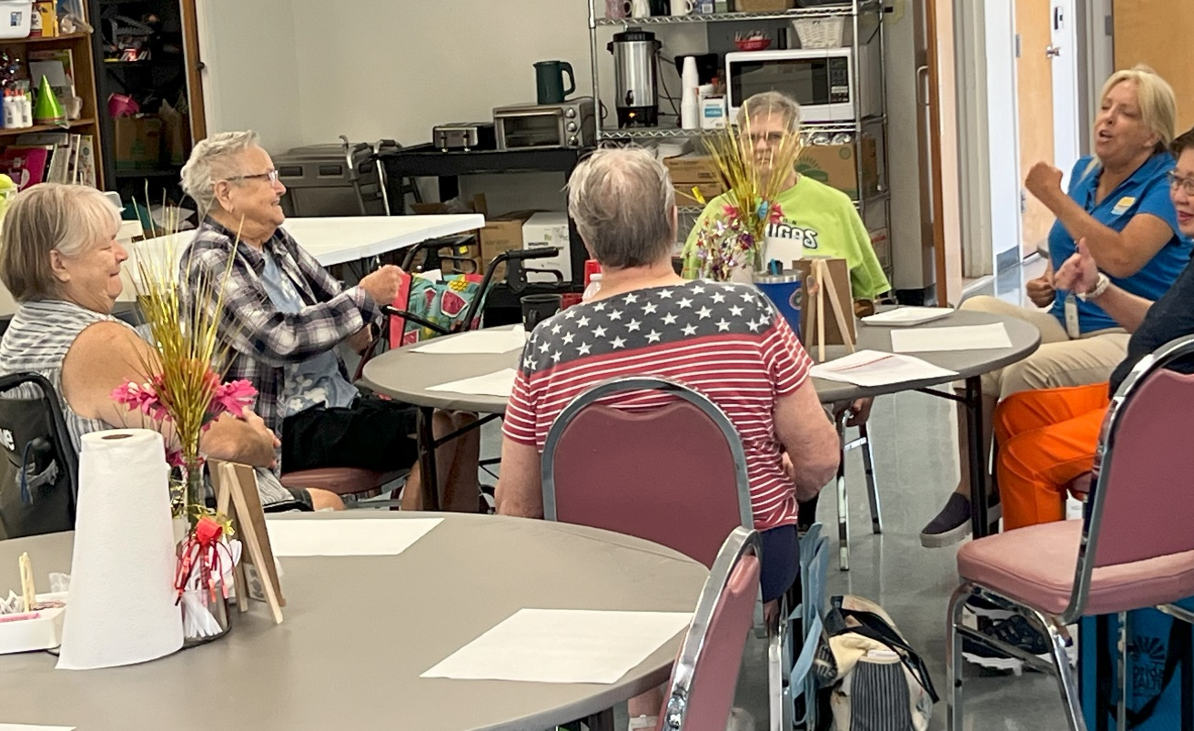
Going beyond our buildings…
Protecting vulnerable populations
Healthy living series with seniors.
Encouraging nutritious celebrations at daycare.
Working with schools on nutritious lunch options.
Nutritious options at food pantries.

Slide 31
Our Why?
Because the leading cause of death in Volusia County is heart disease (22.5%). Volusia County’s is higher than the state average at 190 people per 100,000. The state average is 146 people per 100,000.
Best way to fight heart disease is good nutrition and exercise.

Slide 32
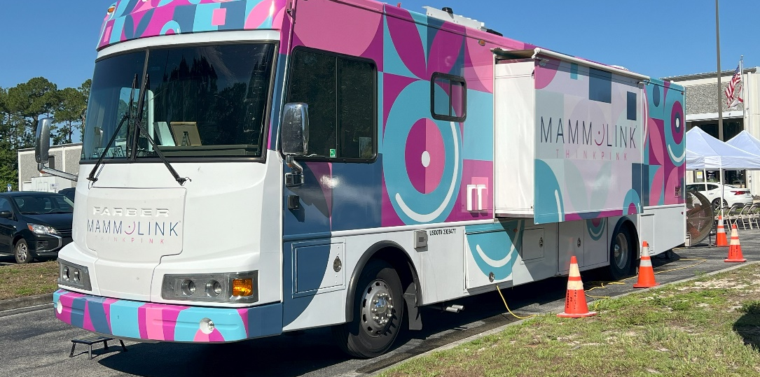

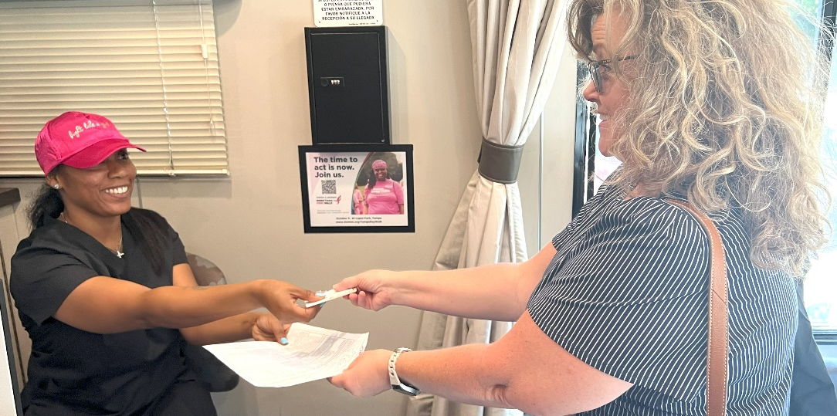
Going beyond our buildings…
Access to Cancer Care
Florida Breast & Cervical
Uninsured women receive free screenings.
DOH-Volusia share the program in public spaces like libraries.
Mammolink bus will take free screenings where needed.

Slide 33


Going beyond our buildings…
Tobacco Education
Anti-vaping Coalition with One Voice for Volusia—working on teen education.
Tobacco Free Florida partnership.
Free diapers, wipes for mom’s who quit.
Tools to Quit classes.

Slide 34
Why?
Because the second leading cause of death in Volusia County is cancer disease (18.4%).
Best way to combat cancer is through early detection and education on the negative effects of tobacco use.

Slide 35

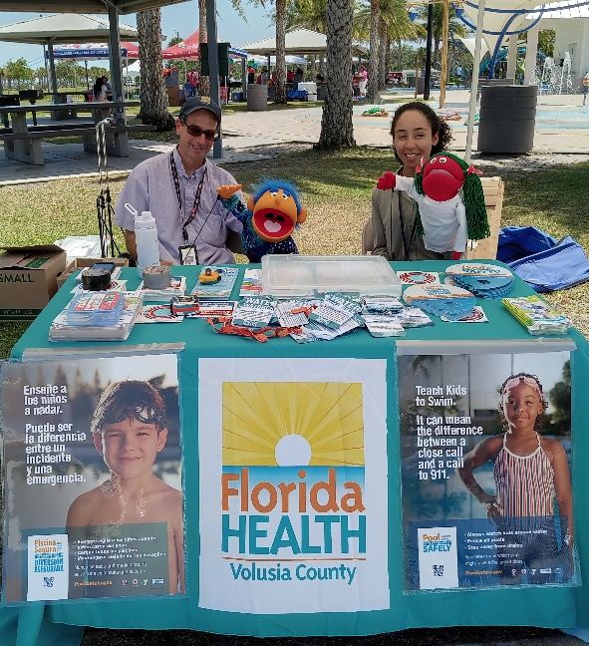
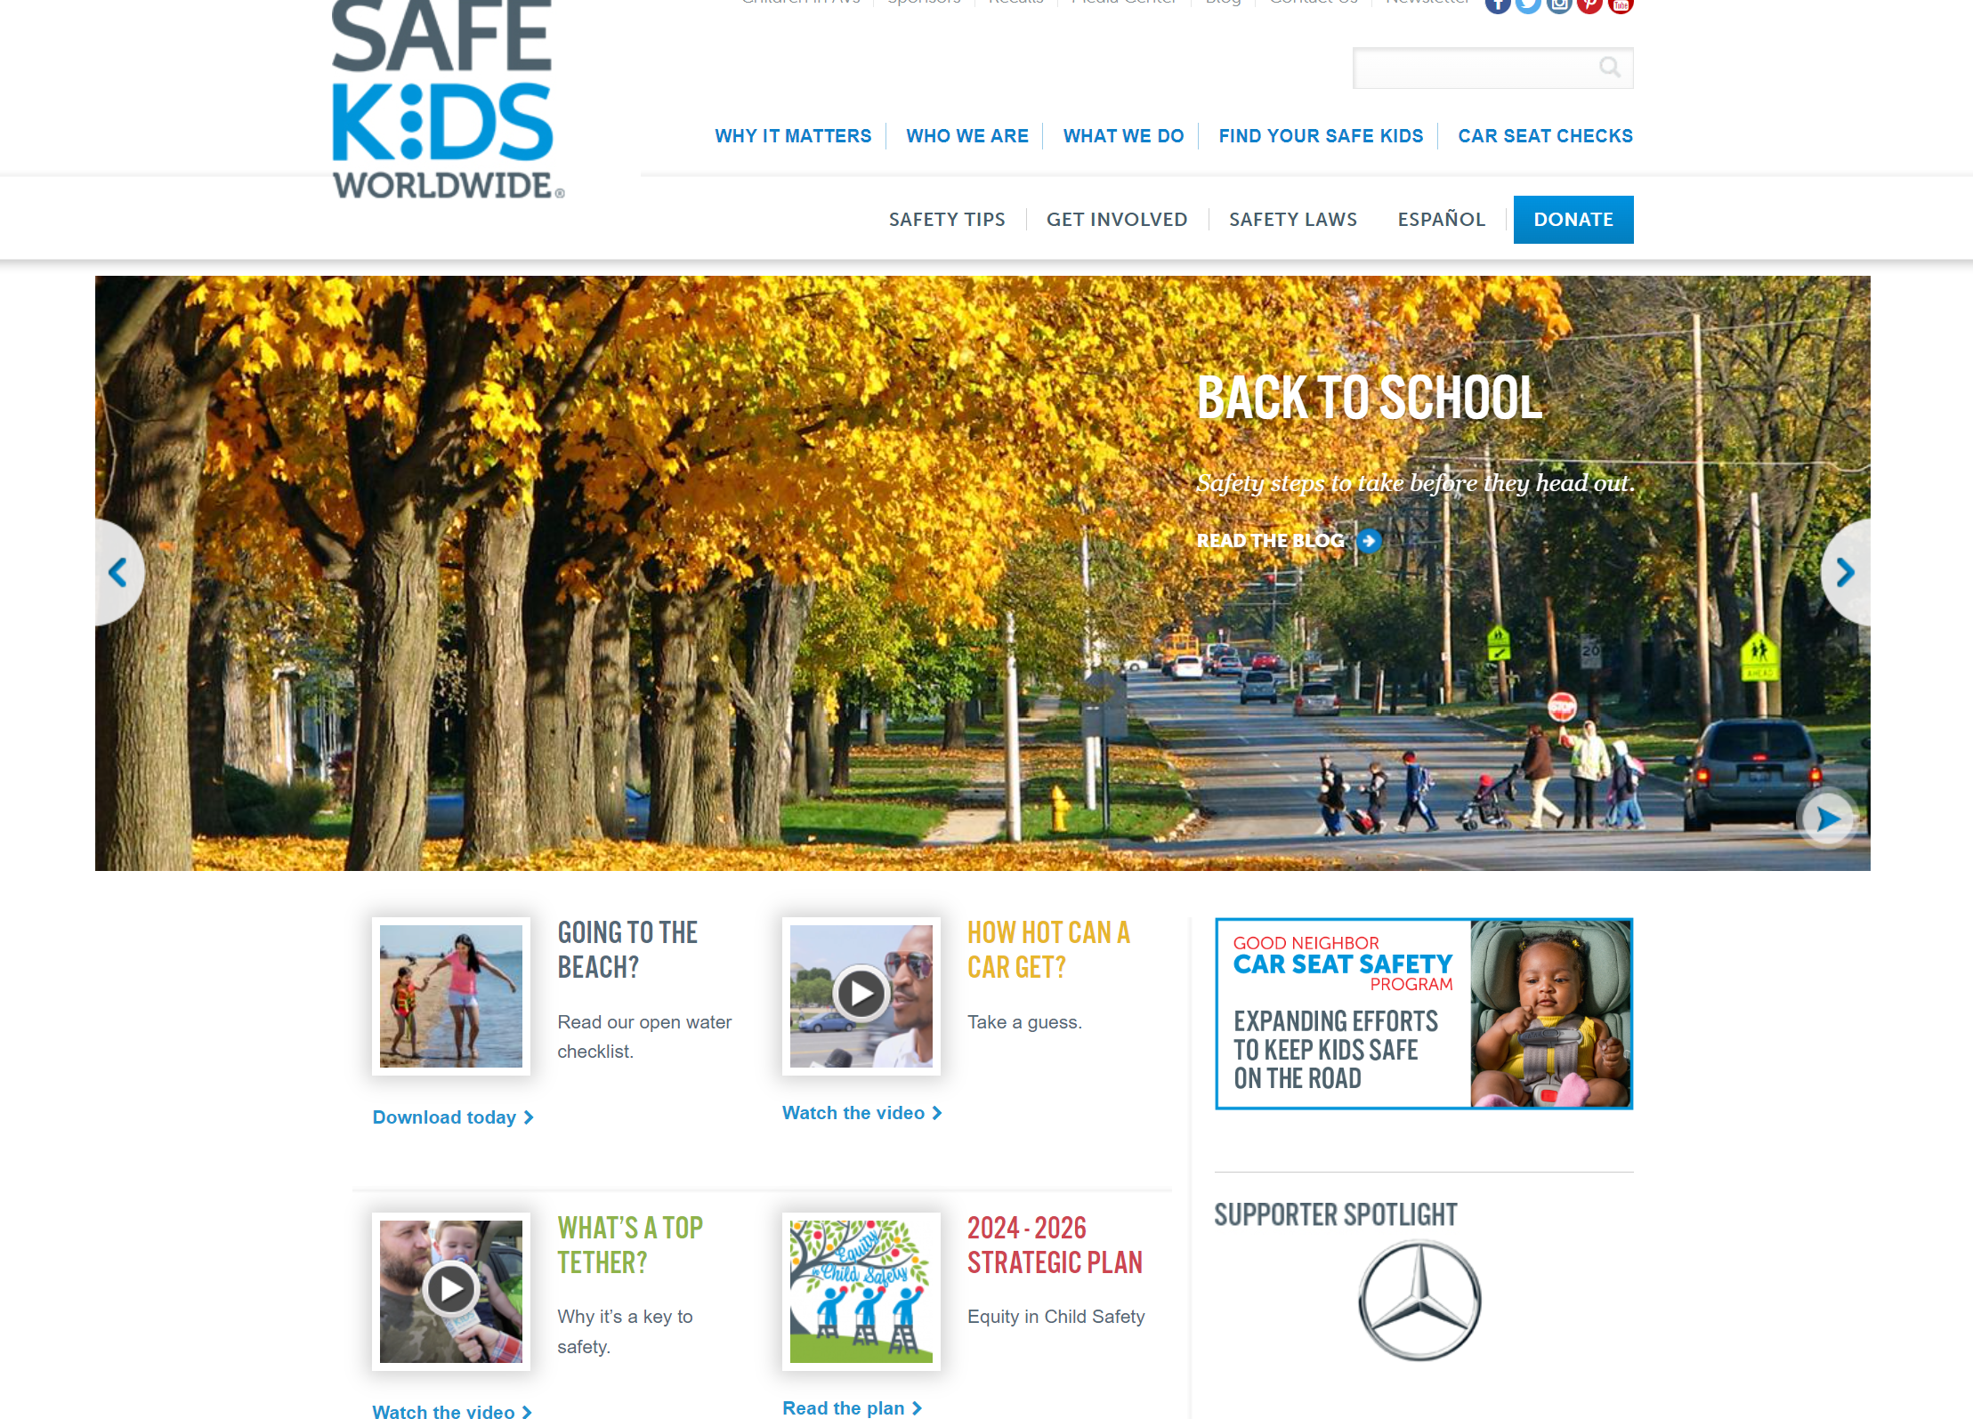
Going beyond our buildings…
Safe Kids Coalition
DOH-Volusia taking lead of coalition.
Coalitions work to reduce unintentional injuries to children.
We need for cities to support our efforts.
Include us in your events.
Send your first responders and parks & recreation staff to our coalition kickoff.
Encourage city staff to become licensed car seat installers.

Slide 36
Why?
Because unintentional injury is the third leading cause of death in Volusia County (8%). Unintentional injury is “injury that is not a result of intended self-harm.” Volusia is higher than the State of Florida (108.8 people per 100,000 people vs. 69.4 people per 100,000 people) in unintentional injury.
We have to work together as a community to increase the use of safety tools (seatbelts, car seats, bike helmets, swimming pool alarms) and increase awareness of pedestrian safety, swim safety and drug and alcohol abuse.

Slide 37

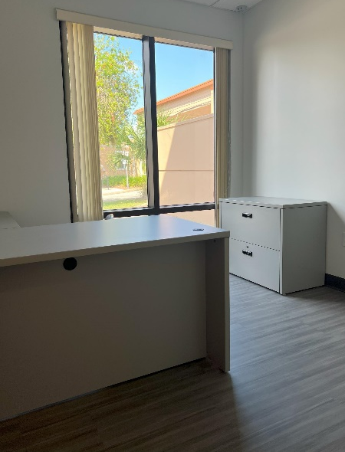
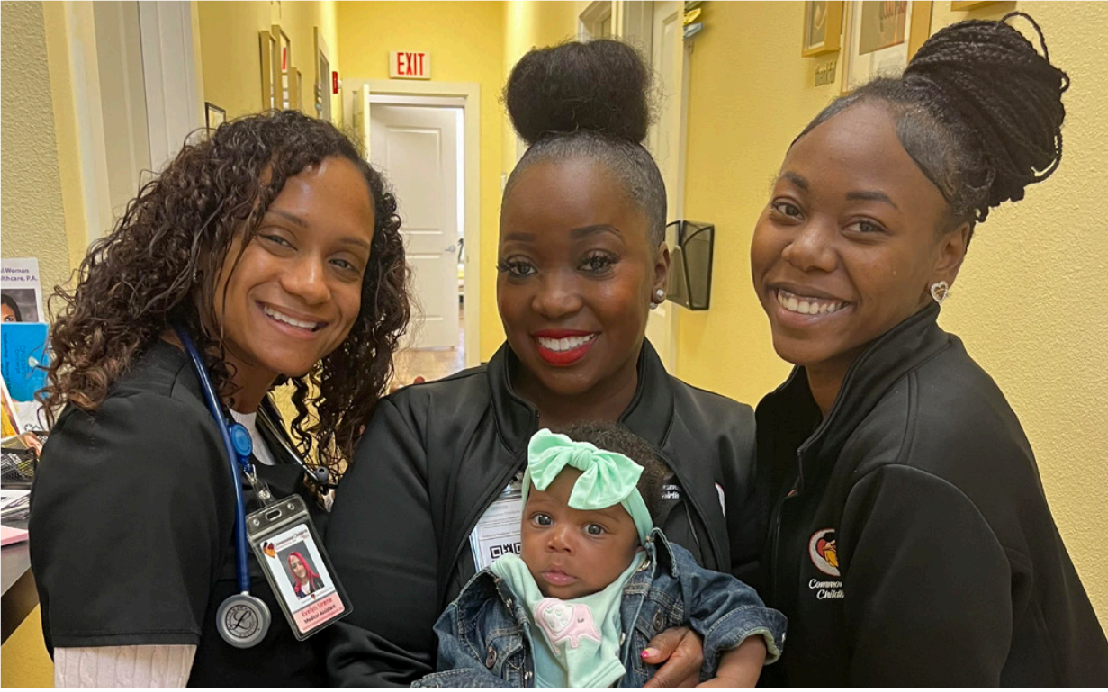
Bringing a building back to life…
Keech Street Center for Women & Babies
Access to care
High-concentration of women-led households and children in area around Keech Street (Historic Midtown).
Hub for WIC (Women, Infants and Children) program.
Pre-natal clinic.

Slide 38
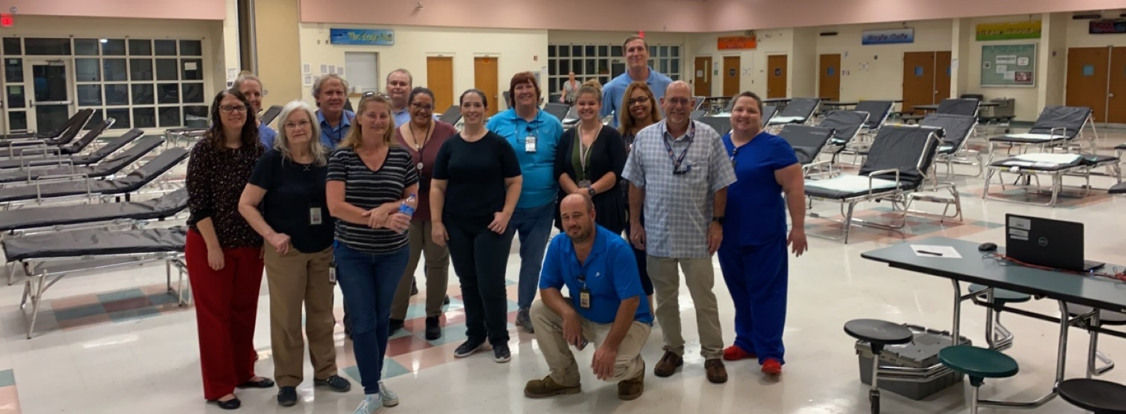
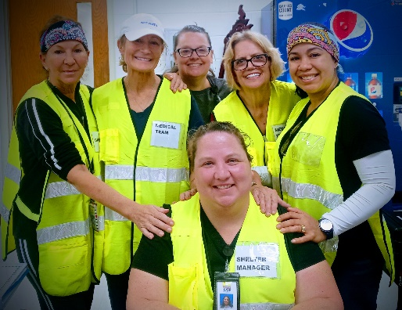
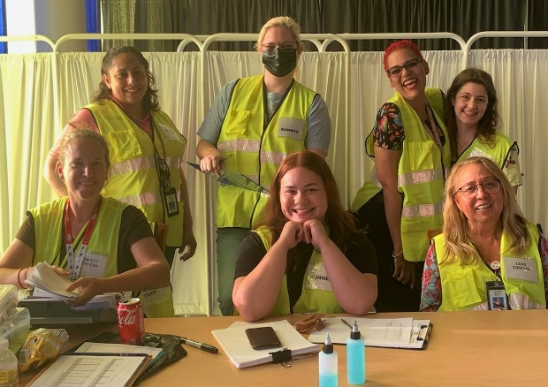
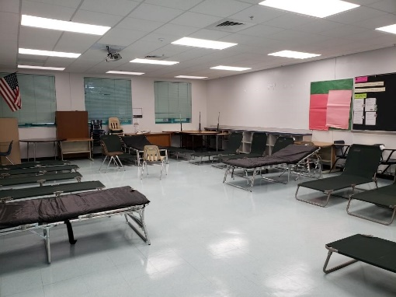
Emergency Operations & Preparedness…
Providing shelter for residents with special needs
Historically shelters have been schools. Considering other options, i.e. community centers, park gyms or churches.
“Special Needs” includes residents who are electric or oxygen dependent or who are elderly, physically, mentally or sensory disabled, visually or hearing impaired.
We want residents to pre-register at https://snr.flhealthresponse.com/ to make entering a shelter during the time of disaster a smooth process.

Slide 39


Plum Cases
“The ultimate in disaster preparedness. With both 5G and LTE cellular and satellite service, the PLUM SAT IV™ allows lower cost, high bandwidth service on cellular, and utilizes satellite service only when multiple carriers are not available. The PLUM SAT IV provides global coverage regardless of landscape or location.”
We have three at the Department of Health.

Slide 40






Slide 41



Going beyond our buildings…

Slide 42
Our Mobile Outreach Unit
Working to wrap a Ford Transit van to represent both sides of Volusia County.
Coming to your city soon!
16 Days in 16 Cities!
We would love to coordinate with you on our visit to your city.
Email Wendi.Jackson@FlHealth.Gov

Slide 43

Contact Your Health Officer
Stephen A. Civitelli, RS, MPH
Administrator/Health Officer
Florida Department of Health in Volusia County
(386) 274-0817,
Stephen.Civitelli@flhealth.gov

Slide 44


II. Community Health Update & Information
SMA Healthcare
Ivan Cosimi, Chief Executive Officer
Nicole Sharbono, Chief Operating Officer

Slide 45













SMA Healthcare
A Brief History of a Safety Net Provider
Mental Health Services
1967
1975
1983
** Integrated Behavioral Healthcare Services **
Volusia Guidance Center
Human Resource Center
Act Corp
2018
2008
Stewart- Marchman Act Behavioral Healthcare
Halifax Alcoholic Court- Oriented Program
Leon F. Stewart Treatment Center
Stewart- Marchman Center
1970
1976
1992
1997
Substance Abuse Services
2012
Acquired St Johns
Putnam Behavioral
2016
Acquired Windward Behavioral Health
2021
Acquired The Centers

Slide 46
Mission / Vision
Mission:
SMA Healthcare improves lives through exceptional substance abuse, mental health and primary care services.
Vision:
SMA Healthcare envisions a community where all individuals living with addiction and mental health needs, find hope, healing, and recovery.

Slide 47




SMA Healthcare
Foundation
Mission
The SMA Healthcare Foundation is a single purpose foundation existing to support SMA Healthcare. Our mission is to foster relationships to increase community awareness and support for services provided by SMA Healthcare.

Slide 48


Slide 49
Prevention
Access Center 24/7 Call Center
Outreach and Awareness Events
Outpatient
Case Management
Substance Abuse & Mental Health Therapy
Men’s/Women’s Residential Treatment
Shelter for Runaway and Truant Youth
Residential
Crisis
Crisis Stabilization
Detoxification
Mobile Crisis Response
Medication Assisted Treatment
In-School Programs
Psychiatric Medication Management
Primary Care
Adolescent Residential Treatment
Emergency Screenings
Men’s Work Release
Florida Assertive Community Treatment (FACT)
Community Education
Pharmacy
SMA Provides the Full Continuum of Care
Notes:
While we provide the continuum of service delivery, there are many gaps that need to be filled in

Slide 50
Current Partnerships:
Partnerships =
Key
to
Maintaining a Safety Net of Services
Volusia County and numerous municipalities
Halifax and AdventHealth
West Volusia Hospital Authority
House Next Door
Neighborhood Center
Rising Against All Odds
Volusia County Schools
Department of Health
Daytona State College, University of Florida, Stetson University
Palmer Chiropractic
Circuit 7 Court Services
Easter Seals
Community Partnership for Children
Other Stakeholders
Notes:
We believe in collaboration… partnering is key in a field that has limited resources

Slide 51
The State of Behavioral Health in Volusia County

Slide 52

The State of Volusia
Children:
  Florida Department of Education estimates there are 400, or .7%, of youth in Volusia County in grades K-12 with an emotional/behavioral disability (2022)
  Florida Department of Health estimates 41.6% of students in Volusia County felt sad or hopeless for two or more weeks in a row in the past year (2022)
Adults:
  17.2% Adults reported poor mental health for 14 or more of the past 30 days (2019)
  18.8% Adults have been told they have a depressive disorder (2019)
Suicide:
  Volusia highest suicide rate for ages 45-54 at 29.9 per 100,000 (2022)
  Florida highest suicide rate for ages 75 or older at 24.6 per 100,000 (2022)
Notes:
Children:
Worse than FL @ .4%
Worse than FL @31.5%
Adults:
Worse than FL @ 15%
Worse than FL @ 17.8%

Slide 53


The State of Volusia

Slide 54


The State of Volusia

Slide 55
SMA Strategies to Enhance the System of Care

Slide 56

SMA Strategies

Slide 57

SMA Strategies
Expand Research Partnership with University of Florida
Expansion of Primary Care Services – Integrated Approach to Behavioral Health Treatment
Construct a New Flagler County Integrated Stabilization Unit
Create a Psychiatric Residency Program Sponsored By SMA and Clinical Internship Program
Construct a New DeLand Outpatient Center for Integrated Services
Notes:
What is SMA strategically doing to improve this???

Slide 58


III. Volusia County Beach On & Off-Site Parking
Benjamin Bartlett, Public Works Department Director, Volusia County

Slide 59

On-Beach Access Program Highlights
New Rates Effective October 1, 2024
$30 Daily pass
$150 Annual Pass for non-residents
Disabled Veterans & Disabled with Placard Complimentary
Vehicular beach access for Volusia residents at no additional charge
Automated vehicular on-beach access using License Plate Recognition (LPR) technology
Real-time ramp status on Volusia Beaches App
Full Rollout of automation by February 2025

Slide 60

Off-Beach Parking Program Highlights
Effective January 1, 2025
$20 Daily pass
$100 Annual Pass for non-residents
Volusia Residents receive free annual pass with registration
Disabled Veterans & Disabled with Placard Complimentary with registration
License Plate Recognition (LPR) Parking Verification
Pay by App, Text-to-Pay, Kiosks on larger lots
Real-time lot capacity publicly visible on Beach App
Violation enforcement by Vendor
Expandable and Scalable for municipalities and other agencies

Slide 61

Resident Registration
Who qualifies for residency status:
Resident address in Volusia County
Own property in Volusia County
College Students (Stetson, BCU & ERAU)
Online instant verification for 90% of residents
One time registration with auto renewal for residents
Automatic verifications of resident status
On-Beach access for residents at no additional charge sunsets on January 31, 2026

Slide 62


Program Implementation
Registration opens on October 1, 2024
Comprehensive public messaging
County parking areas will be signed accordingly
Parking ambassadors at large lots to assist with payment and registration
Download the Volusia Beaches App
Parking available 5a-11p
Vendor staffed offices and 24-hour help line
  Separate

Slide 63


Questions?

