Slide 1
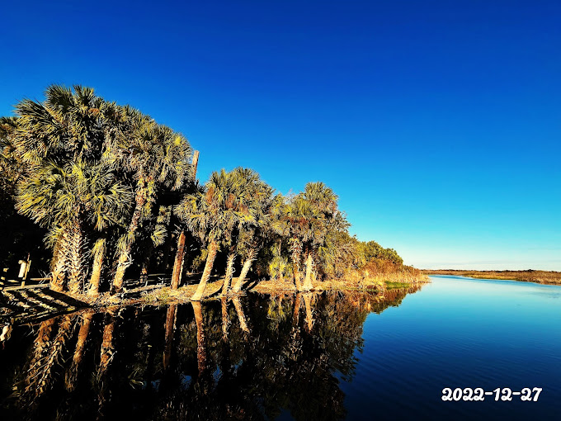
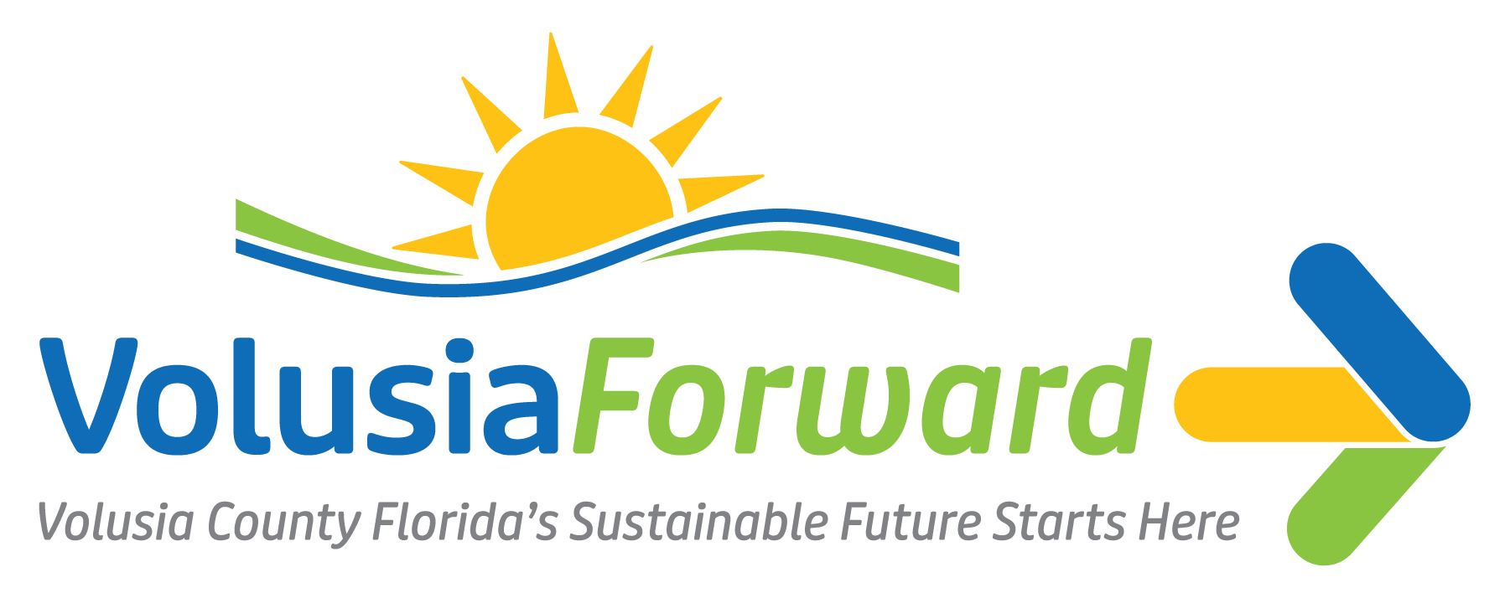
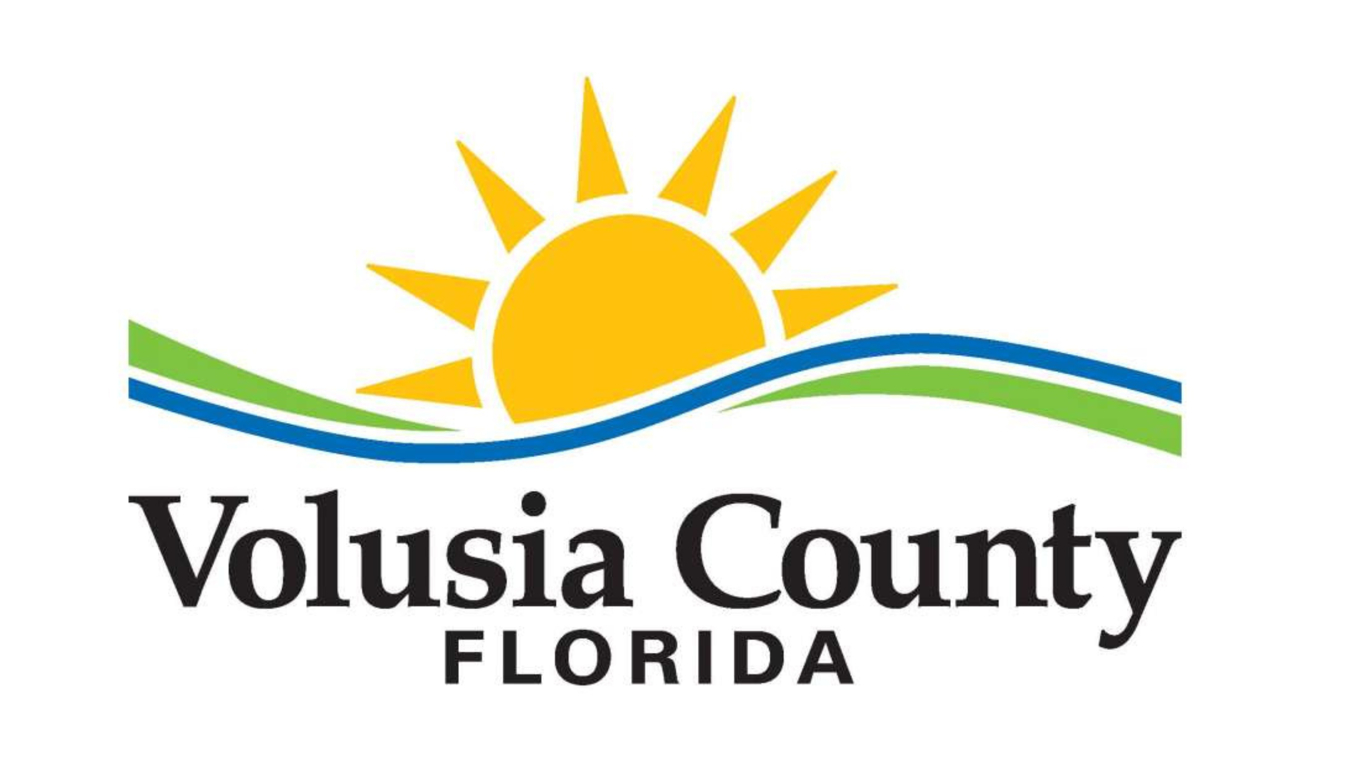
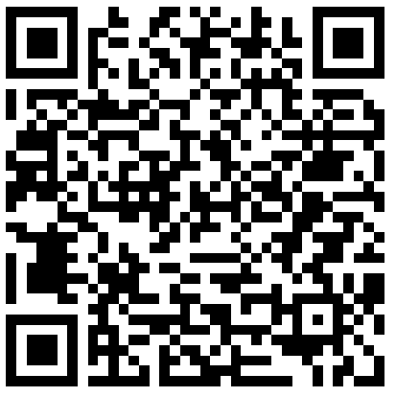
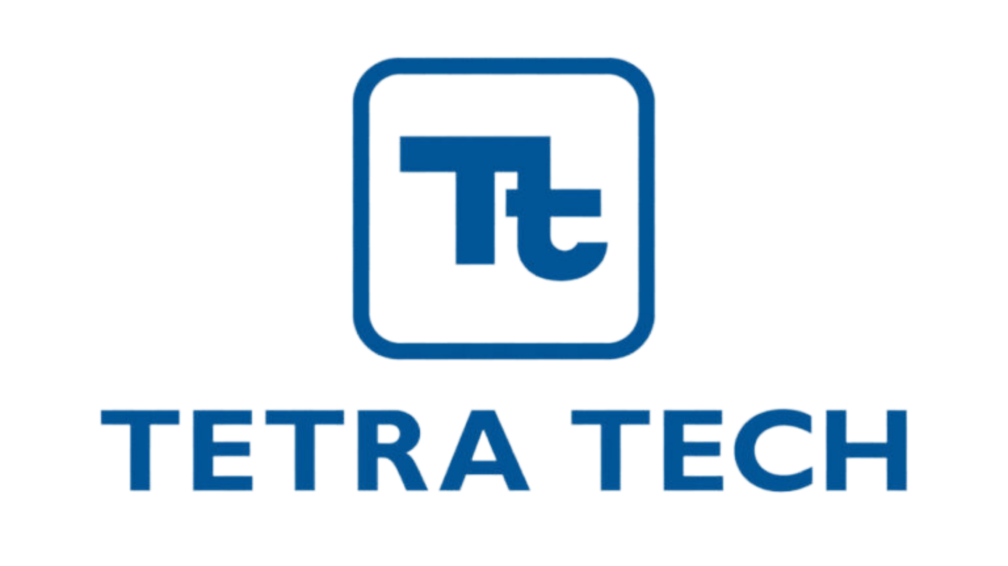
Help us locate the problem areas!
Scan the QR code and complete the activity.

Slide 2
Building Sustainable Communities
An Introduction for Community Members
February 88, 2024
6:00 p.m. – 8:00 p.m.

Slide 3

Project Team
Ginger Adair
Volusia County
Environmental Management Director
Samantha West
Volusia County
Sustainability and Resilience Manager
Sergeneno Rankin
Volusia County
Sustainability and Outreach Coordinator
JaLeesa Tate, CFM
Tetra Tech
Senior Community Resilience Planner
Victoria Colon
Tetra Tech
Emergency Management Specialist
Grace Altenburg
Tetra Tech
Resilience and Climate Adaptation Planner

Slide 4
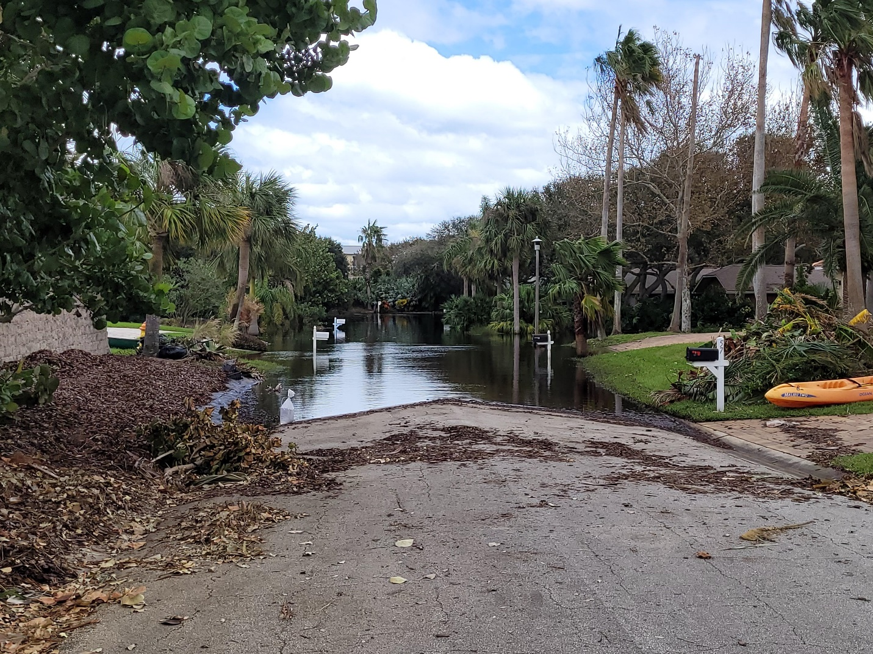
Introductions
Please share your name and your past experience with climate-related impacts in the County.
Please keep introductions to 1 minute.
Photo provided by Town of Ponce Inlet

Slide 5
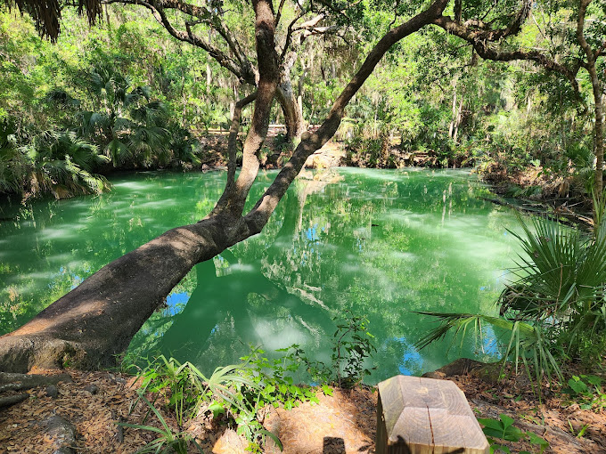
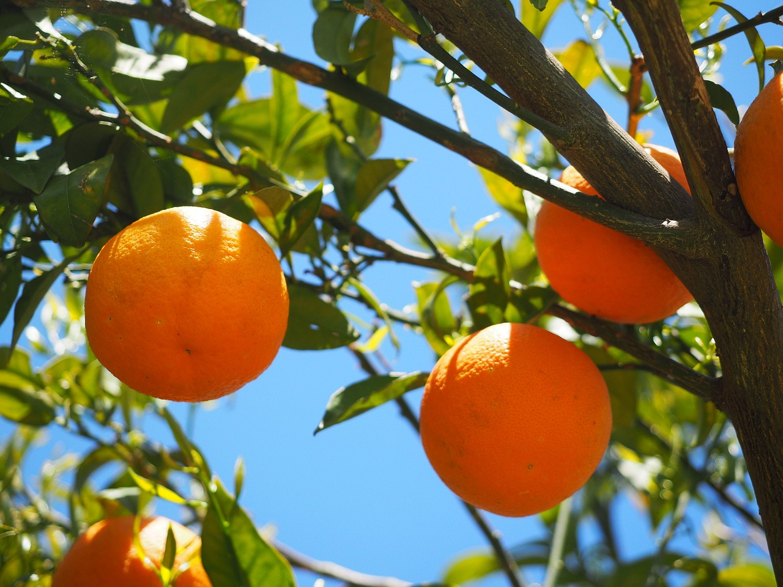
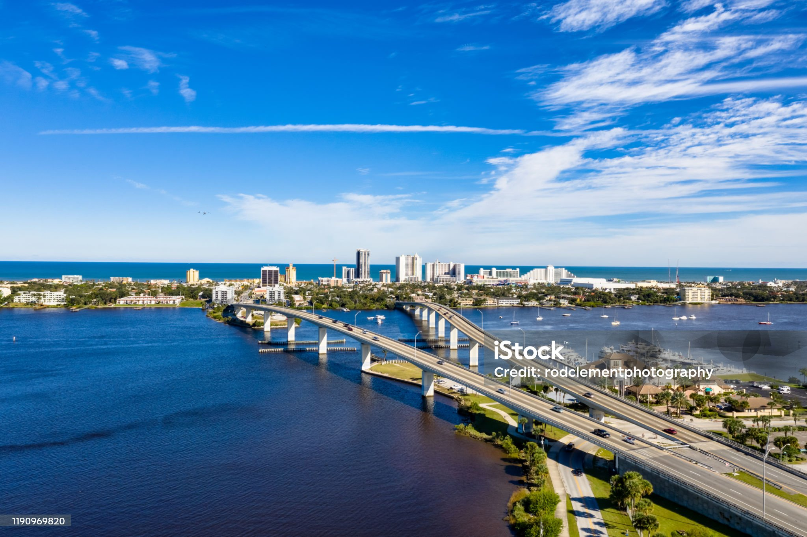
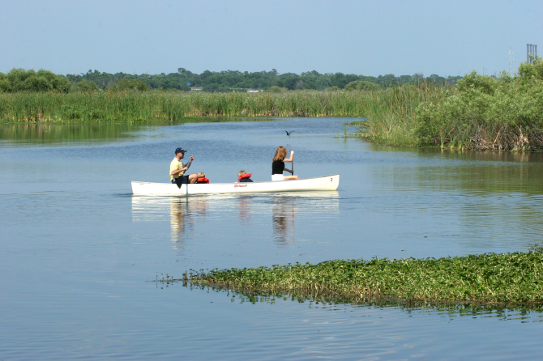
Building Sustainable Communities
Purpose: To enhance the community’s understanding of adaptation and resiliency efforts in the County to build long-term resilience in the face of hazards.
Goal: To serve as a forum to strategize the most effective way to foster resilience in the face of various uncertainties.

Slide 6
Agenda
Introduction to Adaptation Planning Topics
Adaptation and Resilience Planning in Volusia County
Breakout Session: Public Opinion on Resilience and Adaptation
Looking Ahead

Slide 7


Join at slido.com
#VolFwd
ⓘ Start presenting to display the joining instructions on this slide.

Slide 8
Introduction to Adaptation Planning Topics

Slide 9

Define resilience in your own words
During registration, we asked you to define "resilience" in your own words.
ⓘ Start presenting to display the poll results on this slide.

Slide 10
Resilience In Your Own Words
Overcoming obstacles and challenges in life that are typically hard to overcome.
The ability of individuals and communities to plan, sustain, adapt, recover, improve, and grow collaboratively.
Identifying risks and developing short- and long- term strategies to mitigate and/or rebuild.
The ability to recover after disruptions to routine or changes to the physical environment.
The ability to move through and grow from difficult times. A skill developed from the experiences you absorb as you face challenges
Ability to withstand or bounce back from adversity.
Ability to not just survive but THRIVE!

Slide 11
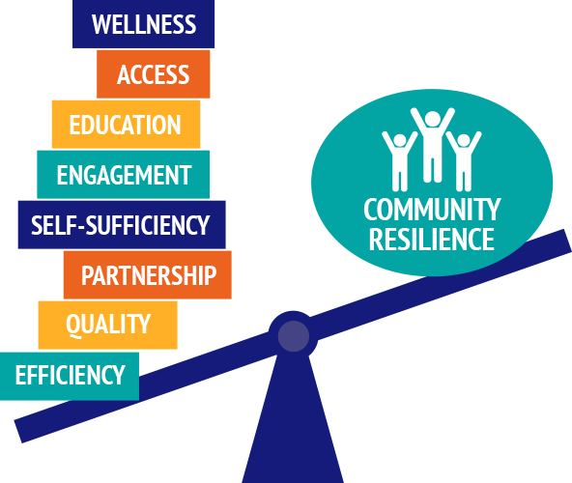
What is Resilience?
“The ability to bounce forward; absorb, recover and get better in the face of short-term shocks like hurricanes or infrastructure failures and long-term stressors like affordable housing, aging infrastructure, shifting economic trends and climate change ”.
Sources: East Central Florida Regional Resilience Collaborative Strategic Resilience Action Plan (2021), Institute for Security Studies and Development- North Macedonia

Slide 12
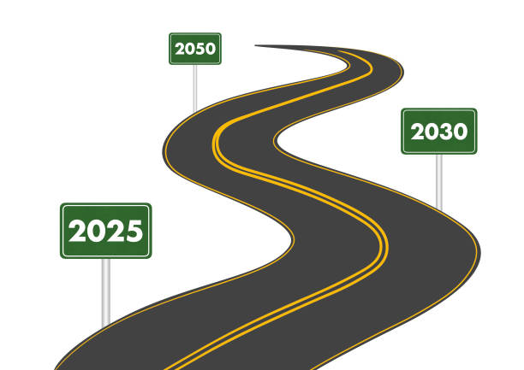
What is Sustainability?
Meeting the needs of the present without compromising the ability of future generations to meet their own needs.
Source: United Nations Brundtland Commission (1987)

Slide 13
Common Terms
Coastal Flooding
Flooding which occurs when water is driven onto land from an adjacent body of water.
Storm Surge
An abnormal rise of water generated by a storm over and above the predicted astronomical (regular) tides.
Flash Flood
A flood caused by heavy or excessive rainfall in a short period of time, generally less than 6 hours.
Stormwater Runoff
Occurs when precipitation flows over land or impervious surfaces and does not penetrate the ground.
King Tide
The highest predicted high tide of the year at a costal location.
Sea Level Rise
An observed increase in the average local sea level or global sea level trend.

Slide 14
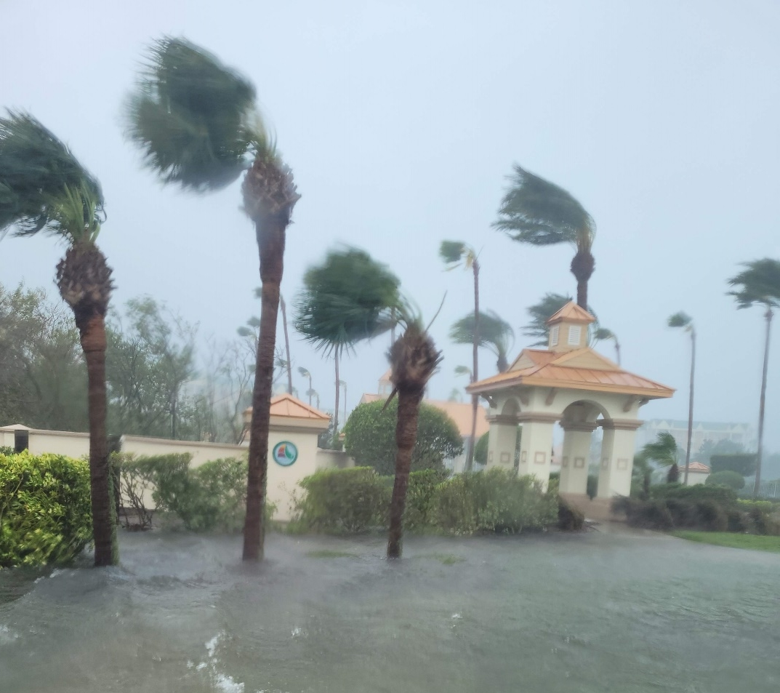
What is Adaptation Planning?
Section 380.093 F.S.
A coordinated approach to maximize the benefit of efforts to address flooding impacts and improve the State’s resilience to flooding and sea level rise.
Establishes the Resilient Florida Program
Includes a Statewide Resilience Plan
Includes a Comprehensive Statewide Flood Vulnerability and Sea Level Rise Dataset Report
Provides requirements for local vulnerability assessments to ensure a cohesive planning process for future inclusion in the Statewide Resilience Plan.
Climate Adaptation is the “adjustment of human and environmental behaviors, interactions, and systems to better respond to and reduce the impacts of climate change”.
Sources: Climate Smart Florida

Slide 15
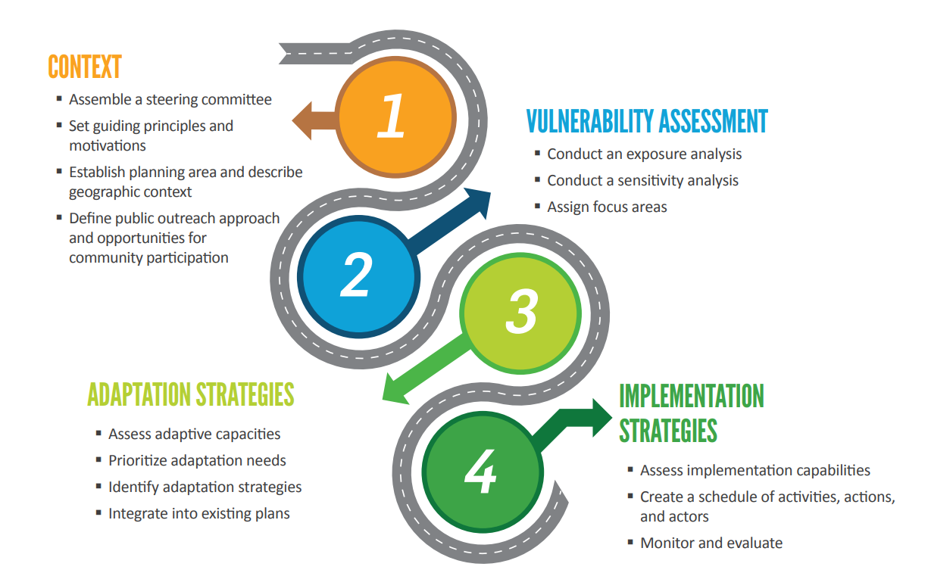
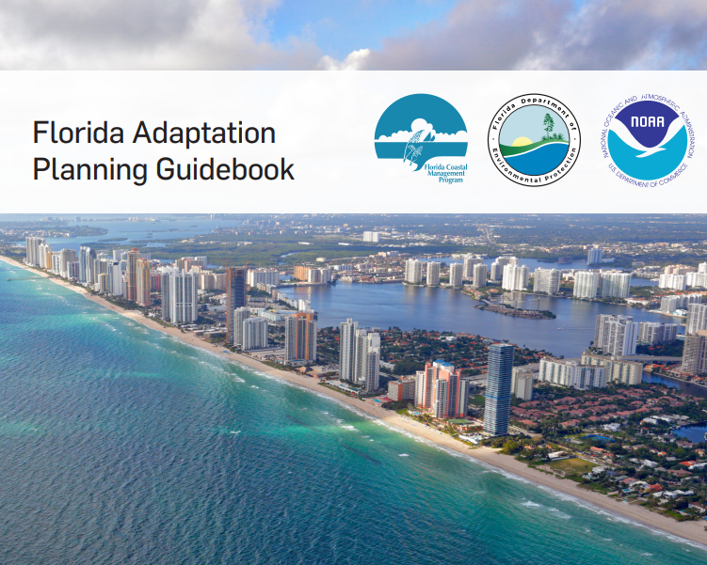
Components of Adaptation Planning
Florida Adaptation Planning Guidebook, 2018

Slide 16
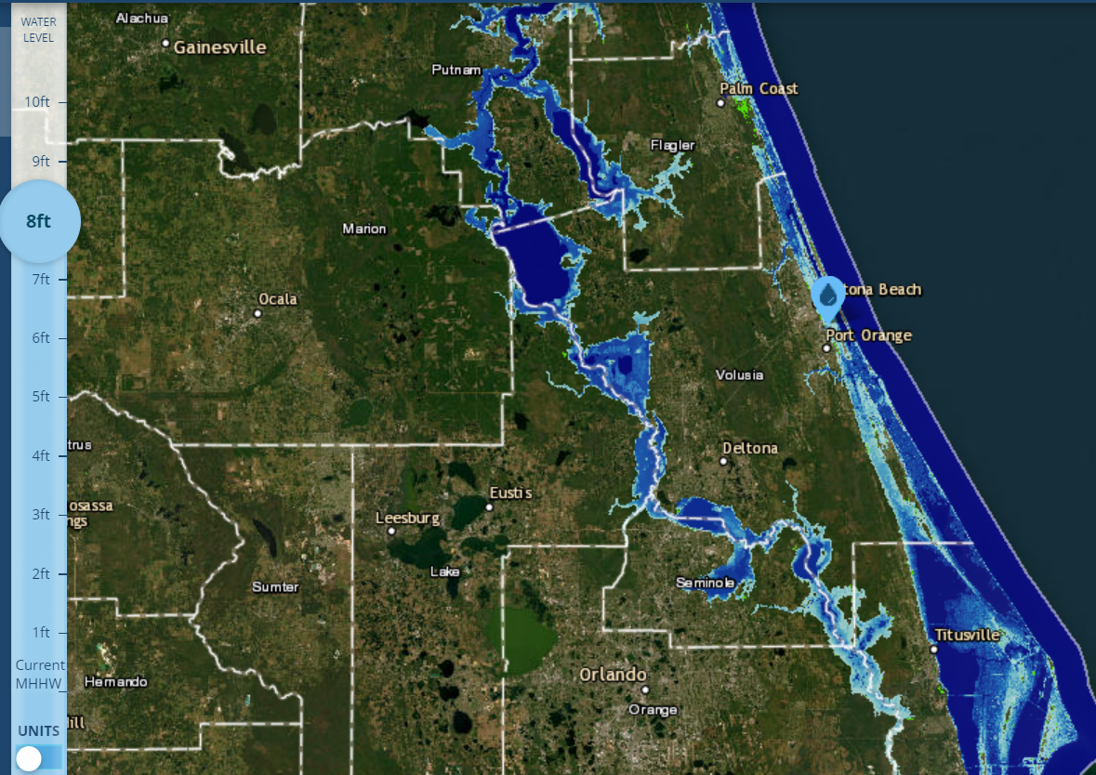
Benefits of Adaptation Planning
Sea level rise has the potential to alter a variety of key Florida industries:
Ocean tourism
Recreation
Water transportation
Marine
Fishing/living resources
To maximize returns and benefits, Florida communities are considering the impacts of sea level rise on coastal infrastructure and environments.
Sea level rise affects the safety and well-being of the community in many ways:
Halting local business/economy.
Damaging homes/apartments/roadways.
Eroding coastlines and natural flood buffers.
NOAA SLR Viewer

Slide 17
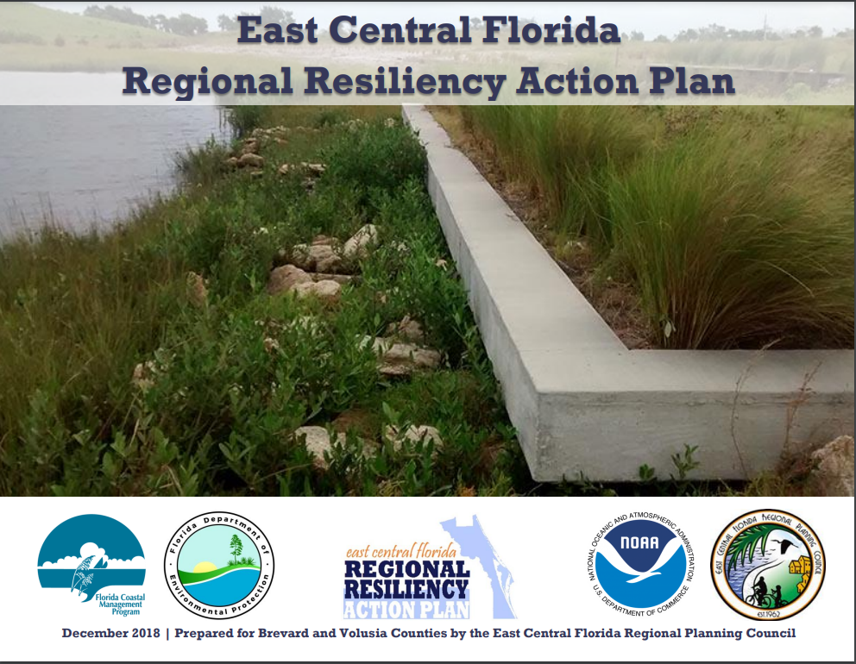
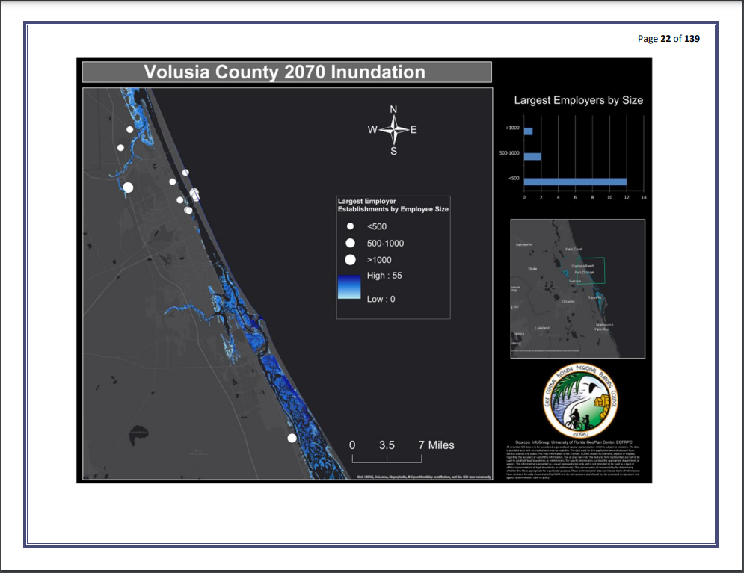
Example: East Central Florida Regional Resiliency Action Plan
Regional, coordinated approach to identify potential risks to infrastructure, plan for future land uses, and determine appropriate mitigation and adaptation measures to reduce flood risk.
Matrix of actions for all levels of government and non-governmental organizations.
Actions focus on infrastructure, health, planning, emergency preparedness, etc.
Goals focus on:
  Leadership and Strategy
  Economic and Society
  Infrastructure and Environment
  Health and Well Being
East Central Florida Regional Resiliency Action Plan (RRAP), 2017

Slide 18
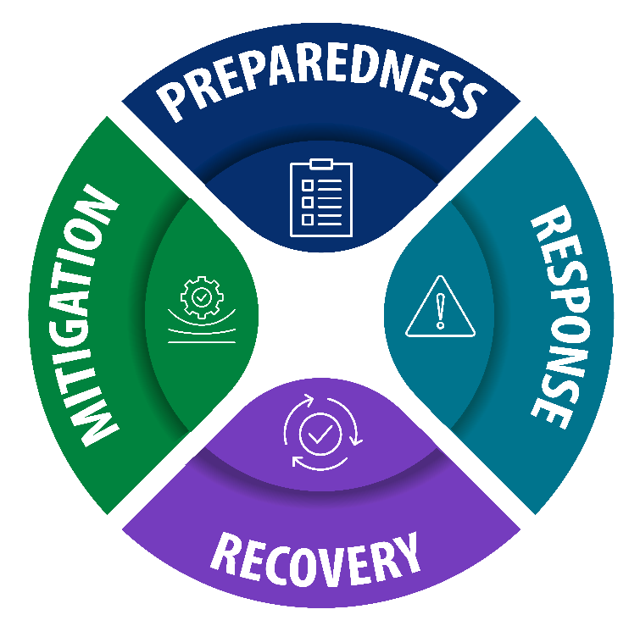
What is Hazard Mitigation?
Hazard mitigation is a sustained action taken to reduce or eliminate long-term risk to life and property from a hazard event.
Hazard mitigation planning refers to the process for identifying community vulnerabilities and risk and then developing long-term strategies for protecting people and property from similar events.
In Florida, Hazard Mitigation Plans are referred to as the ‘Local Mitigation Strategy’.
Event

Slide 19
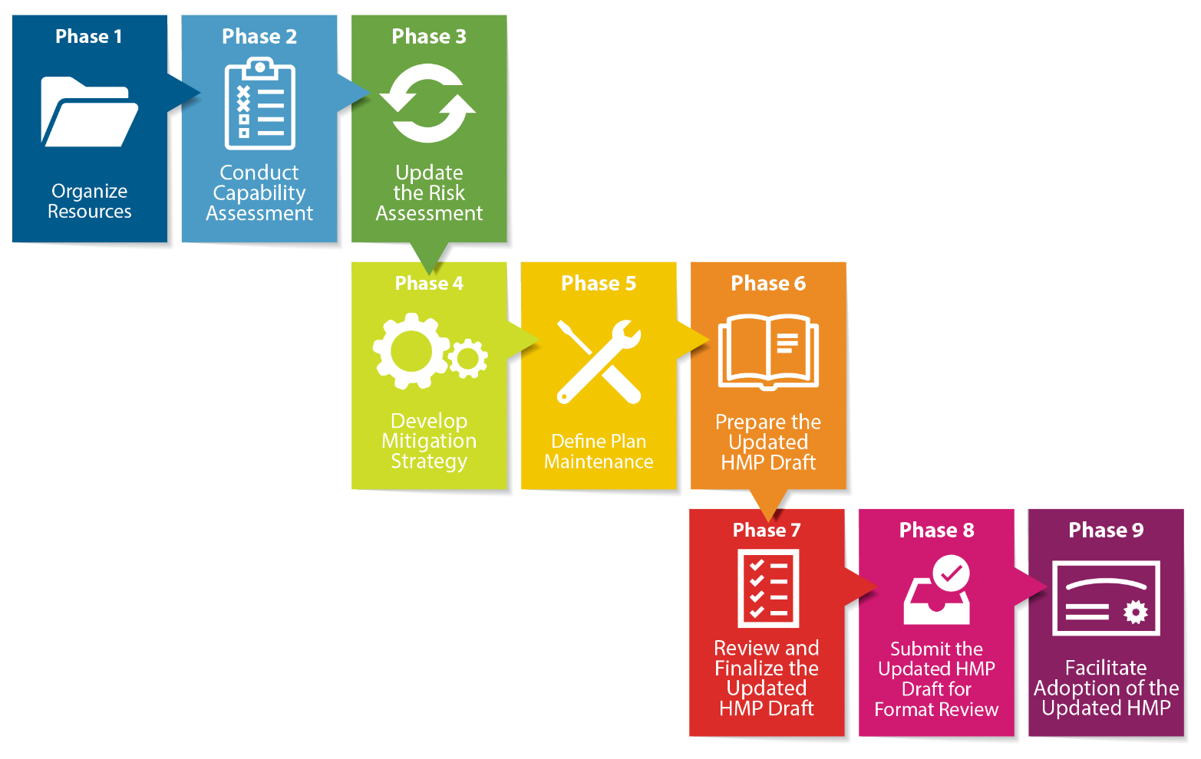
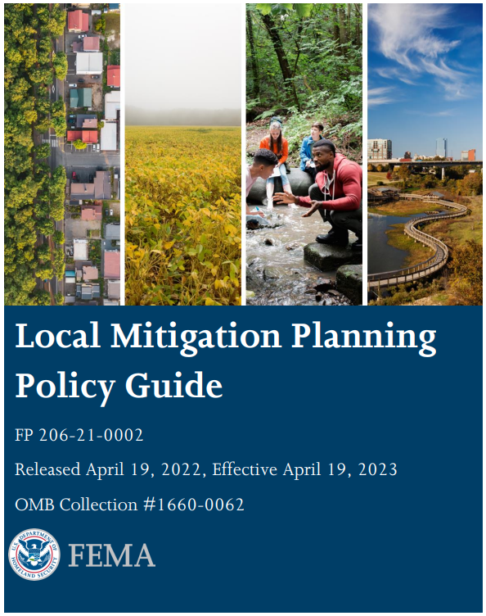
Components of a Local Mitigation Strategy
FEMA Local Mitigation Planning Policy Guide, 2023

Slide 20
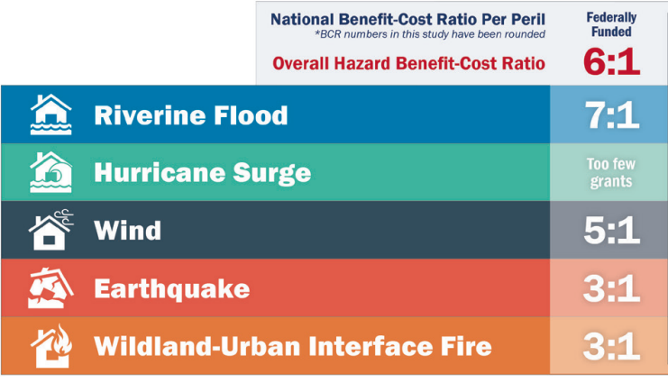
Benefits of the Local Mitigation Strategy
Economy: Communities can save $6 for every $1 spent on average to mitigate hazard impacts.
  Florida can save up to $100 million.
Safety: Reduces and/or eliminates long-term risk to life.
Partnerships: Promotes community engagement and collaboration.
Source: National Institute of Building Sciences
Sources: National Institute of Building Sciences

Slide 21
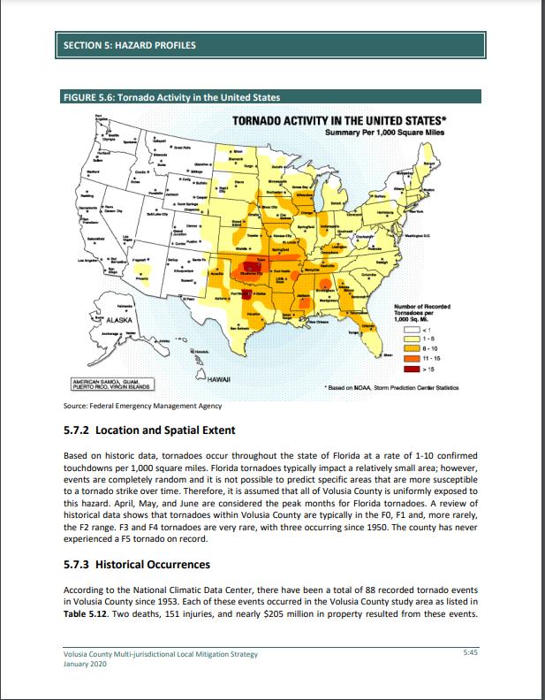
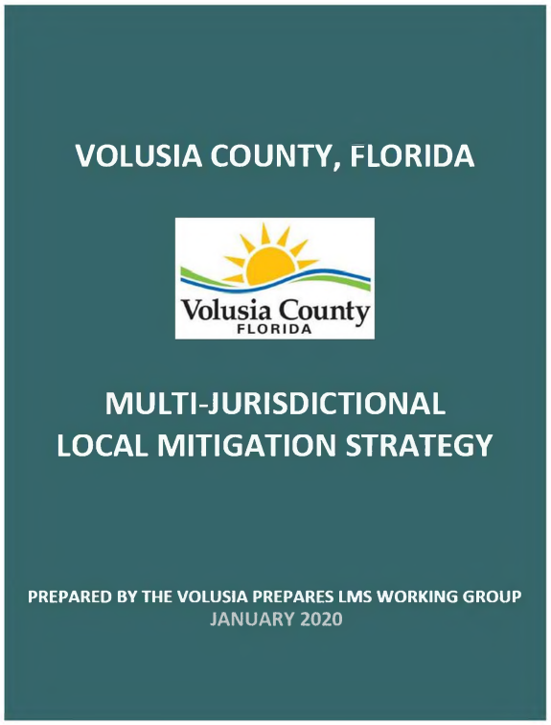
Example: Volusia County Multi-Jurisdictional Local Mitigation Strategy
Hazards Addressed:
  Atmospheric (hail, tropical storm, tornado)
  Hydrologic (coastal erosion, drought, flood)
  Geologic (sinkhole, Tsunami)
  Human-Caused (cyber attack, oil spill, agricultural infestation)
Goals focus on:
  Building capabilities and partnerships
  Strengthening emergency response and recovery
  Protecting public safety
  Ensuring economic vitality
  Increasing property protection
  Increasing public education
Multi-Jurisdictional Local Mitigation Strategy, 2020

Slide 22
Adaptation vs. Mitigation
Adaptation
  Anticipating the possible consequences/impacts of climate change.
  Actively taking steps to build resilience in human, natural, economic, and cultural systems.
  Assumes a long timeframe for impact, and therefore a longer timeframe for implementation.
Mitigation
  Actions to reduce and/or slow climate change impacts.
  Prioritizes actions related to planning/regulations, structures/infrastructure, natural systems, and education/awareness.
  Often planning for a shorter timeframe of 5-years.

Slide 23
Volusia Resilience Jeopardy
Jeopardy

Slide 24
Adaptation and Resilience Planning in Florida

Slide 25
Adaptation Planning in Volusia County
Current
Resilient Volusia County Phase 2 – Adaptation Action Plan Areas (2021)
Resilient Volusia County Phase 1 (2017)
East Central Florida Regional Resiliency Action Plan (RRAP) (2017)
Upcoming
Countywide Vulnerability Assessment
Vulnerability Assessment and/or Adaptation plans for the following cities:
  New Smyrna Beach
  Edgewater
  Daytona Beach Shores
  Deland
  Orange City
  DeBary
  Holly Hill
  Ormond Beach
  Town of Ponce Inlet

Slide 26
Planning in Volusia County

Slide 27
Vulnerability Assessments for Adaptation Planning
Exposure Analysis: Identifies baseline risk and allows the community to understand risk through spatial extent and level of exposure.
Sensitivity Analysis: An inventory of community assets (populations, structures, economic functions) and quantifies/measures the impacts of sea level rise on those assets.
Exposure Analysis
Sensitivity Analysis
Vulnerability
Assessment
How wet will it get?
What will get wet?
Helps a community determine which structural and social assets are likely to be impacted by future coastal flooding and sea level rise.

Slide 28

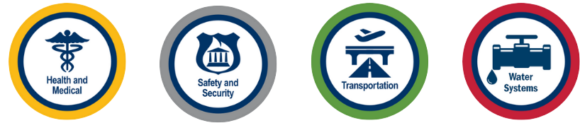
Exposure: What will get wet?
Critical Assets: Community assets that are essential for critical government and business functions, national security, public health and safety, the economy, flood and storm protection, water quality management, and wildlife habitat management.
Regionally Significant Assets: Critical assets that support the needs of communities spanning multiple geopolitical jurisdictions, including, nut not limited to, water resource facilities, regional medical centers, emergency operation centers, regional utilities, major transportation hubs and corridors, airports, and seaports.

Slide 29

What assets in the community are most important to you?
ⓘ Start presenting to display the poll results on this slide.

Slide 30
Potential Impacts
Transportation
Transportation assets and evacuation routes.
Natural, Cultural, & Historical Resources
Greenspace, historical preservation, state parks.
Critical Infrastructure
Wastewater facilities, utilities, communication towers.
Regionally Significant Assets
Major transportation hubs and corridors, airports/seaports, regional utilities, regional medical centers, emergency operation centers.
Critical Community & Emergency Facilities
Community center, library, fire station, hospital.
Population
Children, Older Adults, Individuals with Disabilities, Economically Disadvantaged.

Slide 31
Types of Adaptation Strategies
Protection
Structurally defensive measures that directly protect vulnerable structures allowing them to be left largely unaltered.
Accommodation
Alter physical design of vulnerable structures to allow the structure or land use to stay in place with modification
Retreat
Retreat from areas or infrastructure where protection or accommodation will not be efficient or effective; can be voluntary, incentivized, or done gradually.
Avoidance
Guiding new development away from areas that are subject to coastal hazards and can be done by implementing policy and/or offering of incentives.

Slide 32

What type of adaptation strategies would you prefer?
ⓘ Start presenting to display the poll results on this slide.

Slide 33
Breakout Session: Overcoming Barriers

Slide 34

Breakout Group Discussion Questions
What specific climate-related hazards are you most concerned about? Why?
What existing efforts to address these impacts have worked well? What has not worked?
What role do you think the County plays in addressing these impacts?
  What actions can the County take to reduce or eliminate impacts for climate-related hazards?
What benefits do you see with supporting adaptation strategies? What drawbacks do you see?

Slide 35
Looking Ahead

Slide 36
Looking Ahead

Slide 37
Available Tools and Resources
NOAA’s CanVis
Creates photo-realistic simulations for visualizing the potential impacts from coastal development and sea level rise.
NOAA’s Sea Level Trends
Illustrates regional trends in sea level with arrows representing the direction and magnitude of change.
University of South Carolina’s Social Vulnerability Index (SoVI)
Measures the social vulnerability of U.S. counties and census tracts to environmental hazards, including sea level rise.
NOAA’s Climate Data Online
Provides free access to historic weather and climate data in addition to station history information. Includes daily, monthly, seasonal, and yearly measurements.

Slide 38
Available Tools and Resources
FEMA’s National Risk Index (NRI)
FDEP’s Office of Resilience and Coastal Protection
An online tool that illustrates communities across the U.S. most at risk to 18 different natural hazards. Factors for social vulnerability and community resilience are included.
Provides a multitude of resources to assist with preparing the State’s coastal communities and state-managed lands for the effects of sea level rise, coastal flooding, erosion, and storms.
East Central Florida Regional Planning Council
Aids communities to adapt to natural hazards; conducts vulnerability assessments, maps coastal risk scenarios, and develops strategies for long-range solutions.
Peril of Flood: Florida’s Coastal Resiliency Portal
Resource hub showcasing success stories, resources, and information regarding coastal resiliency in Florida.

Slide 39
Workshop Survey

Slide 40
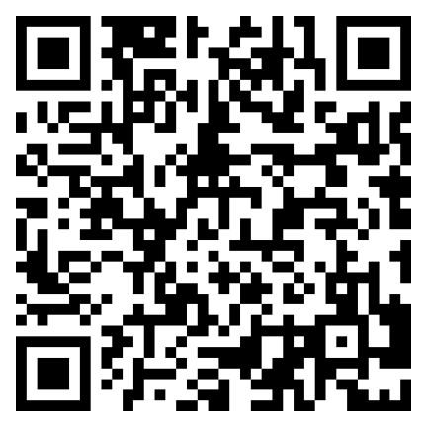
Post-Workshop Survey
Please take 5 minutes to take the survey. Scan the QR code to the right.

Slide 41
Next Steps
Be on the lookout for emails regarding the next workshop!

Slide 42
Questions?

Slide 43
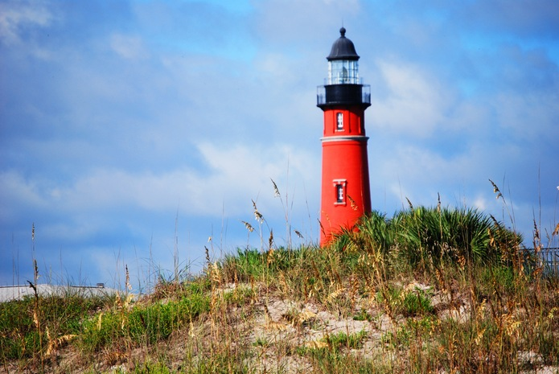
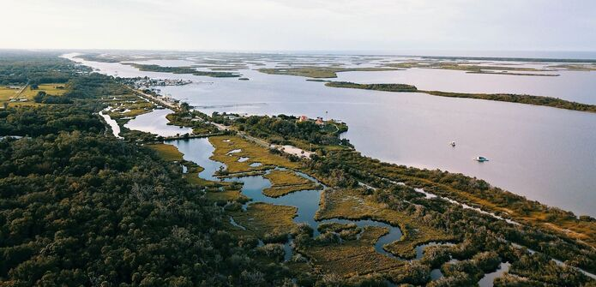
Contact information
123 W. Indiana Ave
DeLand, FL 32720
(386) 736-2700

