Slide 1
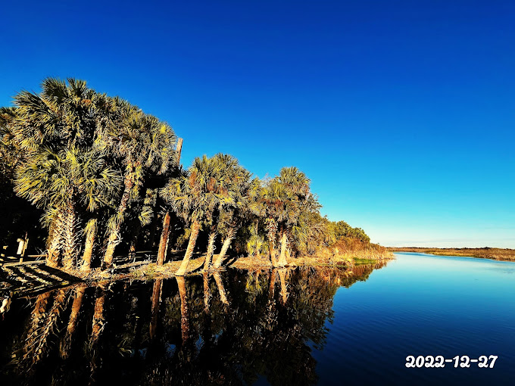
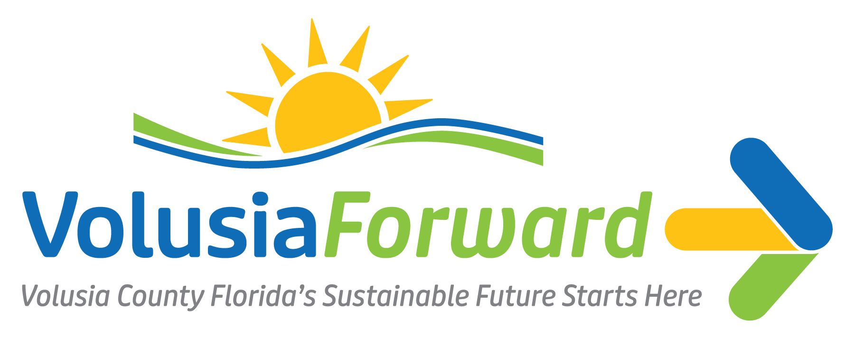
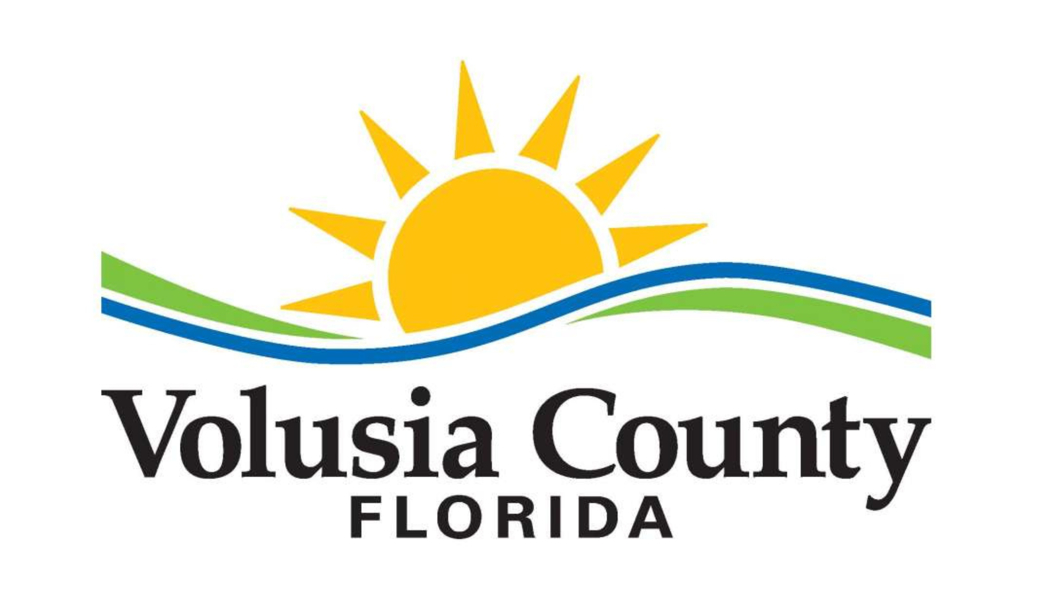

Understanding Risk and Vulnerability for Community Members
Building Sustainable Communities
April 22, 2024
6:00 p.m. – 8:00 p.m.

Slide 2

Project Team
Ginger Adair
Volusia County
Environmental Management Director
Samantha West
Volusia County
Sustainability and Resilience Manager
Sergeneno Rankin
Volusia County
Sustainability and Outreach Coordinator
JaLeesa Tate, CFM
Tetra Tech
Senior Community Resilience Planner
Victoria Colon
Tetra Tech
Emergency Management Specialist
Grace Altenburg
Tetra Tech
Resilience and Climate Adaptation Planner

Slide 3
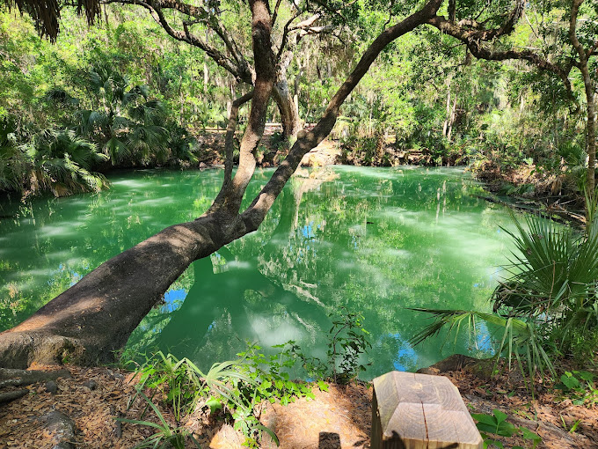

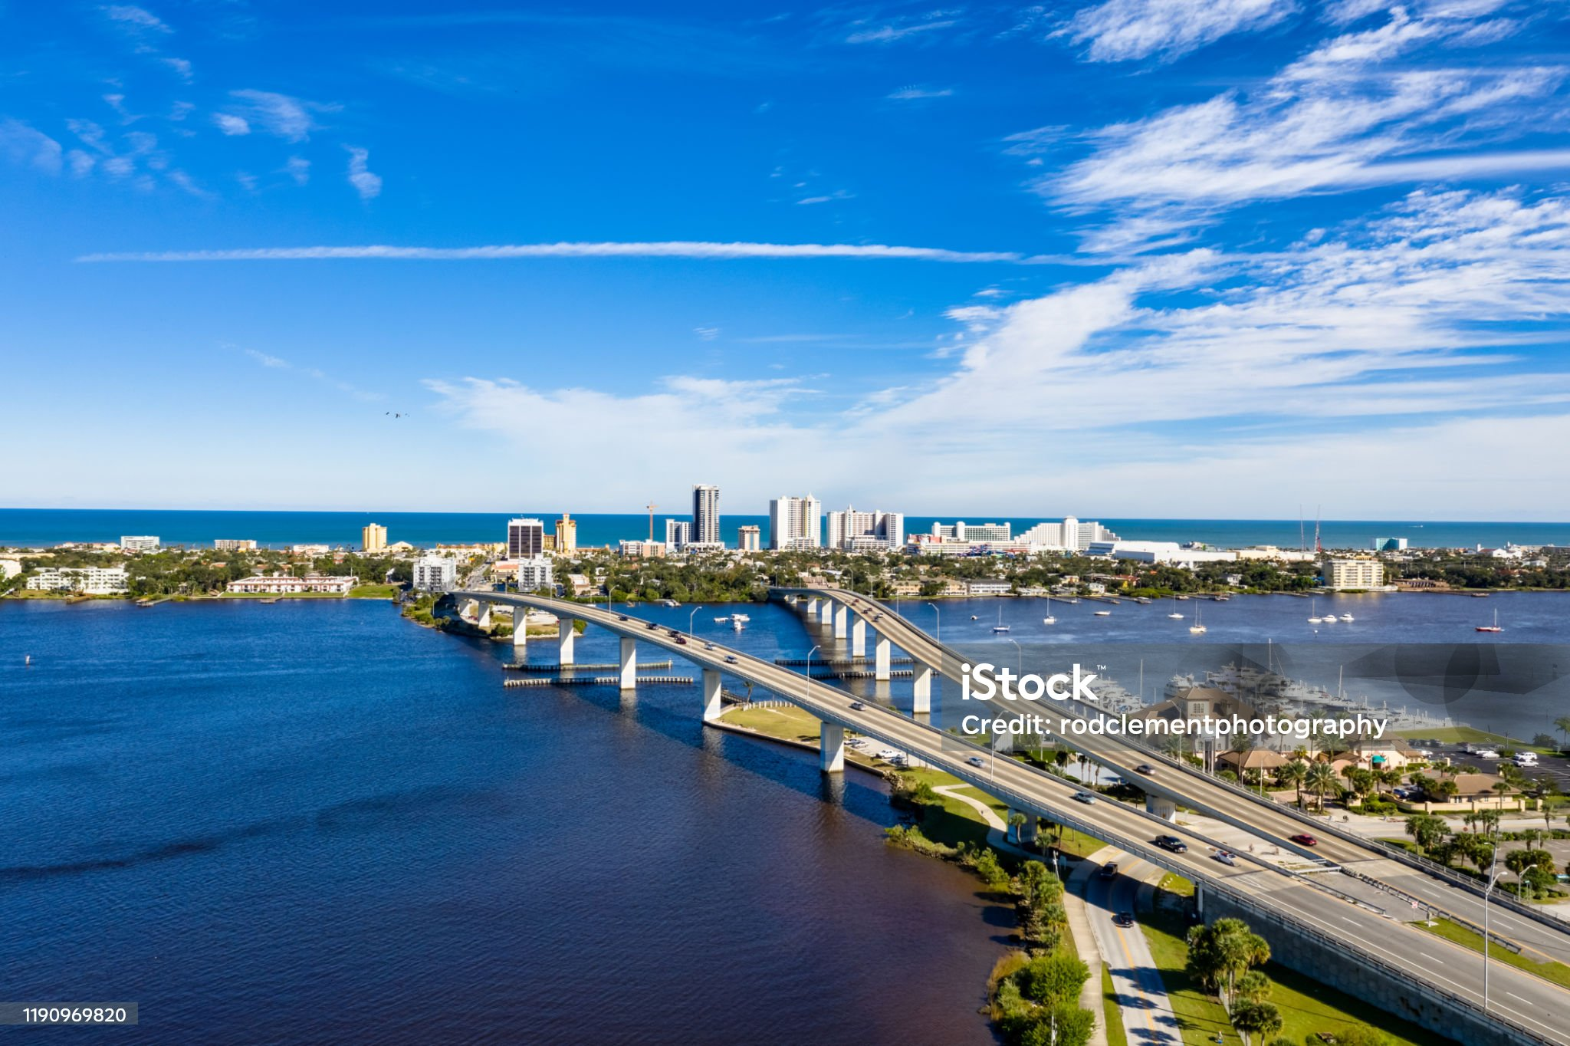
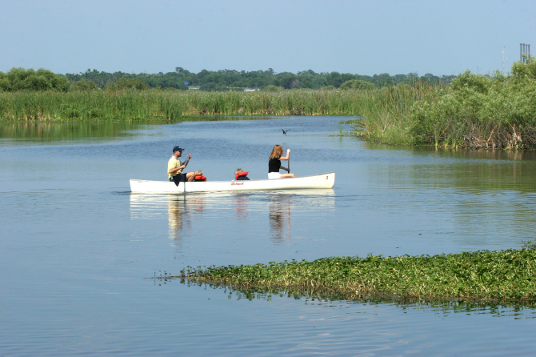
Building Sustainable Communities
Purpose: To equip community members with data and information to understand the current and future risk posed by flooding, storm surge, and sea level rise in Volusia County.
Goal: To build community resilience through peer-to-peer storytelling to learn how neighbors are preparing, adapting, and overcoming challenges and obstacles as risk evolves.

Slide 4
Agenda
Refresher of Risk and Vulnerability
Understanding Impacts to Community Assets
Navigating Future Floods: Mapping Community Assets Identified During Hurricanes Nicole and Ian
Identifying Adaptation Strategies
Moving Forward

Slide 5
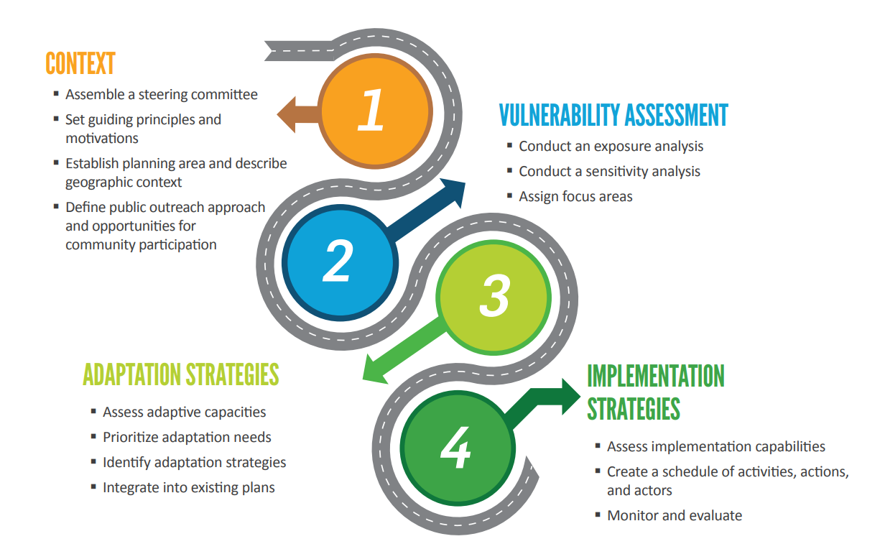
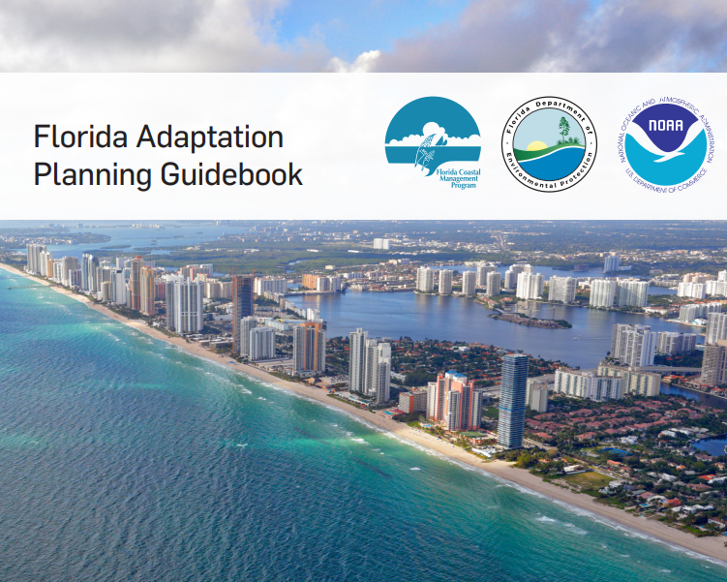
Adaptation Planning Refresher
Florida Adaptation Planning Guidebook, 2018

Slide 6
Vulnerability Assessments for Adaptation Planning
Exposure Analysis: Identifies baseline risk and allows the community to understand risk through spatial extent and level of exposure.
Sensitivity Analysis: An inventory of community assets (populations, structures, economic functions) and quantifies/measures the impacts of sea level rise on those assets.
Exposure Analysis
Sensitivity Analysis
What will get wet?
Identifies depth of flood waters
Vulnerability
Assessment
How wet will it get?
Identifies severity of flooding on assets
Helps a community determine which structural and social assets are likely to be impacted by future coastal flooding and sea level rise.

Slide 7

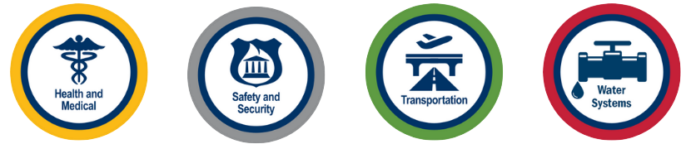
Exposure: What will get wet?
Critical Assets: Community assets that are essential for critical government and business functions, national security, public health and safety, the economy, flood and storm protection, water quality management, and wildlife habitat management.
Regionally Significant Assets: Critical assets that support the needs of communities spanning multiple geopolitical jurisdictions, including, nut not limited to, water resource facilities, regional medical centers, emergency operation centers, regional utilities, major transportation hubs and corridors, airports, and seaports.

Slide 8
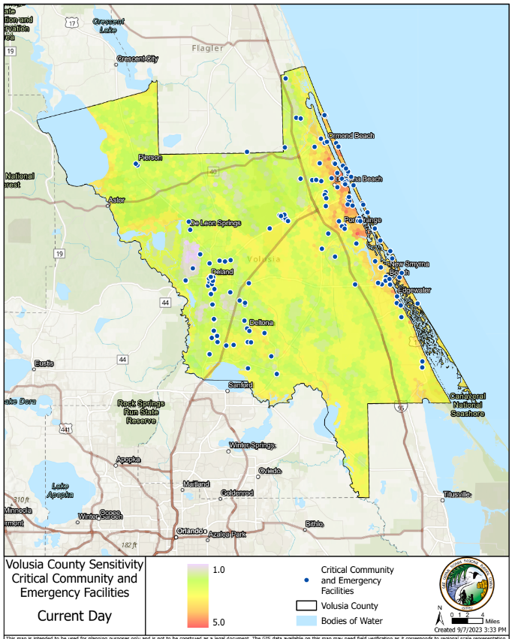
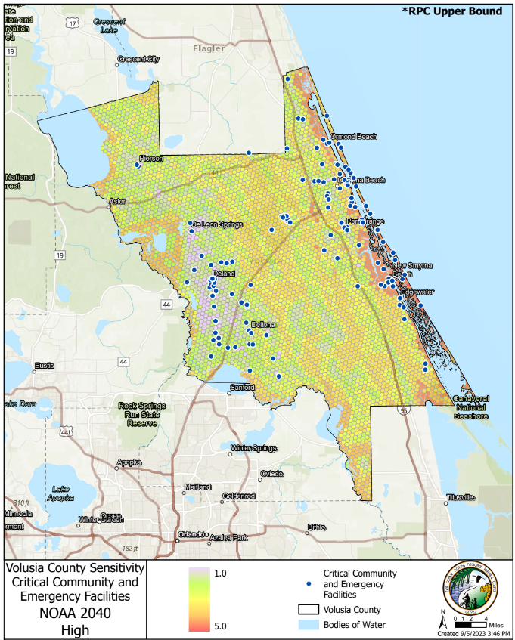
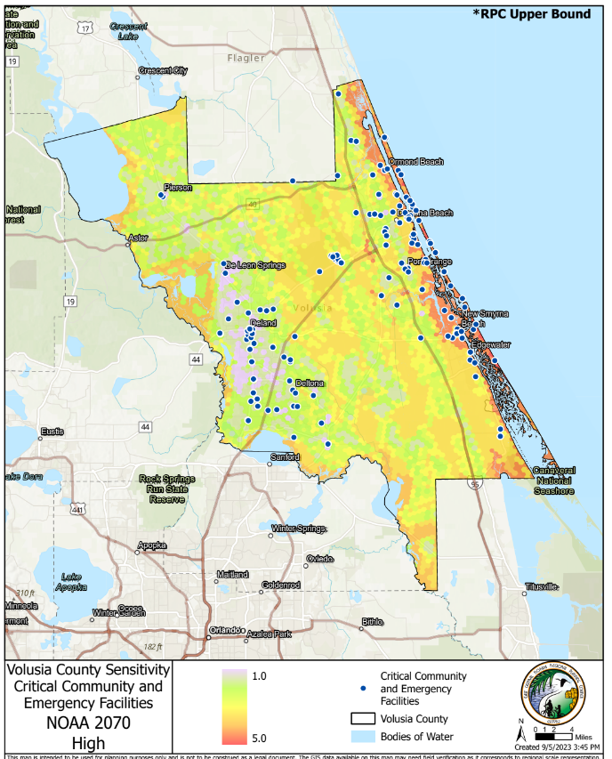
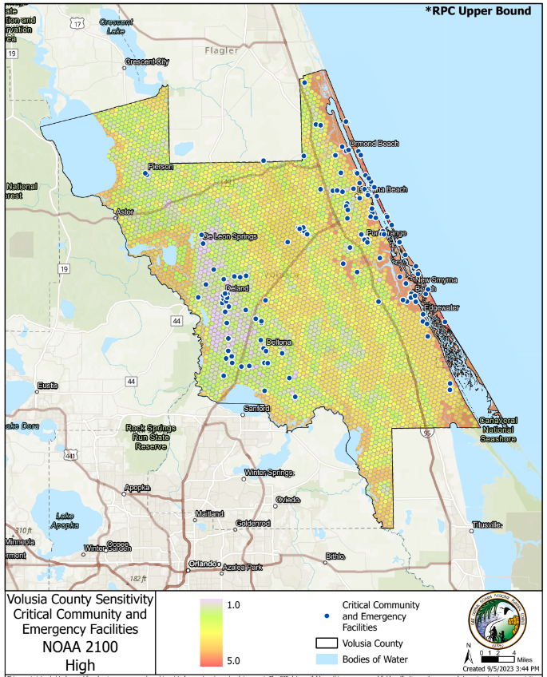
Sensitivity: How wet will it get?
Measurement of the impact of flooding on assets and the community’s dependence on these assets.
Includes factors to assess social vulnerability such as age and dependence, wealth, housing, employment, race, etc.
Current Day
2040
2070
2100

Slide 9
Understanding Impacts to Community Assets

Slide 10
Local Mitigation Strategy Risk Ranking
Snapshot of Volusia County Hazard Ranking:
Local Government | First | Second | Third
Daytona Beach | High Winds | Hail | Storm Surge, Tsunami
Daytona Beach Shores | All-Natural Hazards | Flooding | Storm Surge, Tsunami
DeBary | Flooding | High Winds | Lightning
DeLand | High Winds | Hail | Severe Winter Storm
Deltona | Lightning | Severe Winter Storm | Drought
Edgewater | Thunderstorm | Severe Winter Storm | Drought
Holly Hill | High Winds | Flooding | Drought
Volusia County LMS, 2020

Slide 11
Local Mitigation Strategy Risk Ranking (continued)
Local Mitigation Strategy Risk Ranking
Local Government | First | Second | Third
Lake Helen | High Winds | Flooding | Drought
New Smyrna Beach | High Winds | Flooding | Storm Surge
Oak Hill | Flooding | Flooding | Wildfire
Orange City | Lightning | High Winds | Drought
Ormond Beach | High Winds | Flooding | Storm Surge
Pierson | Wildfire | Wind | Drought
Ponce Inlet | High Winds | Storm Surge, Tsunami | Flooding
Port Orange | High Winds | Lightning | Severe Winter Storm
South Daytona | Flooding | Storm Surge, Tsunami | All-Natural Hazards
Unincorporated | High Winds | Flooding | Wildfire
Volusia County LMS, 2020

Slide 12
LMS Risk Analysis Results
The 2020 Local Mitigation Strategy results:
Flooding: most critical facilities that are located within a flood zone in the County are located within Flood Zone ‘A’. Most of the critical facility structures located within the 100‐year floodplain are in the County’s beachside communities. These include:
  Fire stations in New Smyrna Beach, Ponce Inlet, Daytona Beach Shores, Daytona Beach, and Ormond Beach.
  Hospitals at risk in low-lying areas in Orange City and DeLand.
  Maytown Road in Oak Hill to Osteen/Enterprise is not an evacuation route because of repeated flooding.
Coastal Flooding (Storm Surge):
Buildings at Risk | Cat. 1 Storm Surge | Cat. 3 Storm Surge | Cat. 5 Storm Surge
Total | 10,917 | 70,657 | 86,101
Sources: FDEM (Surge), Volusia County Property Appraiser Data (2019)
Sea Level Rise:
SLR NOAA “High Curve” Projection | Parcels in Zone | Assessed Value
2040 | 14, 953 | > $3.8 Billion
2070 | 31,053 | > $6.1 Billion
2100 | 79,120 | > $13 Billion
Sources: NOAA, UF GeoPlan Center, Volusia County Property Appraiser Data (2019) – Some parcels were not provided a land use code by VCPAO

Slide 13
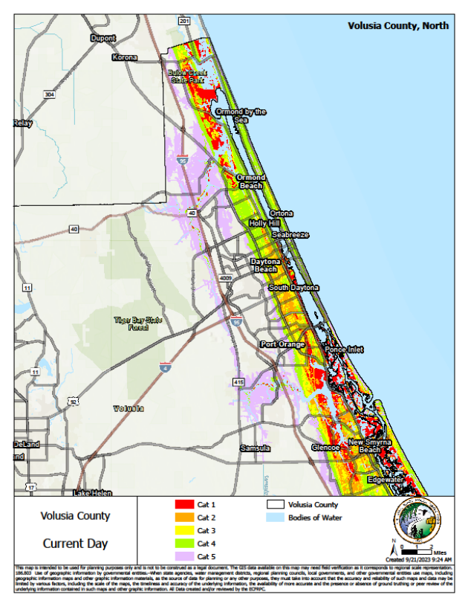
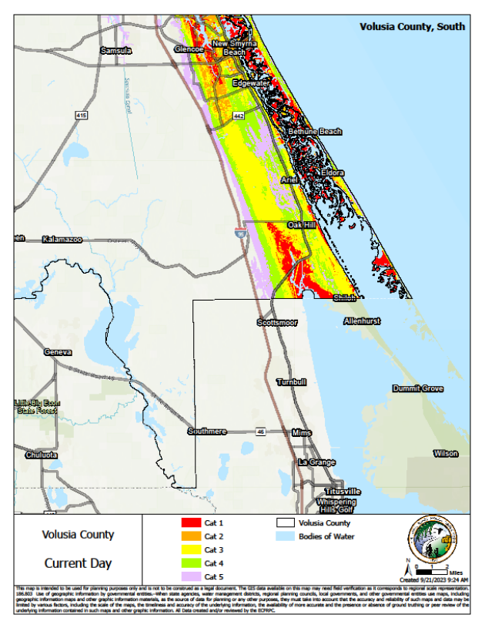
Hazards Addressed in Adaptation Plans (380.093, F.S)
Inland Flooding
Rainfall-induced Flooding
Compound Flooding
Coastal Flooding
Tidal Flooding (high tide flooding)
Storm Surge
Sea Level Rise
Increase in the average local sea level or global sea level trend
ECFRP, Volusia County North Storm Surge, 2023
ECFRP, Volusia County South Storm Surge, 2023
“Vulnerability assessments that identify or address risks of inland or coastal flooding and sea level rise” (Section 380.093, F.S.).

Slide 14
Adaptation Plan Vulnerability Assessment
The 2024 Volusia County Vulnerability Assessment (VA) uses two planning horizons:
2040 – short-term looking 20 years out
2070 – medium-term looking 50 years out
Datasets utilized for DRAFT 2024 Volusia County Vulnerability Assessment
Sea Level Rise: 2040 and 2070 NOAA intermediate-high and intermediate-low projections. Local SLR data is interpolated between the two closest NOAA tide gauges.
Storm Surge: Equal to and exceed the current 100-year (1% annual change flood) event.
Critical Assets: FDEM statewide critical facilities database
Social Vulnerability: University of Central Florida’s Social Vulnerability Index (SoVi)

Slide 15
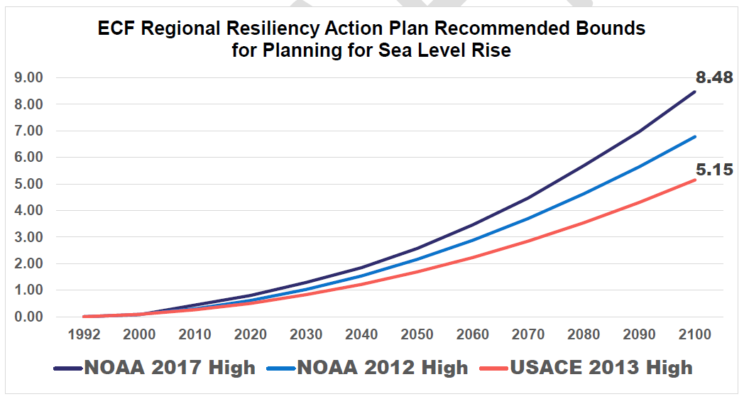
Sea Level Rise Projections Utilized for Adaptation Planning
 | 2040 | 2070 | 2100
NOAA (2017) Intermediate Low (not shown) | 0.73 | 1.29 | 1.75
USACE (2017) High | 1.22 | 2.85 | 5.15
NOAA (2017) Intermediate High (not shown) | 1.48 | 3.35 | 6.08
NOAA (2017) High | 1.85 | 4.47 | 8.48
Medium-term planning horizon
Short-term planning horizon
Long-term planning horizon

Slide 16
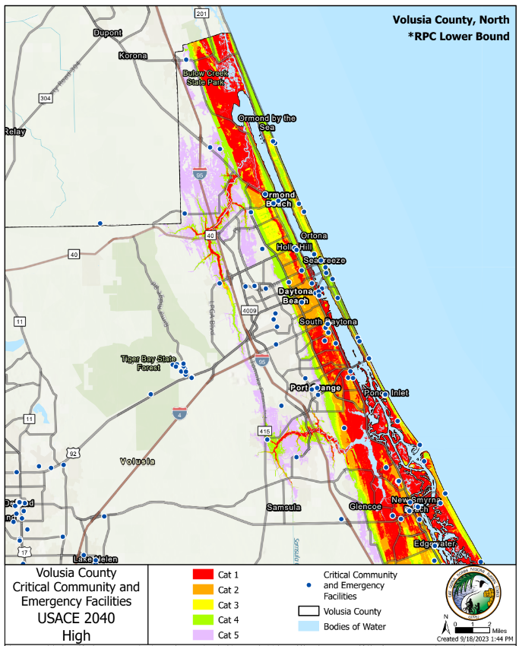
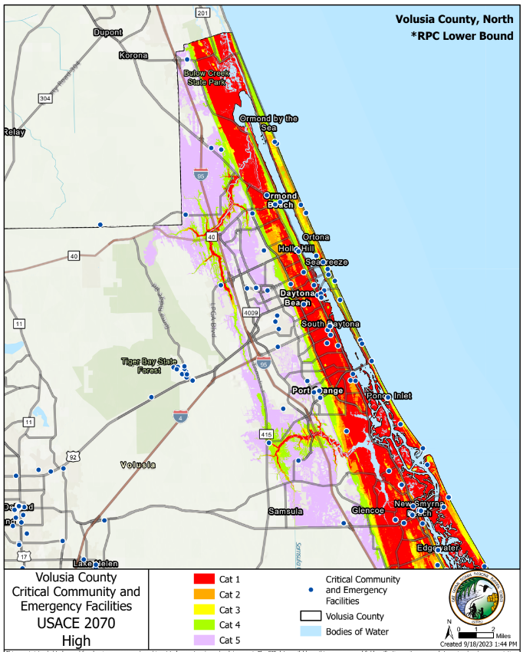
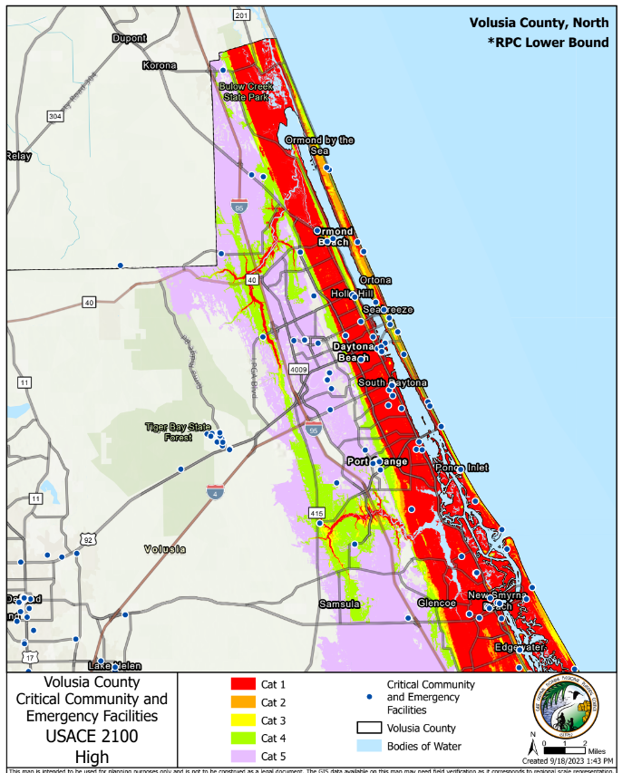



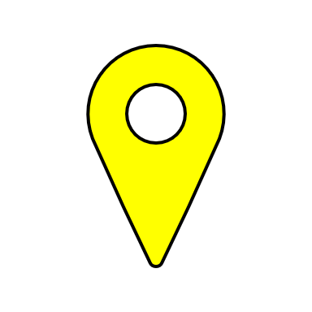
USACE “High Curve”: Recommended SRL projects to use locally for a “conservative” scenario
North
2040
1.22 ft increase
2070
2.85 ft increase
2100
5.15 ft increase
AdventHealth Ormond Beach
AdventHealth Ormond Beach
AdventHealth Ormond Beach
Halifax Hospital
Halifax Hospital
Halifax Hospital
AdventHealth New Smyrna Beach
AdventHealth New Smyrna Beach
AdventHealth New Smyrna Beach

Slide 17
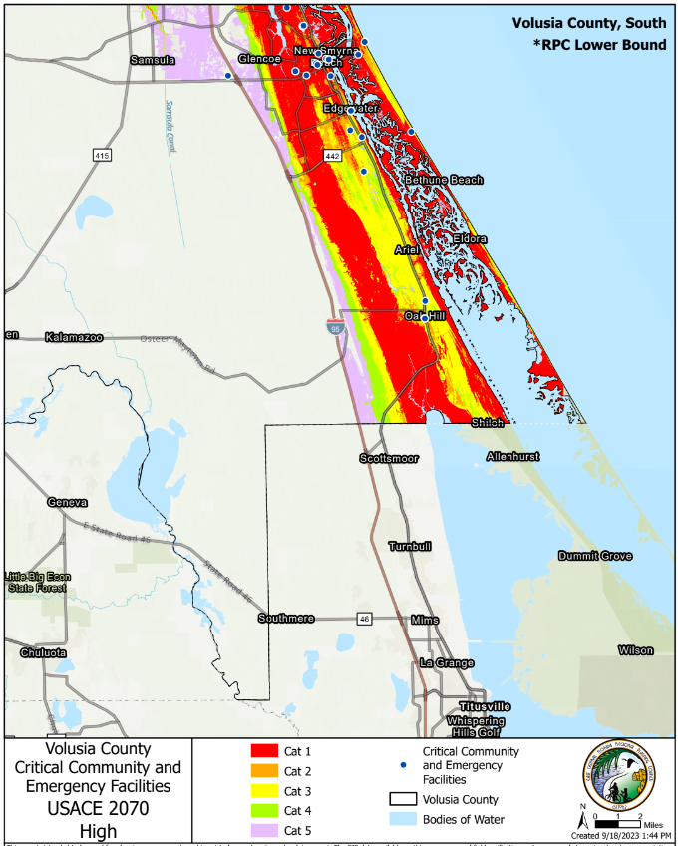
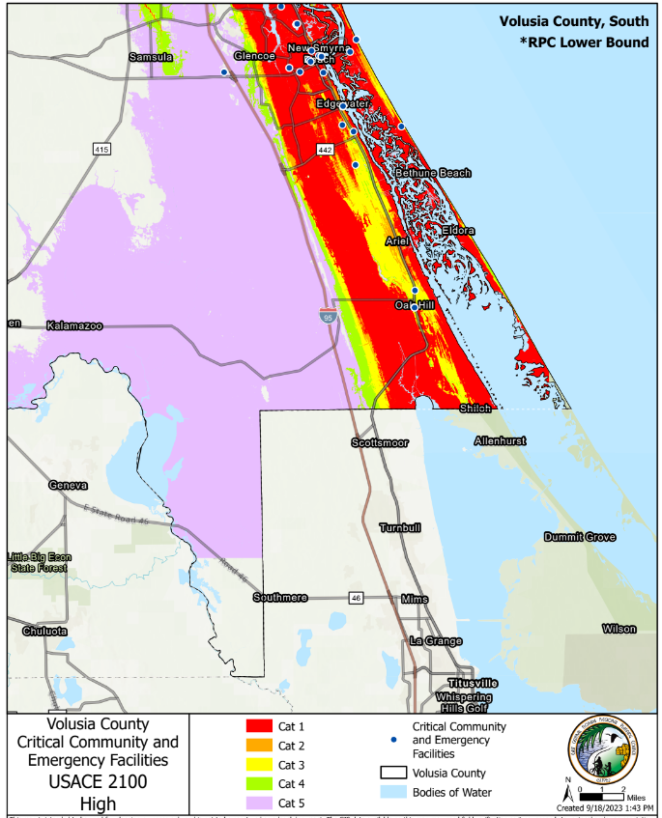
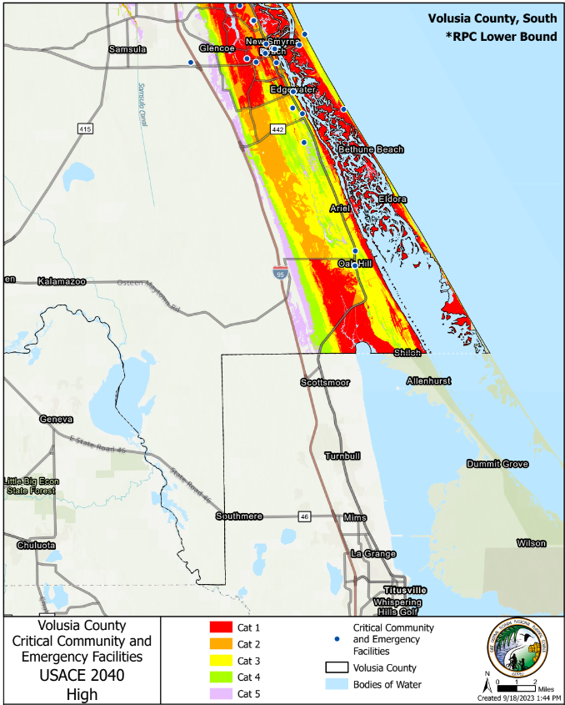
USACE “High Curve”: Recommended SRL projects to use locally for a “conservative” scenario
South
2040
1.22 ft increase
2070
2.85 ft increase
2100
5.15 ft increase
AdventHealth New Smyrna Beach
AdventHealth New Smyrna Beach
AdventHealth New Smyrna Beach

Slide 18
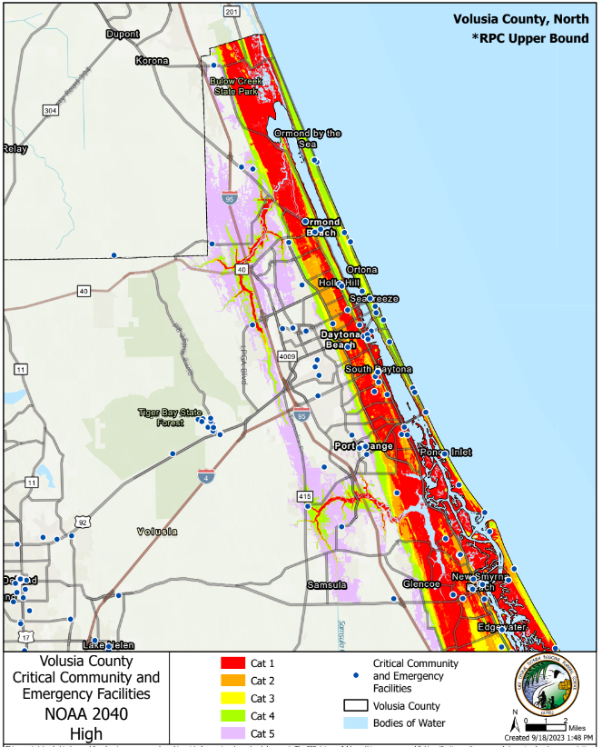
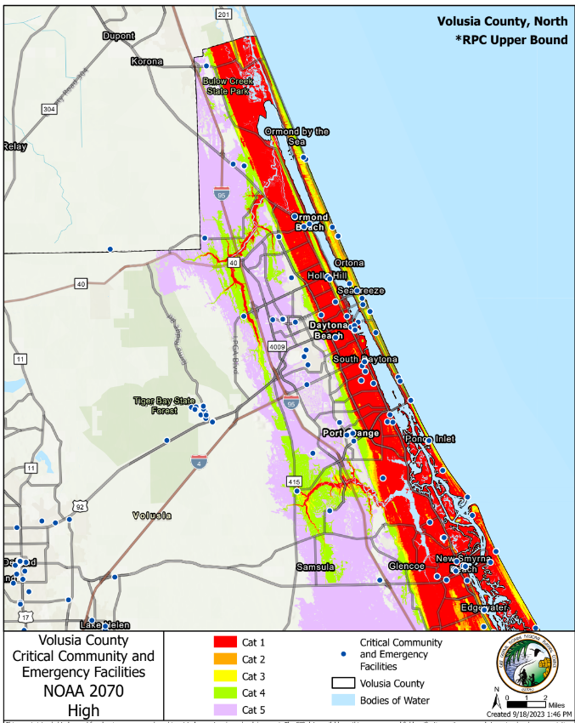
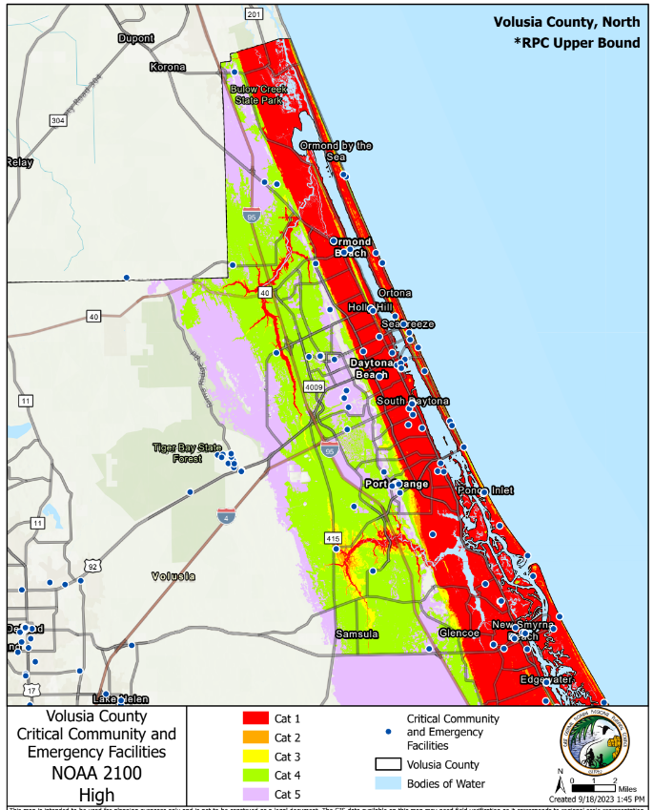
NOAA 2017 “High Curve”: Recommended SRL projects to use locally for a “high” scenario
North
2040
1.85 ft increase
2070
4.47 ft increase
2100
8.48 ft increase
AdventHealth Ormond Beach
AdventHealth Ormond Beach
AdventHealth Ormond Beach
Halifax Hospital
Halifax Hospital
Halifax Hospital
AdventHealth New Smyrna Beach
AdventHealth New Smyrna Beach
AdventHealth New Smyrna Beach

Slide 19
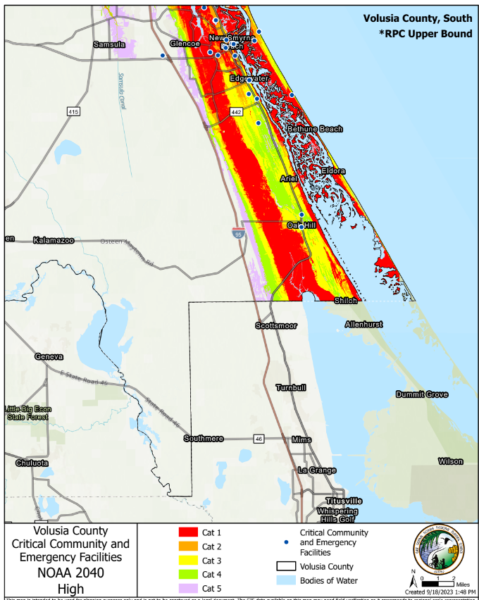
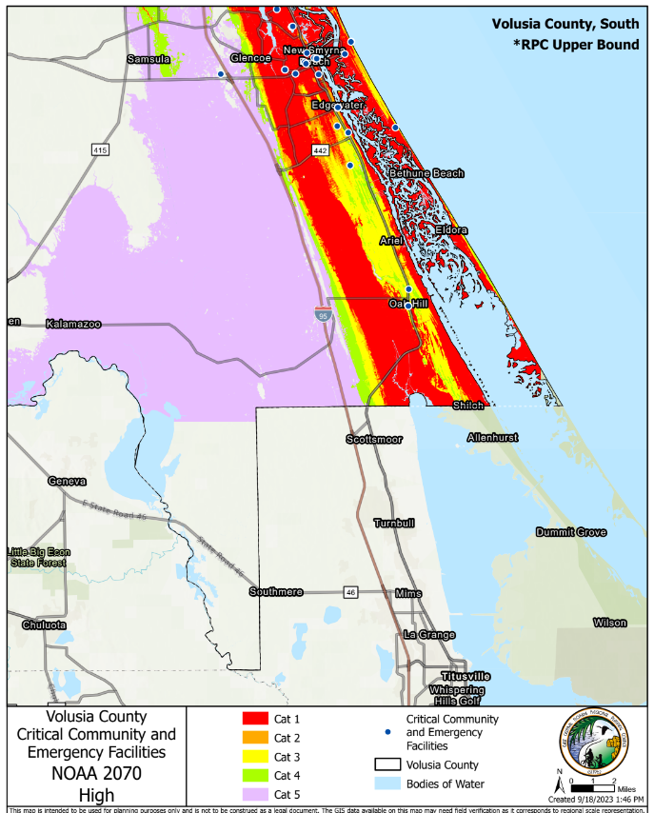
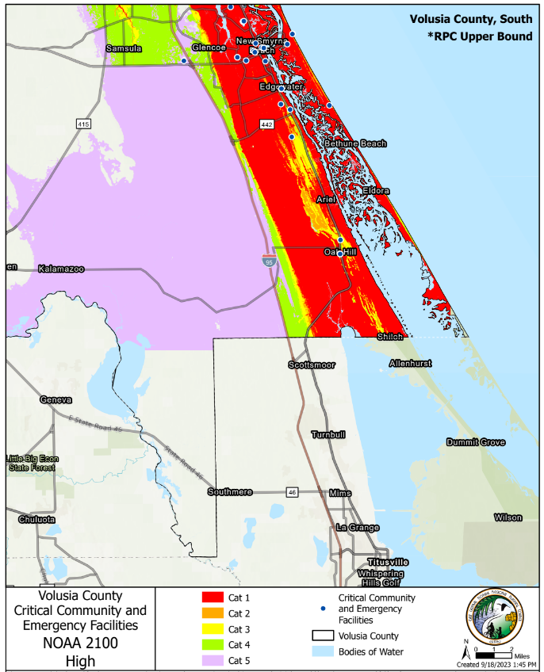
NOAA 2017 “High Curve”: Recommended SRL projects to use locally for a “high” scenario
South
2040
1.85 ft increase
2070
4.47 ft increase
2100
8.48 ft increase
AdventHealth New Smyrna Beach
AdventHealth New Smyrna Beach
AdventHealth New Smyrna Beach

Slide 20
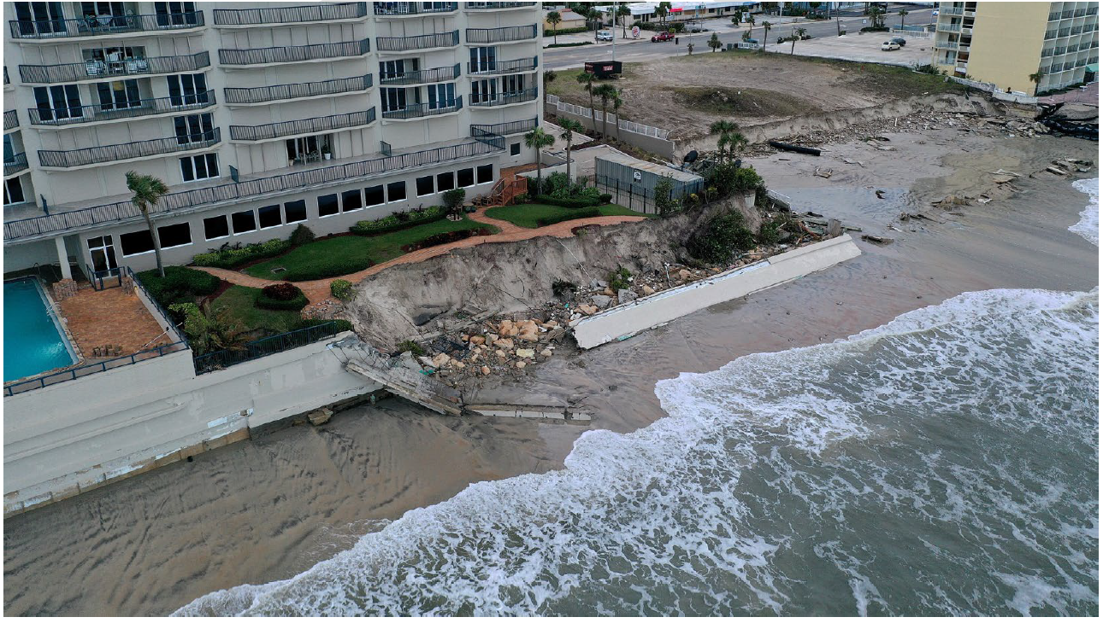
Critically Eroded Shoreline
A segment of the shoreline where natural processes or human activity have caused or contributed to erosion and recession of the beach or dune system to such a degree that upland development, recreational interests, wildlife habitat, or important cultural resources are threatened or lost.

Slide 21
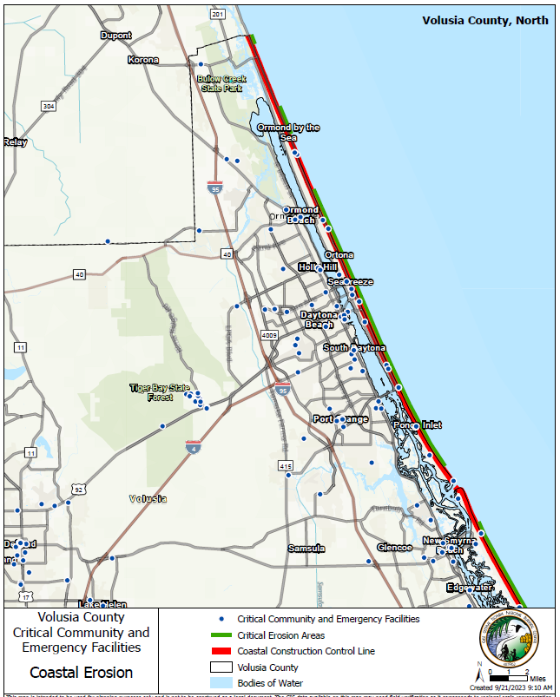
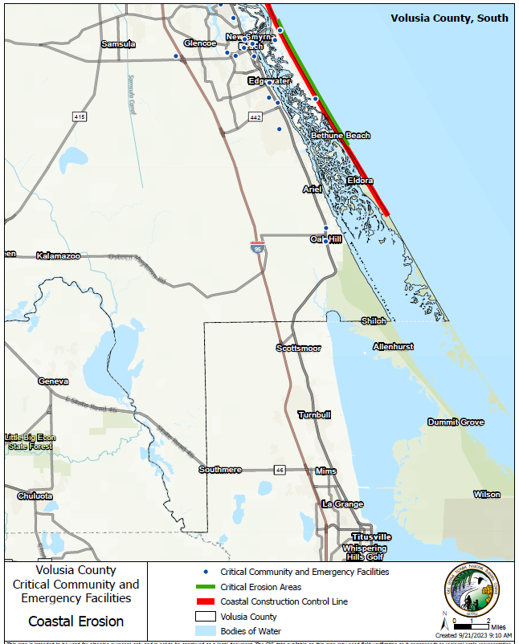
Critical facilities near erosion-prone areas

Slide 22
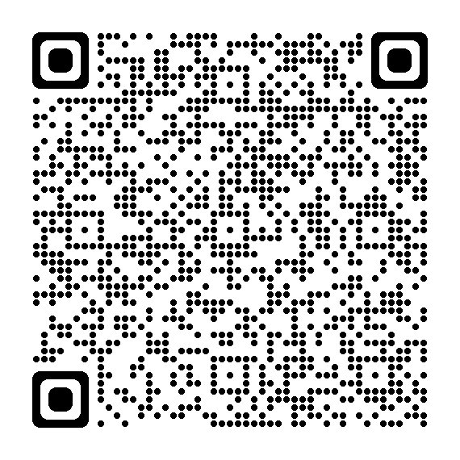
Adaptation Plan Vulnerability Assessment Results
Results are still being developed for the 2024 Volusia County Vulnerability Assessment report.
Once completed they will be available for download on the Volusia Forward webpage.

Slide 23
Navigating Future Floods: Mapping Community Assets Identified During Hurricanes Nicole and Ian

Slide 24

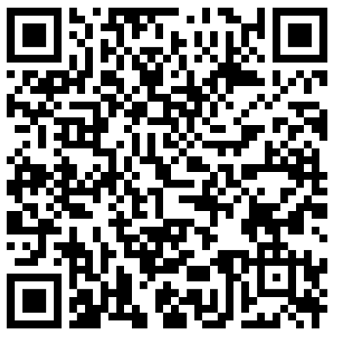
Mapping Activity Instructions
Let’s talk about…
What type of safety did you look for during Hurricanes Nicole and Ian?
What kinds of resources did you search for during Hurricanes Nicole and Ian?
What agency/organization supplied these resources/shelters?
Mark on the maps areas where you sought higher ground, sought shelter, or accessed resources during Hurricanes Nicole and Ian.
If you are joining us virtually, use the QR code to access the virtual map on your phone, or use the link provided in the chat to access the map on your computer.

Slide 25
Identifying Adaptation Strategies

Slide 26
Survey says….

Slide 27
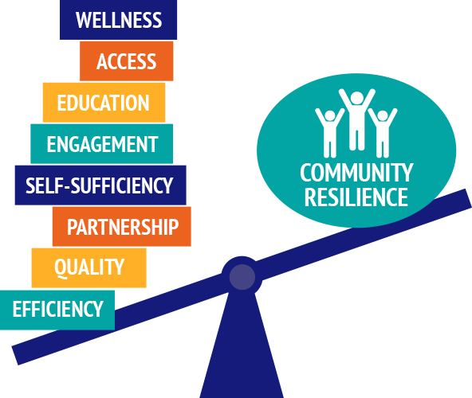
Community Concerns and Priorities
Prefer adaptation strategies that encourage avoidance and retreat.
Increased communication in plain language to communicate risk; build community-support.
New development must include considerations to avoid adverse impacts; stronger growth management; enforcement of coastal construction control line.
Decreasing green, open, and forested spaces.
Additional support is needed for stronger code enforcement.
Existing critical facilities are built in high-risk, hazard-prone areas.
Aging infrastructure.

Slide 28
Moving Forward

Slide 29
Methods for Protecting Your Home
Know Your Risk and Assess Your Options
Determine if your home is within a floodplain using FEMA’s Map Service Center and Volusia County’s Flood Map Viewer.
Consider sea level rise impacts; Volusia County is expected to experience an increase of 6 – 9 mm (approx. ¼ - ⅓ in.) per year.
Determine viable options for protecting your home and family; refer to resources such as FEMA’s Protect Your Property From Flooding guide
Prevent, Protect, and Reduce
Take measures to reduce the vulnerability to your home and property, which may include the following:
  Prevent sewer backups during a flood event by installing backflow valves.
  Reduce flood damage to your home by eliminating impervious surfaces, such as concrete and asphalt.

Slide 30
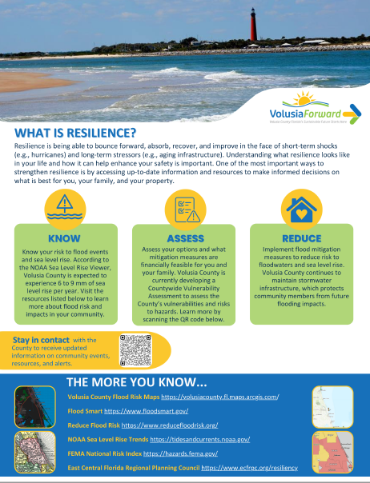
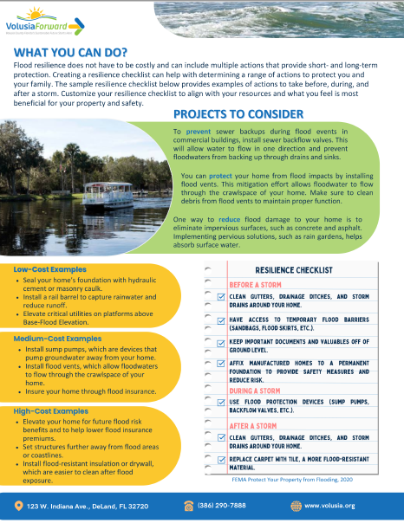
Methods for Protecting Your Home (continued)
Methods for Protecting Your Home
Installation of rain barrels to capture rainwater will reduce runoff and provide secondary uses, such as water for plants.
Elevation of critical utilities, such as AC units, on platforms above the Base-Flood Elevation to prevent flood damages.
Insure your home by obtaining flood insurance.
Install flood-resistant insulation, drywall, and other building material, which is easier to clear after storm damage.

Slide 31
Resilience Checklist: Flood Preparedness
Before a Storm
Clean gutters, drainage ditches, and storm drains.
Ensure access to temporary flood barriers, such as sandbags, flood skirts, and more.
Keep important documents/valuables away from the ground level.
Affix manufactured homes to a permanent foundation to reduce risk.
During a Storm
Utilize flood protection devices, such as sump pumps, backflow valves, and more.
After a Storm
Replace carpet with tile for a more flood-resistant material.

Slide 32
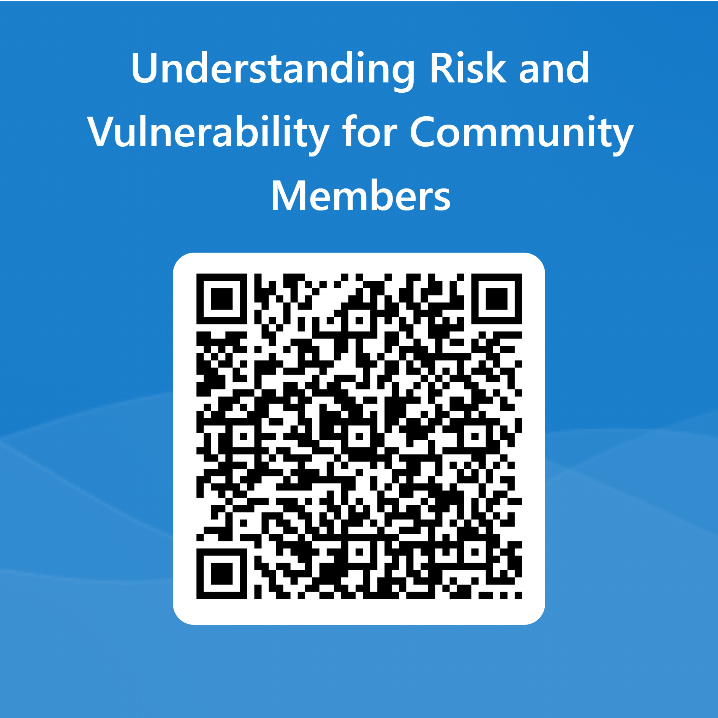
Post-workshop Survey

Slide 33
Learn More: Resources and Tools

Slide 34
Planning in Volusia County
Current
Resilient Volusia County Phase 2 – adaptation Action Plan Areas (2021)
Resilient Volusia County Phase 1 (2017)
East Central Florida Regional Resiliency Action Plan (RRAP) (2017)
Upcoming
Countywide Vulnerability Assessment with Community Engagement
Vulnerability Assessment and/or Adaptation plans for the following cities:
  New Smyrna Beach
  Edgewater
  Daytona Beach Shores
  Deland
  Orange City
  DeBary
  Holly Hill
  Ormond Beach
  Town of Ponce Inlet

Slide 35
Available Tools and Resources
NOAA’s CanVis
Creates photo-realistic simulations for visualizing the potential impacts from coastal development and sea level rise.
NOAA’s Sea Level Trends
Illustrates regional trends in sea level with arrows representing the direction and magnitude of change.
University of Central Florida’s Vulnerability Analysis Mapping Platform
Measures the social vulnerability of U.S. counties and census tracts to environmental hazards, including sea level rise.
NOAA’s Climate Data Online
Provides free access to historic weather and climate data in addition to station history information. Includes daily, monthly, seasonal, and yearly measurements.

Slide 36
Available Tools and Resources (2 of 4)
Available Tools and Resources
FEMA’s National Risk Index (NRI)
FDEP’s Office of Resilience and Coastal Protection
An online tool that illustrates communities across the U.S. most at risk to 18 different natural hazards. Factors for social vulnerability and community resilience are included.
Provides a multitude of resources to assist with preparing the State’s coastal communities and state-managed lands for the effects of sea level rise, coastal flooding, erosion, and storms.
East Central Florida Regional Planning Council
Aids communities to adapt to natural hazards; conducts vulnerability assessments, maps coastal risk scenarios, and develops strategies for long-range solutions.
Peril of Flood: Florida’s Coastal Resiliency Portal
Resource hub showcasing success stories, resources, and information regarding coastal resiliency in Florida.

Slide 37
Available Tools and Resources (3 of 4)
Available Tools and Resources
FDEP’s Quarterly Resilience Forum
FDEP’s Newsletter
FDEP hosts a quarterly webinar forum that allows attendees from all over the state to hear what their counterparts are working on. Participants provide project updates, introduce new resources, and engage with each other asking for advice/recommendations.
Subscribe to stay up-to-date on FDEP announcements and grant opportunities.
Resilient Florida Grant Resources and Program Office Hours
Grant resources, guidance documents, and attachments for the Resilient Florida Program grant opportunity. The Program also holds Virtual Office Hours to aid current grantees and prospective grant applicants. The virtual office hours are held twice weekly via Microsoft Teams
Resilient Florida Project Dashboard
GIS resource dashboard showcasing all awarded Resilient Florida Grant Program projects and project information. This platform allows the user to filter by project category, region, and more.

Slide 38
Available Tools and Resources (4 of 4)
Available Tools and Resources
FDEP’s Comprehensive Statewide Flood Vulnerability and Sea Level Rise Data Set
Florida Commerce Community Planning: Adaptation Planning Guidance
This data set contains information on, but not limited to, critical and regionally significant assets (i.e., transportation, critical infrastructure and emergency facilities), topographical data (i.e., digital elevation models and survey data), and flood scenario data (i.e., precipitation, sea level rise, land use and groundwater elevation data).
The Florida Department of Commerce led the Community Resiliency Initiative, to provide technical assistance to coastal communities interested in pursuing innovative planning and development strategies that ensure their long-term vitality while addressing current and future coastal flooding risks.
FDEP’s Green Stormwater Infrastructure
The Florida Department of Environmental Protection led the Green Stormwater Infrastructure Initiative, to promote GSI projects aimed at controlling pollution, preventing severe flood impacts, and beautifying the community.
FDEP’s Living Shoreline Database
FDEP collaborated on a Living Shoreline Database that includes permit information on public living shoreline projects throughout Florida.

Slide 39
Questions?

Slide 40
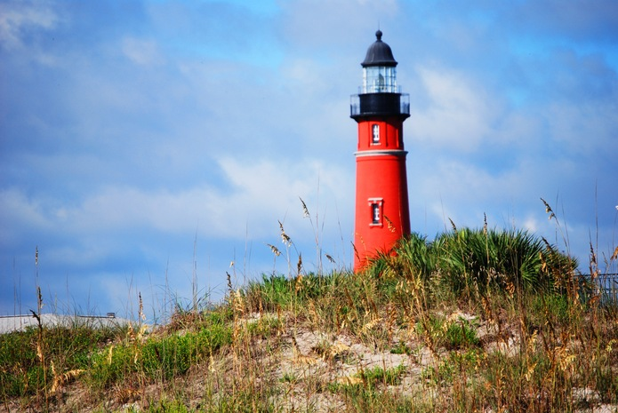
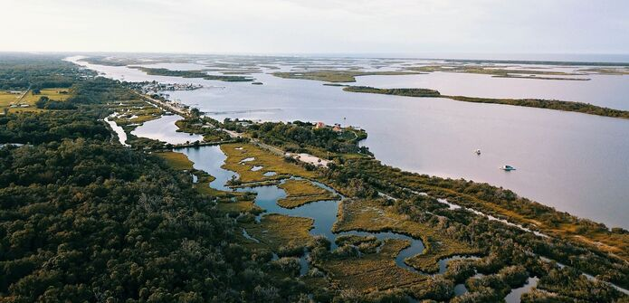
Closing slide
123 W. Indiana Ave
DeLand, FL 32720
(386) 736-2700

