Slide 1

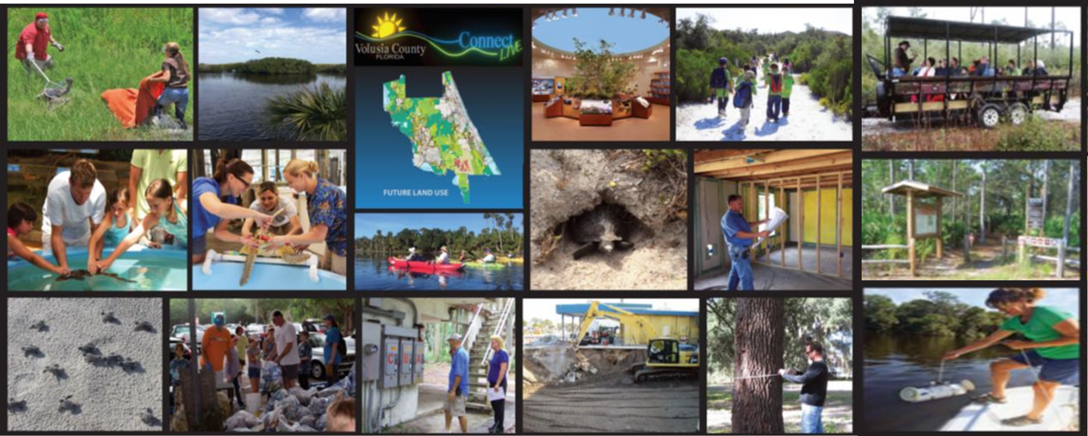
Environment and Natural Resources Committee
Volusia County
November 6, 2024

Slide 2
Deliverables
Comprehensive Plan Amendments
  Future Land Use Element - Complete
Chapter 72 Land Planning Amendments
  Article I - Definitions and Interpretation - Complete
  Article II – Zoning – Complete
  Article III - Land Development Regulations - Complete
New LID Guidance Manual

Slide 3
Deliverables – LID Guidance Manual
Recommended for Approval 10/2/24
Chapter 2 – Standards: Lot Development Incentives
  Flexible lot sizes
    The developer may create the preferred minimum lot size for the subdivision development.

Slide 4
Deliverables – LID Guidance Manual
Recommended for Approval as Amended 9/4/24
Chapter 2 – Standards: Lot Development Incentives (continued)
  Flexible Building Setbacks
    The developer may identify the preferred minimum building setbacks for any primary or secondary structure within an interior lot in the development. However, on a project’s perimeter lots, boundaries, or tracts, primary or secondary structures must comply with the minimum principal or accessory use yard requirements of the property’s zoning classification.

Slide 5
Deliverables – LID Guidance Manual
Recommended for Approval as Amended 10/2/24
Chapter 2 – Standards: Lot Development Incentives (continued)
  Increased Density
    The developer may increase the density in urban residential zoning classifications within Urban Low Intensity to 8 dwelling units per acre and increase to 16 dwelling units per acre within Urban Medium Intensity.
    Increased density is not permitted within rural land use designations.
    Conservation subdivisions cannot gain additional density bonuses for implementing LID BMPs beyond those permitted by Section 72-547, of the Land Development Code.

Slide 6
Deliverables – LID Guidance Manual
Recommended for Approval 10/2/24
Chapter 2 – Standards: Lot Development Incentives (continued)
  Increased Floor Area Ratio
    The developer may increase the floor area ratio by 10% of the maximum within Urban Low Intensity, Urban Medium Intensity, Urban High Intensity, Commercial, and Industrial land use classifications.

Slide 7
Deliverables – LID Guidance Manual
Recommended for Approval as Amended 10/2/24
Chapter 2 – Standards: Zoning Incentives
  Increased Maximum Height
    The maximum height permitted within Section 72-241, of the Zoning Ordinance, may be increased by 30 feet within multifamily, commercial and industrial zoning classifications. Height incentives are not permitted in the following areas:
      1. Between the Atlantic Ocean and the westerly boundary of any lots or parcels that abut the easterly right-of-way line of the easternmost north-south public maintained roadway.
      2. The area 50 feet west of the westerly right-of-way line of the easternmost north-south public maintained roadway.

Slide 8
Deliverables – LID Guidance Manual
Recommended for Approval 10/2/24
Chapter 2 – Standards: Zoning Incentives (continued)
  BMP Permitted within Landscape Buffers and Setbacks
    The engineer does not have to abide by the prohibitions related to stormwater within Section 72-284, of the Zoning Ordinance.

Slide 9
Deliverables – LID Guidance Manual
Recommended for Approval 10/2/24
Chapter 2 – Standards: Zoning Incentives (continued)
  BMP Permitted within Landscape Islands and Row-Ends
    The engineer does not have to abide by the prohibitions related to stormwater within Section 72-284, of the Zoning Ordinance.

Slide 10
Deliverables – LID Guidance Manual
Recommended for Approval 10/2/24
Chapter 2 – Standards: Zoning Incentives (continued)
  BMP Credited as Landscaping
    The engineer does not have to abide by the specific planting requirements of Section 72-284, of the Zoning Ordinance, but may propose an alternative native planting plan with the Zoning Enforcement Official.

Slide 11
Deliverables – LID Guidance Manual
Recommended for Approval 10/2/24
Chapter 2 – Standards: Zoning Incentives (continued)
  BMP Credited as Common Open Space
    The specific Site Design or Stormwater Storage, Treatment and Conveyance BMP is permitted within and counts toward common open space areas.
    A maximum of 50% of the pond area can be used as common open space.

Slide 12
Deliverables – LID Guidance Manual
Recommended for Approval 10/2/24
Chapter 2 – Standards: Zoning Incentives (continued)
  Off-Street Parking Flexibility
    The minimum and maximum number of off-street parking spaces, required within Section 72-286, of the Zoning Ordinance, may be increased or decreased by 25%.
    This does not apply to single-family dwellings.

Slide 13
Deliverables – LID Guidance Manual
Recommended for Approval 10/2/24
Chapter 2 – Standards: Zoning Incentives (continued)
  Increased Lot Coverage
    The maximum lot coverage consisting of principal and accessory buildings and structures permitted within Section 72-241, of the Zoning Ordinance, may be increased by 5%.

Slide 14
Deliverables – LID Guidance Manual
Recommended for Approval 10/2/24
Chapter 2 – Standards: Environmental Incentives
  Reduction in Tree Replacement Requirements
    Allows for a 5% reduction in tree replacement required by Section 72-842(a), of the Land Development Code.
    Therefore, tree replacement is based on the replacement of 10% of the total cross-sectional area of the trunk of the tree removed.

Slide 15
Deliverables – LID Guidance Manual
Recommended for Approval as Amended 10/2/24
Chapter 2 – Standards: Fee Incentives
  Reduced Building Permit Application Fees
    Building permit application fees for residential (RES) and commercial (COM) structures may be reduced by 10%.
    This does not include accessory structures or ancillary permit application fees or applications that are using a Private Provider service for plan review as described in Florida Statutes 553.
Notes:
Discuss this item.
-When a private provider is used for plan review, the plan review fee is waived.
-When a private provider is used for inspections, inspection fees are discounted.
-Application fees are not waived in either scenario.
-Customers must tell Permit Tech when app. is submitted whether they are using a private provider. So, if ENRAC wants to keep this revised wording, they can. They just need to be aware that using a private provider does not already get a customer a discount on application fees.

Slide 16
Deliverables – LID Guidance Manual
Recommended for Approval 10/2/24
Chapter 2 – Standards: Fee Incentives (continued)
  Reduced Land Development Application Fees
    The following initial application fees may be reduced by 10%:
      Subdivision Review Fees – Overall Development Plan, Preliminary Plat, and Final Plat
      Site Plan Review Fees – Final Site Plan

Slide 17
Deliverables – LID Guidance Manual
Recommendation Not Required – Incentive aligns with FLU & Ordinance Amendments
Chapter 2 – Standards: Other
  Variance and/or Waiver Not Required
    The BMP and associated incentive are permitted by right, unless otherwise stated within the Comprehensive Plan.

Slide 18
Chapter 3 – Catalog of Stormwater Best Management Practices: Site Design
Recommended for Approval 10/2/24
Maintain Natural Topography
  Option A: Maintain natural topography for 30% of the site. The area must be contiguous and preserved with a conservation easement dedicated to Volusia County, severing all development rights.
  The submitted Final Site Plan or Overall Development Plan and Preliminary Plat must identify the square-footage/acreage of these areas.

Slide 19
Chapter 3 – Catalog of Stormwater Best Management Practices: Site Design
Recommended for Approval as Amended 10/2/24
Maintain Natural Topography (continued)
  Option B: The notes on a Final Plat or Final Site Plan must state stem-wall construction is required for all primary structures. If a subdivision, this must also be stated within the Declaration of Covenants, Conditions and Restrictions (DCCRs).
  Fill and grading is limited to the footprint of and a 15-foot perimeter around the building and the upstream side of the structure to route water around as necessary to facilitate stormwater conveyance. This must be depicted within the engineered drawings on the Final Stie Plan or Preliminary Plat application.

Slide 20
Chapter 3 – Catalog of Stormwater Best Management Practices: Site Design
Recommended for Approval 10/2/24
Preserving Floodplain
  100% of the FEMA Flood Hazard Areas identified at the time of application are protected through a conservation easement dedicated to Volusia County, severing all development rights, when they encompass 30% or more of the site.
  This can include the tree preservation area required by Section 72-837, of the LDC.

Slide 21
Chapter 3 – Catalog of Stormwater Best Management Practices: Site Design
Recommended for Approval 10/2/24
Retaining Tree Canopy and Native Vegetation
  Retain an additional 5% of the square footage of any development for the preservation of existing trees beyond the minimum requirements of Section 72-837, of the LDC.
  A conservation easement dedicated to Volusia County, severing all development rights, is required.

Slide 22
Chapter 3 – Catalog of Stormwater Best Management Practices: Site Design
Recommended for Approval 10/2/24
Retaining Large Riparian or Vegetated Natural Buffers
  Option A: Retain a 20% greater buffer than the minimum required by Division 11, of the LDC, adjacent to all wetland/surface waters on 100% of the site.
  Option B: Retain a 20% greater natural landscape buffer than the minimum required by Section 72-284, or the Zoning Ordinance, along all property boundaries.

Slide 23
Chapter 3 – Catalog of Stormwater Best Management Practices: Site Design
Recommended for Approval 10/2/24
Cluster Subdivisions
  Must follow the provisions of Section 72-304, of the Zoning Ordinance.
Conservation Subdivisions
  Must follow the provisions of Section 72-547, of the Land Development Code.

Slide 24
Chapter 3 – Catalog of Stormwater Best Management Practices: Site Design
Recommended for Approval as Amended 10/2/24
Common Open Space
  Option A: Provide an additional 5% common open space beyond the minimum required. This area may be preserved in a natural state, but cannot include the minimum tree preservation area required by Section 72-837, of the LDC.
  Option B: Where no minimum common open space is required, provide a minimum 15% common open space. This cannot include the minimum tree preservation area required by Section 72-837, of the LDC.

Slide 25
Chapter 3 – Catalog of Stormwater Best Management Practices: Site Design
Recommended for Approval as Amended 10/2/24
Corridor Protection
  Option A: Preserve natural land which provides a connection to (or is within) the Florida Wildlife Corridor or the Volusia Conservation Corridor and continues through the development project to allow future connection and expansion of the corridor.
  This area must be at least 30 feet wide and can count toward the required 15% tree preservation area.
  A conservation easement dedicated to Volusia County, severing all development rights, is required.

Slide 26
Chapter 3 – Catalog of Stormwater Best Management Practices: Site Design
Recommended for Approval 10/2/24
Corridor Protection (continued)
  Option B: Creation of an internal vegetated multi-use trail of pervious material that connects to a larger pedestrian/bicycle network.
  The area dedicated to this use must include existing or planted native shade tree species and native understory vegetation.
  Tree species chosen must have enough space from the trail to ensure survival, as approved by the County Forester.

Slide 27
Chapter 3 – Catalog of Stormwater Best Management Practices: Site Design
Recommended for Approval 10/2/24
Native Landscape, Fertilizers and Irrigation
  Option A: All planted vegetation within a commercial site is 100% Florida native species (including grasses). Smart Irrigation Controllers are required for the irrigation system. Educational signage describing the benefits of native plants and Be Floridian Now fertilizer principles are placed throughout public spaces.
  Option B: The subdivision common areas/landscape buffers must have 100% Florida native vegetation (including grasses – non-native turfgrass is not permitted), Smart Irrigation Controllers for the irrigation system, and educational signage describing the benefits of native plants and Be Floridian Now fertilizer principles placed throughout the common areas.

Slide 28
Chapter 3 – Catalog of Stormwater Best Management Practices: Site Design
Recommended for Approval 10/2/24
Native Landscape, Fertilizers and Irrigation (continued)
  Option B (continued): In addition, 20% of the square-footage of each residential lot must be planted with and maintain native vegetation.
  Irrigation systems for the individual lots must have Smart Irrigation Controllers.
  The plat notes and DCCRs must identify the individual lot requirements. A typical planting detail is required to be provided with the Preliminary Plat application.

Slide 29
Chapter 3 – Catalog of Stormwater Best Management Practices: Site Design
Recommended for Approval as Amended 10/2/24
Habitat Management
  Preserve 10 acres or more of contiguous undeveloped area, with a conservation easement dedicated to Volusia County, severing all development rights.
  This can include the tree preservation area required by Section 72-837, of the LDC.
  The habitat management plan must be submitted with the Final Site Plan or Preliminary Plat application. The Declaration of Covenants, Conditions, and Restrictions must identify the habitat management requirements. Annual reports must be submitted to the Land Development Office.

Slide 30
Chapter 3 – Catalog of Stormwater Best Management Practices: Site Design
Recommended for Approval as Amended 10/2/24
Alternative Surface Material
  A minimum 50% of the off-street parking spaces (excluding ADA parking spaces) and 100% of the sidewalks (excluding sidewalks identified as ADA accessible routes) must be an alternative surface material (permeable pavers, grass pavers, pervious concrete, or porous asphalt).
  The pervious surface type must be identified on the civil plans.

Slide 31
Chapter 3 – Catalog of Stormwater Best Management Practices: Site Design
Concentrated Landscape Parking Islands/Row-Ends
  A minimum 50% of the off-street parking spaces (excluding ADA parking spaces) and 100% of the sidewalks must be an alternative surface material (permeable pavers, grass pavers, pervious concrete, or porous asphalt).
  The pervious surface type must be identified on the civil plans.

Slide 32
Chapter 3 – Catalog of Stormwater Best Management Practices: Site Design
Minimize Building Construction Footprint
  Utilize multistory construction to reduce building lot coverage by at least 25% of the maximum building lot coverage permitted within Section 72-241, of the Zoning Ordinance.
  This is only permitted within commercial and industrial zoning classifications.

Slide 33
Chapter 3 – Catalog of Stormwater Best Management Practices: Site Design
Total Impervious Area
  Option A: Reduce the maximum impervious area within a commercial or industrial site to 50%. The notes on the Final Site Plan must state this maximum.
  Option B: Design the stormwater system to account for 10% mor than the allowable lot coverage permitted within Section 72-241, of the Zoning Ordinance, for each individual lot within a residential development.
      The notes on a Final Plat or Final Site Plan must state this maximum. If a subdivision, this must also be stated within the DCCRs.

Slide 34
Chapter 3 – Catalog of Stormwater Best Management Practices: Site Design
Minimize Directly Connected Impervious Areas
  All roof stormwater runoff must be directed into a pervious area (i.e. rain garden, swale, etc.).
  The disconnect area must be identified on the civil plans and within a table.

Slide 35
Chapter 3 – Catalog of Stormwater Best Management Practices: Stormwater
Stormwater Treatment Park
  Create a passive/active recreational stormwater treatment park with educational signage, one or more clearly defined, visible entrances connecting to other internal sidewalks, a sidewalk surrounding the pond with pedestrian scale lighting, with no fewer than three of the following:
    Playground meeting the Consumer Product Safety Commission playground safety guidelines for public use,
    Two 15’ x 20’ picnic shelters with a minimum of 2 picnic tables each,
    One 20’ x 30’ covered pavilion or shelter with a minimum of 5 picnic tables each,
    Five standalone picnic tables,
    Open “free play” areas,
    Fenced dog par, or
    Three-piece ASTM F3101 Compliant Outdoor Fitness Site or individual stations

Slide 36
Chapter 3 – Catalog of Stormwater Best Management Practices: Stormwater
Stormwater Treatment Park (continued)
  Option A: Wet Pond – Must include a littoral zone comprised of native emergent and submerged aquatic macrophytic vegetation. Biosorption Activated Media (BAM) must be used and can only contain non-petroleum-based products (expanded clay, sawdust, palm fronds, limestone, etc.).
  Option B: Dry Pond – Must include an upland buffer of native trees, shrubs and understory vegetation. Biosorption Activated Media (BAM) must be used and can only contain non-petroleum-based products (expanded clay, sawdust, palm fronds, limestone, etc.).

Slide 37
Chapter 3 – Catalog of Stormwater Best Management Practices: Stormwater
Wet Pond
  A wet pond is designed to capture 15% more rainwater than required by the minimum standards within Division 8, of the LDC. The entirety of the pond must include a littoral zone comprised of native emergent and submerged aquatic macrophytic vegetation. Biosorption Activated Media (BAM) must be used and can only contain non-petroleum-based products (expanded clay, sawdust, palm fronds, limestone, etc.).
  The 15% shall not include additional capacity for compensating storage for fill in the floodplain.

Slide 38
Chapter 3 – Catalog of Stormwater Best Management Practices: Stormwater
Dry Pond
  A dry pond is designed to capture 15% more rainwater than required by the minimum standards within Division 8, of the LDC. The entirety of the pond must include an upland buffer of native trees, shrubs and understory vegetation. Biosorption Activated Media (BAM) must be used and can only contain non-petroleum-based products (expanded clay, sawdust, palm fronds, limestone, etc.).
  The 15% shall not include additional capacity for compensating storage for fill in the floodplain.

Slide 39
Chapter 3 – Catalog of Stormwater Best Management Practices: Stormwater
Underground Retention and Detention Systems
  An underground storage system is installed to minimize impact of 10% of natural areas on-site within a commercial or multifamily site. The water table must be appropriate for use of this BMP.
  The applicant cannot gain an incentive if this is the only option to meet minimum stormwater management requirements of Division 8 on-site (i.e. the site is constrained).

Slide 40
Chapter 3 – Catalog of Stormwater Best Management Practices: Stormwater
Infiltration & Exfiltration Trenches
  The infiltration/exfiltration trench must be used on-site and may be used to meet total stormwater volume required by Division 8, of the Land Development Code. This must be demonstrated in the stormwater calculations.
  This BMP can only be utilized in a commercial site, private streets, or outside the public right-of-way. The water table must be appropriate for the use of this BMP.

Slide 41
Chapter 3 – Catalog of Stormwater Best Management Practices: Stormwater
Stormwater Harvesting
  A stormwater harvesting method must be used on-site and may be used to meet total stormwater volume required by Division 8, of the Land Development Code. This must be demonstrated in the stormwater calculations.
  The proposed stormwater harvesting vessel (pond, cistern, etc.) and all related piping, etc. and the reuse activity must be demonstrated on the Final Site Plan construction plans.
  This is only permitted within multifamily, commercial, and industrial zoning classifications.

Slide 42
Chapter 3 – Catalog of Stormwater Best Management Practices: Stormwater
Stormwater Harvesting (continued)
  Harvested stormwater for non-potable uses must be approved by the Florida Department of Health.
  A cistern must be designed to eliminate openings for mosquitos and protected from sunlight.
  Incentives cannot be gained by using a stormwater harvesting method to meet minimum fire water requirements required by the Florida Fire Prevention Code, only. An additional non-potable use must be included.

Slide 43
Chapter 3 – Catalog of Stormwater Best Management Practices: Stormwater
Vegetated Swale
  A vegetated swale must be used on-site and may be used to meet total stormwater volume required by Division 8, of the Land Development Code. This must be demonstrated in the stormwater calculations.

Slide 44
Chapter 3 – Catalog of Stormwater Best Management Practices: Stormwater
Rain Garden
  A rain garden must be used on-site and may be used to meet total stormwater volume required by Division 8, of the Land Development Code. This must be demonstrated in the stormwater calculations.
  The landscape plan must depict native plant species, location, and number, and any landscape rocks, etc. Species do not need to be chosen from the Zoning Landscape Plant List, as they may be aquatic in nature.

Slide 45
Chapter 3 – Catalog of Stormwater Best Management Practices: Stormwater
Tree Box Filters & Rainfall Interceptor Trees
  A tree box filter with a Florida native rainfall interceptor tree must be used on-site and may be used to meet total stormwater volume required by Division 8, of the Land Development Code. This must be demonstrated in the stormwater calculations.

Slide 46
Chapter 3 – Catalog of Stormwater Best Management Practices: Stormwater
Vegetated Roofs & Walls
  A vegetated roof or wall must be used on-site and may be used to meet total stormwater volume required by Division 8, of the Land Development Code. This must be demonstrated in the stormwater calculations.
  All vegetation must be native and identified within the landscape plans.

Slide 47
Deliverables – LID Guidance Manual
Other
  To promote creativity in site design, the applicant may present alternative LID BMPs and gain appropriate incentives, as approved by the Development Review Committee.
  The Manual must be updated every two years, with approval by the Development Review Committee. Updates are not limited to this timeframe and may occur more frequently.

Slide 48
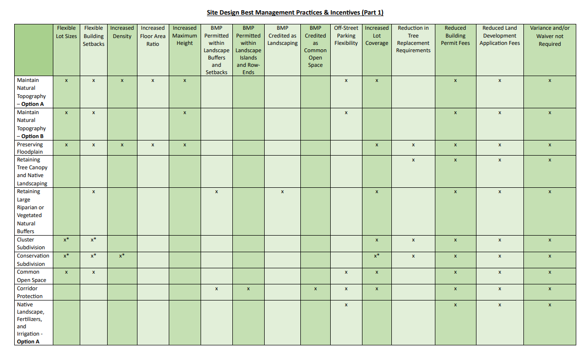
BMP Incentive Matrix
Any changes?

Slide 49

Next Steps
Final review and edits
November 21, 2024: Planning and Land Development Review Commission
January – February 2025 (tentative): County Council for adoption (2 hearings are required for the Comprehensive Plan changes)

