Slide 1

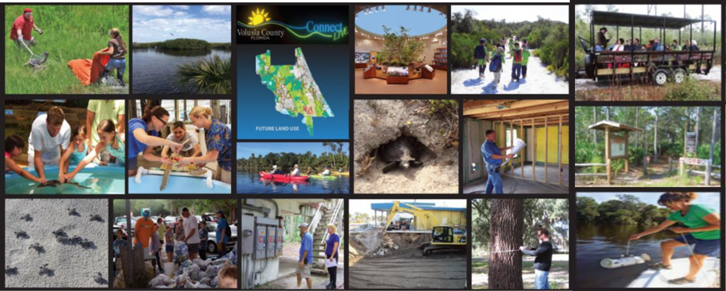
Environment and Natural Resources Committee
Volusia County
September 4, 2024

Slide 2
LID Milestones
August 2022 – June 2023
  $75,000 grant from the Florida Department of Economic Opportunity Community Planning and Assistance Program to develop LID ordinance recommendations for Volusia County and implementation guidebook for the region.
June 2023
  ENRAC recommendation: “The County Council direct staff to employ the LID+GSI Code Audit Tool to evaluate our Land Development Code (LDC) for existing ordinances that employ LID tools, barriers or conflicts to LID, and opportunities to enhance the use of LID and GSI. This is with the goal of revising the LDC to facilitate a hybrid use of LID and GSI across the county to mitigate flooding and nutrient pollution.”

Slide 3
LID Milestones
October 2023
  County Council directed staff to utilize the LID Audit Tool to evaluate Chapter 72 Land Development Regulations and develop a draft ordinance which encompasses voluntary LID and GIS practices with incentives.
November 2023 – April 2024
  County staff conducted an audit of the Comprehensive Plan, Zoning Ordinance, and Land Development Regulations.

Slide 4
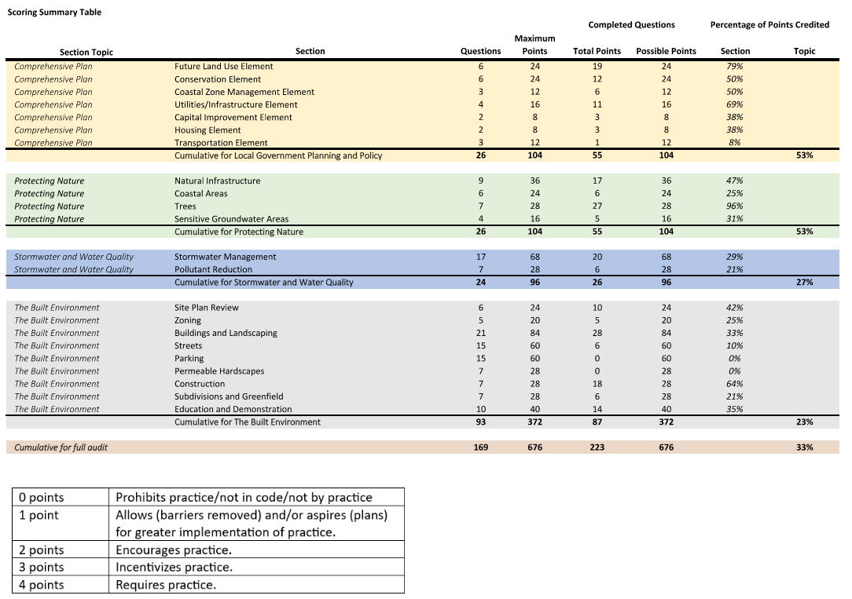
LID Milestones
Audit Results

Slide 5
LID Milestones
January 2024 – August 2024
  County staff developed a draft Future Land Use Element amendment, ordinance, and LID Guidance Manual.
August 2024 – October 2024
  ENRAC, stakeholder and citizen comment period.

Slide 6
LID & ENRAC
LID discussions at ENRAC
  2022
    December 7, 2022
  2023
    April 5, 2023
    May 3, 2023
    June 7, 2023
    November 1, 2023
  2024
    September 4, 2024

Slide 7
Deliverables
Comprehensive Plan Amendments
  Future Land Use Element
Chapter 72 Land Planning Amendments
  Article I - Definitions and Interpretation
  Article II - Zoning
  Article III - Land Development Regulations
New LID Guidance Manual

Slide 8
Deliverables – Future Land Use Element Amendment
Clarification between urban and rural land use.
Allows conservation subdivisions within urban residential land use designations.
  Previously only allowed them within or directly adjacent to the Environmental Core Overlay.
Allows creation of flexible process for implementing LID/GSI with incentives.

Slide 9
Deliverables – Future Land Use Element Amendment
Restricts clustering to Urban Low Intensity and Urban Medium Intensity land use designations with central utilities.
Allows density bonuses:
  Urban Low Intensity
    Current maximum: 4 dwelling units per acre
    Proposed maximum: 6 dwelling units per acre
  Urban Medium Intensity
    Current maximum: 8 dwelling units per acre
    Proposed maximum: 12 dwelling units per acre

Slide 10
Deliverables – Future Land Use Element Amendment
Prohibits density bonuses within:
  Natural Resource Management Area
  Wetlands
  Areas vulnerable to sea level rise
  FEMA designated flood hazard areas (100-year floodplain)
Prohibits fill in FEMA designated flood hazard areas for the development of lots (in a LID development).

Slide 11
Deliverables – Future Land Use Element Amendment
Allows maximum 5% floor area ratio bonus within:
  Low Impact Urban
  Urban Low Intensity
  Urban Medium Intensity
  Urban High Intensity
  Commercial
  Industrial
Adds associated definitions and acronyms.

Slide 12
Deliverables – Chapter 72, Article I Definitions & Interpretation
Adds new definitions:
  Environmental provisions
  Green infrastructure
  Green stormwater infrastructure
  Low impact development
  Low Impact Development Guidance Manual
Revises substandard lot definition (any lot less than 5,000 square feet or 50 feet of width) to clarify that approved low impact development subdivision lots shall not be considered substandard.

Slide 13
Deliverables – Chapter 72, Article II Zoning
Permits LID lots to be smaller in size and width than permitted by the zoning classification.
Allows LID incentives, such as building height and reduced setbacks, to be permitted by right and not require a variance or waiver from the Zoning Enforcement Official.

Slide 14
Deliverables – Chapter 72, Article II Zoning
Removes barrier -
  Previous regulation: A continuous non-mountable six-inch high concrete curb is required around all landscaped areas.
  Proposed regulation: A protection measure is required around all landscaped areas and may be designed to facilitate the use of LID for stormwater management purposes.

Slide 15
Deliverables – Chapter 72, Article II Zoning
Removes barrier -
  Previous regulation included specifications for landscaping within an interior landscaped area.
  Proposed regulation allows flexibility when interior landscaped area is being used for LID stormwater management purposes.

Slide 16
Deliverables – Chapter 72, Article III Land Development Regulations
Adds fire service facilities to concurrency requirements.
Removes barrier –
  Previous regulation only allowed conservation subdivisions within or directly adjacent to the Environmental Core Overlay.
  Proposed regulation also allows conservation subdivisions within urban residential land use designations.

Slide 17
Deliverables – Chapter 72, Article III Land Development Regulations
Adds new Division 19 – Low Impact Development
  Identifies specific LID regulations are within the LID Guidance Manual.
  Clarifies conservation subdivisions can use LID practices and gain incentives but cannot gain additional density bonuses.
  States LID subdivisions and site plans must follow existing procedures in the Land Development Regulations.

Slide 18
Deliverables – Chapter 72, Article III Land Development Regulations
Division 19 – Low Impact Development (continued)
  Requires submittal of an Environmental Impact Assessment.
  Identifies waivers/modifications to the Manual are permitted by the Development Review Committee (DRC).

Slide 19
Deliverables – Chapter 72, Article III Land Development Regulations
Division 19 – Low Impact Development (continued)
  Identifies process of appeal to the county council.
  Specifies that requirements for construction and maintenance of LID best management practices (BMPs) are a condition of approval of a Development Order.
  Identifies that failure to maintain or removal of LID BMPs will result in code compliance action.

Slide 20
Deliverables – LID Guidance Manual
Education, Regulations, Incentives and Maintenance.
Chapter 1 – Introduction
Chapter 2 – Standards
Chapter 3 – Evaluating Your Site
Chapter 4 – Catalog of Stormwater Best Management Practices
Chapter 5 – Maintenance of LID Practices

Slide 21
Deliverables – LID Guidance Manual
Chapter 2 – Standards
  Pre-application meeting with Land Development recommended.
  Minimum 4 site design BMPs & 2 stormwater storage, treatment, and conveyance BMPs required.
  Specific submittal requirements – cover letter and environmental impact assessment.

Slide 22
Deliverables – LID Guidance Manual
Chapter 2 – Standards
  Lot Development Incentives:
    Flexible lot sizes
    Flexible building setbacks
    Increased density
    Increased floor area ratio

Slide 23
Deliverables – LID Guidance Manual
Chapter 2 – Standards
  Zoning Incentives:
    Increased maximum height
    BMP permitted within landscape buffers and setbacks
    BMP permitted within landscape islands and row-ends
    BMP credited as landscaping
    BMP credited as common open space
    Off-street parking flexibility
    Increased lot coverage

Slide 24
Deliverables – LID Guidance Manual
Chapter 2 – Standards
  Environmental Incentives:
    Reduction in tree replacement requirements
  Fee Incentives:
    Reduced building permit fees
    Reduced land development fees
  Other Incentives:
    Variance and/or waiver not required

Slide 25
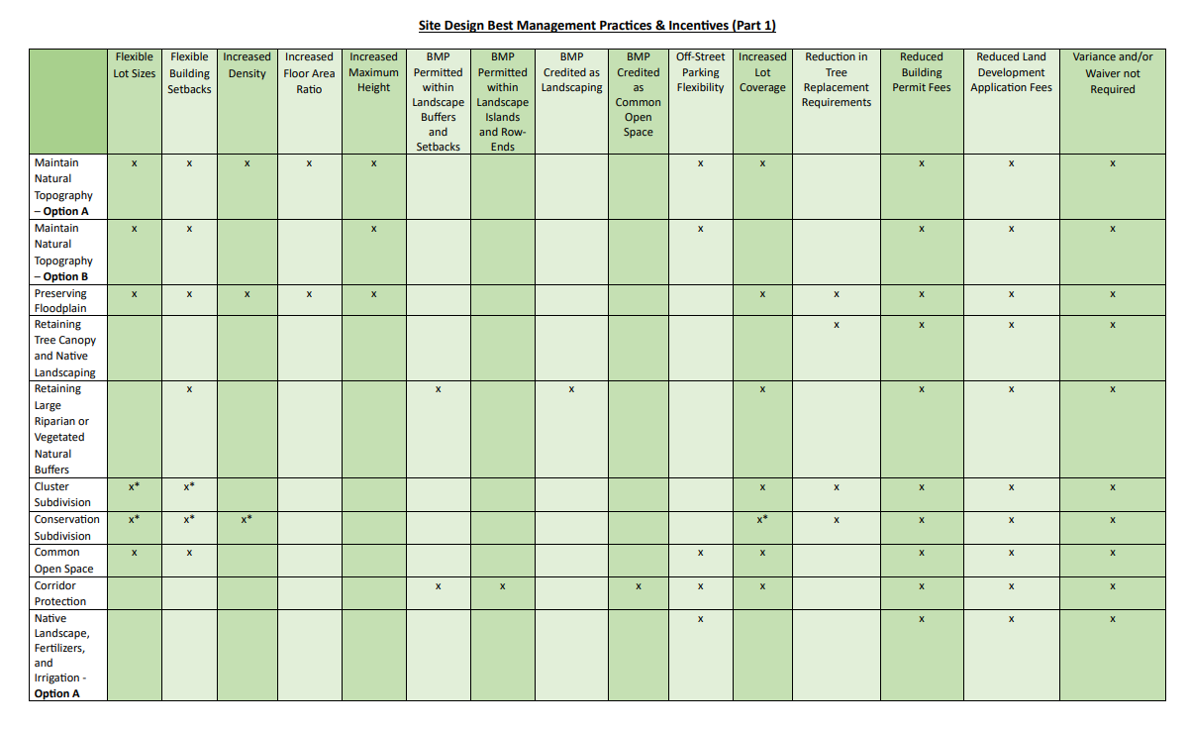
Deliverables – LID Guidance Manual
Chapter 2 – Standards
  BMP Incentive Matrix
    Quick guide to identify BMP and associated incentive.

Slide 26
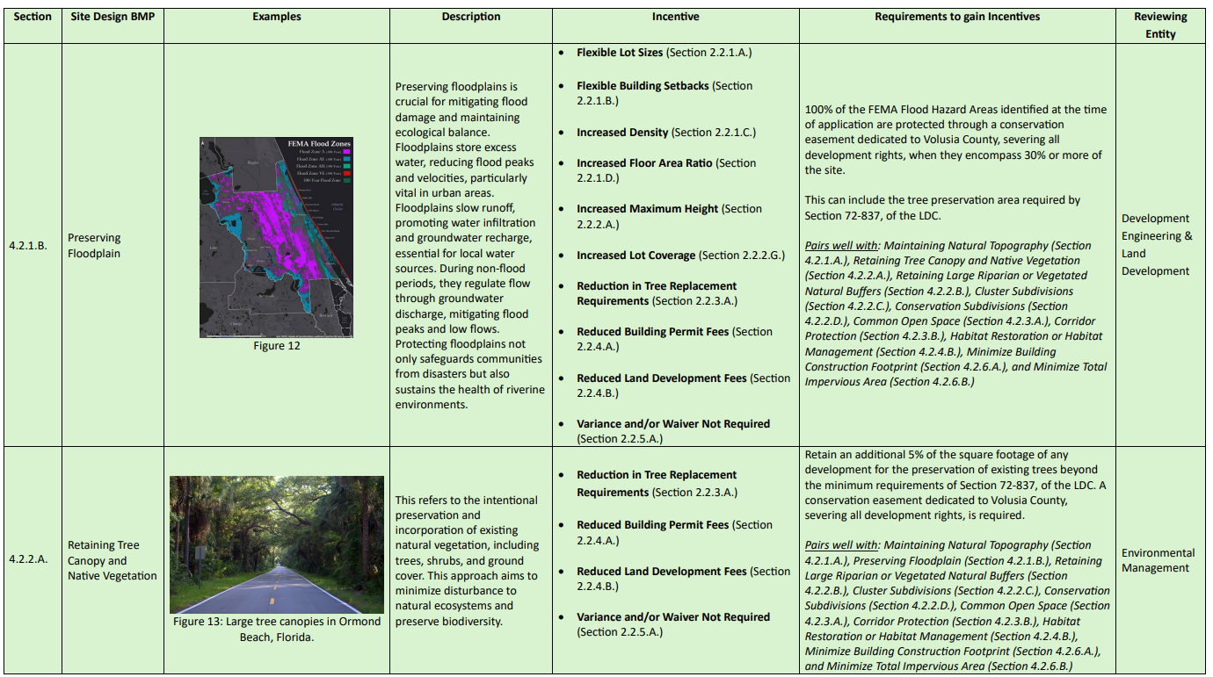
Deliverables – LID Guidance Manual
Chapter 2 – Standards
  BMP Table
    In-depth table providing a brief definition, examples, incentives, requirements, and reviewing entity.

Slide 27
Deliverables – LID Guidance Manual
Chapter 3 – Evaluating Your Site
  Education on what to look for in hydrology, topography, soils, and vegetation when planning out site design.

Slide 28
Deliverables – LID Guidance Manual
Chapter 3 – Catalog of Stormwater Best Management Practices
  Describes all 25 BMPs, examples, incentives, and requirements.
  BMPs are broken down into two groups – Site Design and Stormwater Storage, Treatment, and Conveyance.

Slide 29
Deliverables – LID Guidance Manual
Chapter 3 – Catalog of Stormwater Best Management Practices
  Site Design – 15 BMPs (must choose 4)
    Maintain natural topography
    Preserving floodplain
    Retaining tree canopy and native vegetation
    Retaining large riparian or vegetated natural buffers
    Cluster subdivisions
    Conservation subdivisions
    Common open space
    Corridor protection
    Native landscape, fertilizers, and irrigation
    Habitat management
    Alternative pervious surface material
    Concentrated landscape parking islands and row ends
    Minimize building construction footprint
    Total impervious area
    Minimize directly connected impervious areas

Slide 30
Deliverables – LID Guidance Manual
Chapter 3 – Catalog of Stormwater Best Management Practices
  Stormwater Storage, Treatment, and Conveyance – 10 BMPs (must choose 2)
    Stormwater treatment park
    Wet pond
    Dry pond
    Underground retention and detention systems
    Infiltration and exfiltration trenches
    Rainwater harvesting
    Vegetated swale
    Rain gardens
    Tree boxes and rainfall interceptor trees
    Vegetated roofs and walls

Slide 31
Deliverables – LID Guidance Manual
Chapter 3 – Catalog of Stormwater Best Management Practices
  Stormwater Storage, Treatment, and Conveyance – Modifications to highlighted areas in Manual for Infiltration & Exfiltration Trenches, Rainwater Harvesting, Vegetated Swale, Rain Gardens, and Vegetated Roofs & Walls:
    The [insert BMP] must be used on-site and may be used to meet total stormwater volume required by Division 8, of the Land Development Code. This must be demonstrated in the stormwater calculations.

Slide 32
Deliverables – LID Guidance Manual
Chapter 4 – Maintenance of LID Practices
  Identifies maintenance responsibilities for LID BMPs in site plans and subdivisions.
  Identifies typical maintenance requirements for BMPs.

Slide 33
Deliverables – LID Guidance Manual
Other
  To promote creativity in site design, the applicant may present alternative LID BMPs and gain appropriate incentives, as approved by the Development Review Committee.
  The Manual must be updated every two years. Updates are not limited to this timeframe and may occur more frequently.

Slide 34


Next Steps
Public comment period
Final review and edits
Planning and Land Development Review Commission
County Council for adoption
Documents can be found at:

Slide 35
Next steps
Questions?

